Slide 1
ANALYSIS AND SYNTHESIS OF OPTICAL BURST SWITCHED NETWORKS
Li, Shuo
Supervisor: Prof. Moshe Zukerman
Co-supervisor: Dr. Eric W. M. Wong
Further Credits: Dr. V. Abramov, Dr. Meiqian Wang and Zhang Jianan
Jan. 06, 2014

Slide 2
Outline
Background: Optical burst switching (OBS)
Bounds for blocking probability obtained by Overflow Priority Classification Approximation (OPCA) in OBS networks with deflection routing
Effective and ineffective utilizations in OBS networks
EBSL – a combination of Emulated-OBS (E-OBS), segmentation and least remaining hop-count first (LRHF)
Q & A

Slide 3
Outline
Background: Optical burst switching (OBS)
Bounds for blocking probability obtained by Overflow Priority Classification Approximation (OPCA) in OBS networks with deflection routing
Effective and ineffective utilizations in OBS networks
EBSL – a combination of Emulated-OBS (E-OBS), segmentation and least remaining hop-count first (LRHF)
Q & A

Slide 4
Optical networks
Ever-increasing demand for higher bandwidth
Bandwidth intensive applications – voice over IP, video-on-demand
Fast increasing number of Internet users
Solution: Optical data communication
Use circuit switching (CS) & packet switching (PS)
Drawbacks:
CS: low bandwidth efficiency
PS: buffer & high energy consuming

Slide 5
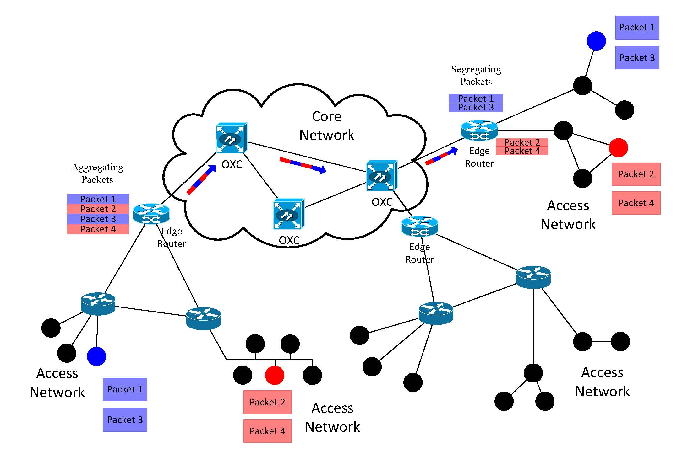
Optical Burst Switching (OBS)
OXC: optical cross-connect
Dump
Trunk: A group of fibers connecting two OXCs.
A trunk
Packets with the same destination are aggregated at ingress nodes to form bursts
A control packet is sent ahead of a burst to reserve wavelength channels along the transmission path hop by hop
Bursts may be dumped before reaching their destinations

Slide 6
Outline
Background: Optical burst switching (OBS)
Bounds for blocking probability obtained by Overflow Priority Classification Approximation (OPCA) in OBS networks with deflection routing
Effective and ineffective utilizations in OBS networks
EBSL – a combination of Emulated-OBS (E-OBS), segmentation and least remaining hop-count first (LRHF)
Q & A

Slide 7
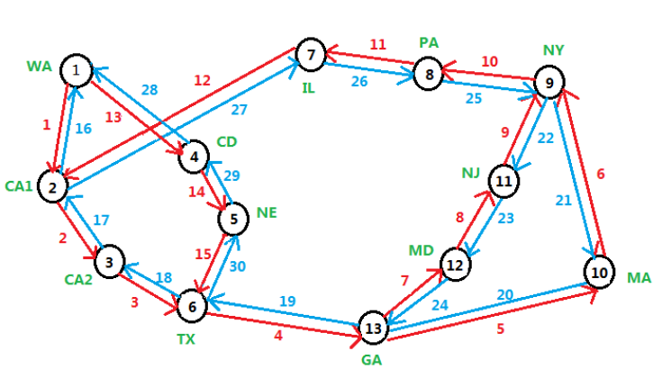
Network model
Independent Poisson process of arrivals
Holding times - independently, exponentially distributed with unit mean
Full wavelength conversion
The offered load to each source-destination (SD) pair is identical
Source | WA | CA1 | CA1 | CA2 | TX | GA
Destination | MD | IL | MA | CD | NY | MA
Source | MD | IL | MA | CD | NY | MA
Destination | WA | CA1 | CA1 | CA2 | TX | GA

Slide 8
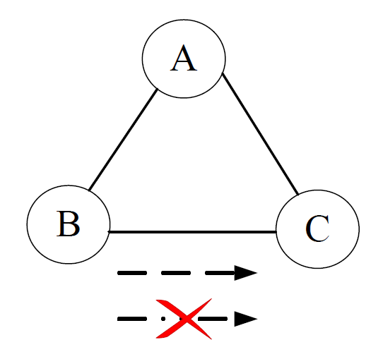
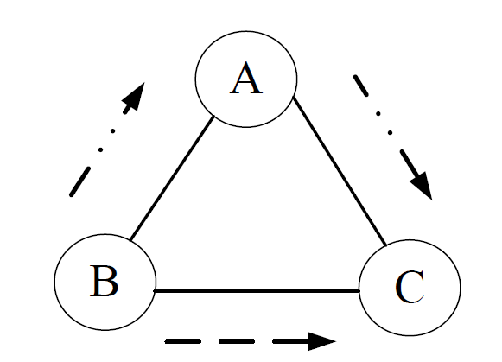
One Contention Resolution Method
Deflection routing
Performance study of OBS networks with deflection routing
Blocking probability

Slide 9
Erlang Fixed Point Approximation (EFPA)
decouple a given system into independent trunks
traffic offered to each trunk follows an independent Poisson process
Overflow error -- ignore high variance of deflected traffic and dependence
Path error-- ignore the effect of traffic smoothing, and the positive correlation of trunk occupancy along the path that increases the probability to admit bursts

Slide 10
Overflow Priority classification Approximation (OPCA)
Define a surrogate model based on classifying the traffic into different layers (priorities)
Layer i for traffic deflected i times
Strict priority regime
Junior bursts – higher priority
Senior bursts –lower priority
The surrogate is without inter-layer mutual dependence (but may still have intra-layer mutual dependence)
Solve the surrogate system by applying EFPA-like algorithm in each layer

Slide 11
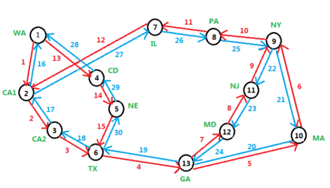
Why OPCA?
In our example, OPCA needs less time than EFPA
D=3
C-number of channels per trunk
Offered load to each SD pair is 0.5C
only consider 4 significant digits of the fixed-point solutions when
When , set
j: trunk number
k: deflection times
Calculation task | Running time of EFPA in seconds | Running time of OPCA in seconds
Blocking probability of the whole network and C=50 | 0.271 | 0.197
Blocking probability of the whole network and C=2000 | 64.45 | 12.91
Blocking probability of the whole network and C=10000 | 3006 | 397
Blocking probability of the whole network and C=20000 | 13665 | 1232
Comparison of the times used by EFPA and OPCA to calculate the blocking probabilities in the NSFNet

Slide 12
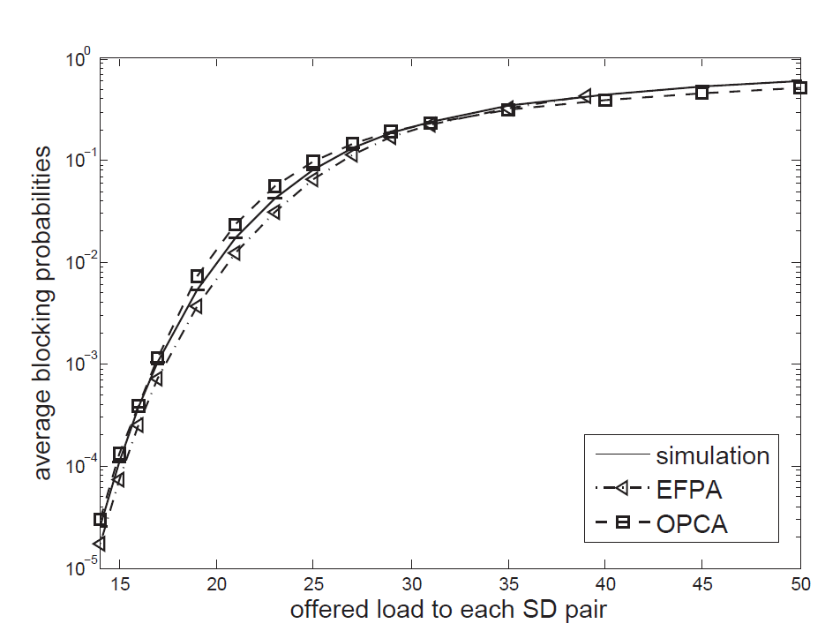
Why OPCA?
In our example, OPCA needs less time than EFPA
In practical range, OPCA is more accurate than EFPA and generally it is not worse
D=3
C=50
in the practical loading range, EFPA does not performs better than OPCA
EFPA is only more accurate than OPCA when the offered load is within 35–40
when the offered load is within 40–50, EFPA cannot converge

Slide 13
Objectives
Provide the upper and lower bounds for the blocking probability obtained by OPCA
Understand and mathematically prove the conditions under which the bounds draw near each other
Find a way to make the bounds converge faster, use them to find solutions for OPCA

Slide 14
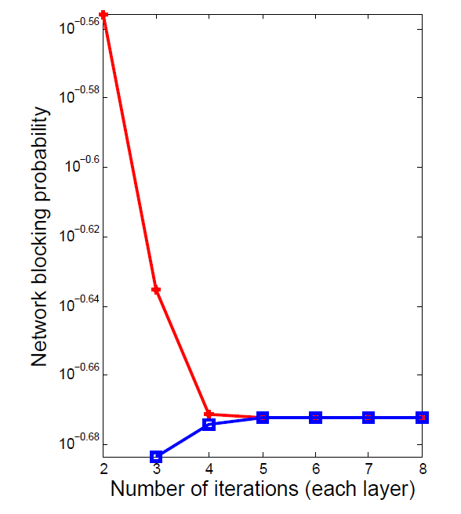
Numerical results
C=50
Offered load to each SD pair: 30 Erlangs
When no. of iterations = 7,
$\frac{distance between two bounds}{lower bound value}< {10}^{−7}$

Slide 15
Summary
Prove that the upper and lower bounds draw near each other
Numerically demonstrate that the bounds become closer to each other very fast

Slide 16
Outline
Background: Optical burst switching (OBS)
Bounds for blocking probability obtained by Overflow Priority Classification Approximation (OPCA) in OBS networks with deflection routing
Effective and ineffective utilizations in OBS networks
EBSL – a combination of Emulated-OBS (E-OBS), segmentation and least remaining hop-count first (LRHF)
Q & A

Slide 17
Performance study of OBS networks
Blocking probability
Utilization
Occupied by bursts that: successfully transmitted or dumped before reaching the destinations
Notes:
Previous performance studies of OBS networks have focused on two measurements.
One is the blocking probability, defined as a ratio of the bursts that are lost to the bursts that are sent.
And utilization, defined as the average proportion (over all trunks) of busy channels out of the total number of channels in a trunk.

Slide 18
Objective
To gain insight into the efficiency and performance of OBS networks
Effective
Utilization (EU) [%]
Channels used by bursts that eventually reach their destinations
Goodput
[Erlangs]
Traffic that successfully reach the destinations
Utilization (U) [%]
Ineffective Utilization
(IU) [%]
Channels used by bursts that are dumped before reaching their destinations
Notes:
To gain insight into the efficiency effects of topology and traffic parameters, we view OBS utilization as composed of two parts: effective and ineffective utilizations, distinguishing between channels used by bursts that eventually reach their destinations, and bursts that are
dumped before reaching their destinations, respectively.
While both types of utilization compete for the same pool of resources and contribute to blocking probability, effective utilization translates into network goodput, which is defined as the traffic successfully reach the destination, but ineffective utilization does not.

Slide 19
An Example
Free channel
Busy channel occupied by a burst that can reach its destination →EU
Busy channel occupied by a burst that dumped before reach its destination → IU
Burst AD
Burst AD
Burst CD
Burst AD: from A to D through B and C
Burst BD: from B to D through C
Burst CD: from C to D
Node A
Node B
Node C
Node D
Burst BD
Burst BD
Trunk 1:
U: 50%
EU: 0%
IU: 50%
Trunk 2:
U: 100%
EU: 50%
IU: 50%
Trunk 3:
U: 100%
EU: 100%
IU: 0%
Burst AD is dumped
Notes:
Already in PS networks, we are the first in OBS.
a 4-node 3-trunk network with two channels per trunk is depicted in which bursts are designated by their end nodes. Burst AD (sent from Node A to D), which
utilizes a channel in trunks 1 and 2, is blocked and dumped in Node C because the only two channels in Trunk 3 are already occupied by bursts CD and BD. In this example, Trunk 1 is 50% ineffectively utilized. Trunk 2 is 50% effectively and 50% ineffectively utilized, and Trunk 3 is 100% effectively utilized.

Slide 20
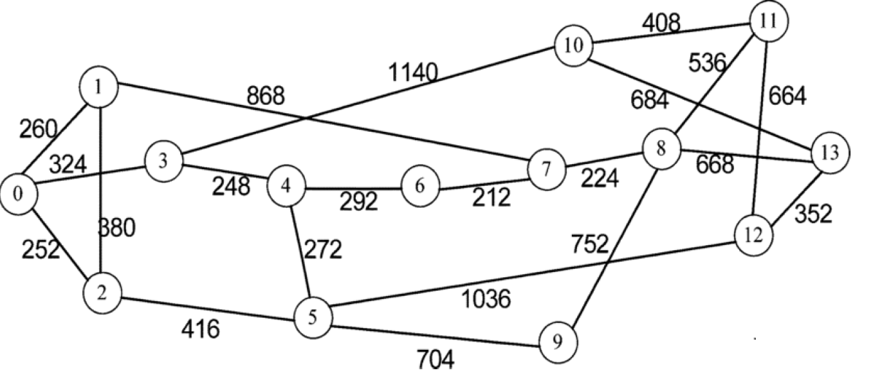
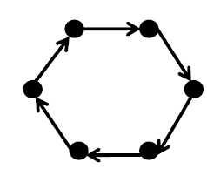
Network Models
200
200
200
200
200
200
6-node ring
14-node NSFNet
With only 3-hop SD pairs
With all possible SD pairs

Slide 21
Our Simulation Scenario
Independent Poisson process of arrivals
Transmission rate: 10 Gb/s
Fixed packet size: 1250 Bytes/packet
Burst size: Exponential distribution (rounded) with mean 250 packets/burst
Mean burst transmission time: 250 μs
1-hop offset time: 10 μs
Switching time is ignored
Number of channels on each trunk – 50
Shortest path for each source-destination (SD) pair
Full wavelength conversion

Slide 22
Our Simulation Scenario
I-OCS is used as a benchmark for OBS
idealized version of optical circuit switching
ignore inefficiency associated with reservation and takedown
In I-OCS only EU, no IU

Slide 23
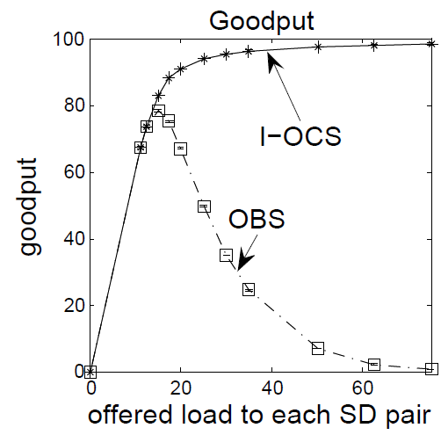
Results in ring network
C=50
In OBS, we observe goodput collapse under overload conditions
In I-OCS, goodput asymptotically approaches the available capacity
Notes:
With increasing load, in OBS, we observe goodput collapse. For I-OCS, we do not see this phenomenon, as the goodput asymptotically approaches the available capacity.

Slide 24
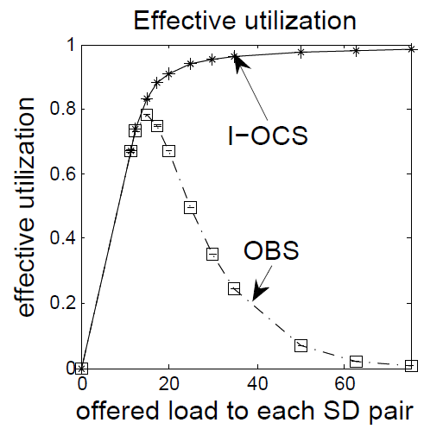
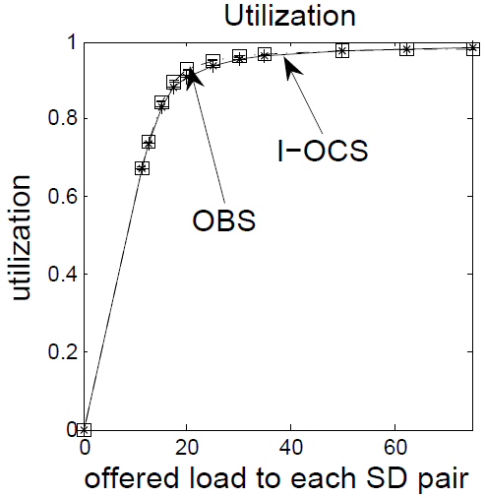
Results in ring network
C=50
Notes:
For OBS, as long as the blocking probability is negligible, its effective utilization increase with the load as in I-OCS. Then, as the load keeps increasing, the blocking probability, see part (c), and the ineffective utilization keep increasing. Since effective and ineffective utilizations compete on the same resource, increase of ineffective utilization causes reduction of effective utilization, see part (b), which leads to goodput degradation.
We can also observe that the difference between OBS and its I-OCS benchmark are far wider in terms of goodput and effective utilization than they are in terms of blocking probability. Clearly, effective utilization and goodput are important performance measures for OBS networks.

Slide 25
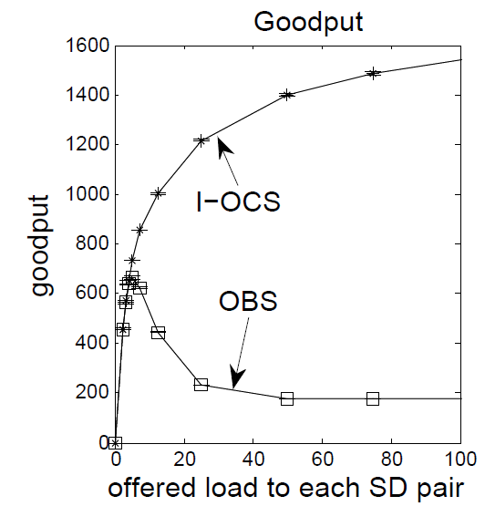
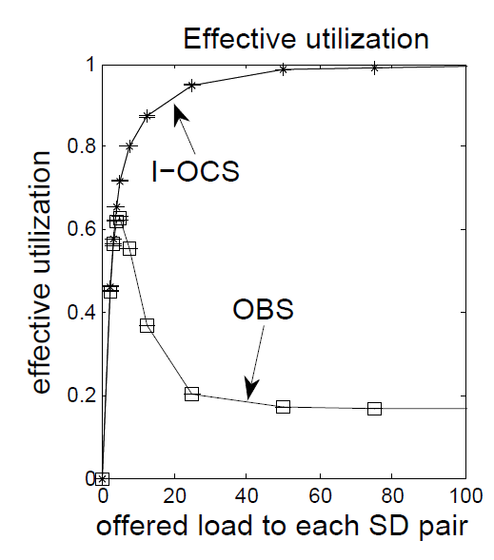
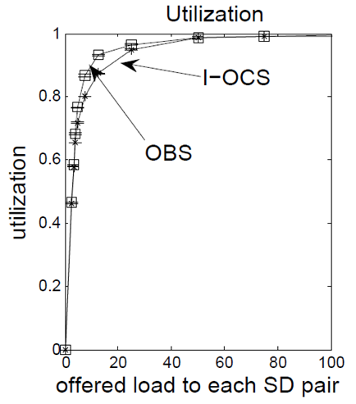
Results in the NSFNet
C=50
Notes:
For OBS, as long as the blocking probability is negligible, its effective utilization increase with the load as in I-OCS. Then, as the load keeps increasing, the blocking probability, see part (c), and the ineffective utilization keep increasing. Since effective and ineffective utilizations compete on the same resource, increase of ineffective utilization causes reduction of effective utilization, see part (b), which leads to goodput degradation.
We can also observe that the difference between OBS and its I-OCS benchmark are far wider in terms of goodput and effective utilization than they are in terms of blocking probability. Clearly, effective utilization and goodput are important performance measures for OBS networks.

Slide 26
Results
C=50
In NSFNet: Under heavy traffic, most of the successfully transmitted bursts are 1-hop pairs → guarantee a certain level of effective utilization and goodput

Slide 27
Summary
Effective and ineffective utilizations are key factors affecting performance and efficiency of OBS networks
They explain a weakness of OBS under high traffic load conditions leading to goodput degradation way below its I-OCS benchmark
Understanding these key effects is important for understanding and improving performance and efficiency of OBS networks
Notes:
We have illustrated that effective and ineffective utilizations are key factors affecting performance and efficiency of OBS networks. They explain a level of OBS efficiency which almost equal to its I-OCS benchmark when the blocking probability is kept low and they also explain a weakness of OBS under high traffic load conditions leading to goodput degradation way below its I-OCS benchmark. Understanding these key effects and in particular the adverse effect of ineffective utilization is important for understanding and improving performance and efficiency of OBS networks.

Slide 28
Outline
Background: Optical burst switching (OBS)
Bounds for blocking probability obtained by Overflow Priority Classification Approximation (OPCA) in OBS networks with deflection routing
Effective and ineffective utilizations in OBS networks
EBSL – a combination of Emulated-OBS (E-OBS), segmentation and least remaining hop-count first (LRHF)
Conclusion
Q & A
Notes:
In the third part, I will introduce a new contention resolution strategy which we called EBSL.

Slide 29
Goodput and effective utilization degradations
Notes:
As we showed before, when the traffic load is heavy, the goodput and effective utilization drops very fast, which means the network resource is use inefficiently. If we can increase the efficiency in this range, the network will perform better.

Slide 30
Objective
Building on the concept we have introduced of effective utilization, we aim to increase effective utilization in order to increase goodput & reduce the network blocking probability.
Segmentation
Solution: EBSL
Offset-Time-Emulated OBS
Least Remaining
Hop-Count First
Least Remaining Hop-Count First (White et al.) :
Let the bursts which have already used more network resources have a higher probability to reach their destinations
Notes:
So our objective is to reduce the ineffective utilization, which is the same meaning as increasing the effective utilization. Our idea is to let the bursts which have already used a lot of network resources have a higher probability to reach their destinations. The solution is EBSL. EB is represents for offset-time-emulated OBS, this is a wavelength reservation scheme. S is for segmentation and L is for least remaining hop-count first, these two are contention resolution strategies. I will introduce them one by one.

Slide 31
Least Remaining Hop-Count First (LRHF) (White et al.)
Bursts with fewer remaining hops have higher priority.
When all the channels on the output trunk are fully occupied, a new higher priority burst can preempt a lower priority burst on the output trunk.
The entire preempted lower priority burst is then dropped.
Problems:
Preempting the entire burst is not efficient
Difficult to control in a distributed system
Notes:
In LRHF algorithm, bursts with fewer remaining hops have higher priority, so when a burst travels along its path, its priority increases by one level every hop. When a burst arrives at a trunk, it will first try to find a free channel for its transmission.
If there is no free channel on that trunk, burst contention occurs. Then this new arrival burst can preempt a lower priority burst on the output trunk and the preempted lower priority burst is then dropped. However, there are two problems in LRHF. Since the first part of the original burst has already been transmitted to the next node, preempting the whole burst is not efficient and it is difficult to control in a distributed system.

Slide 32
Segmentation
A burst is divided into several segments.
One segment contains one packet or several packets.
When contention happens, instead of dropping the whole contending burst, only the overlapped segments are dropped.
Notes:
Thus we combine LRHF with segmentation. In segmentation, a burst is divided into several segments and one segment can be as small as one packet. When contention happens, instead of dropping the whole contending burst, only the overlapped segments are dropped, so this part can still travels to its destination and may make contribute to the network goodput.

Slide 33
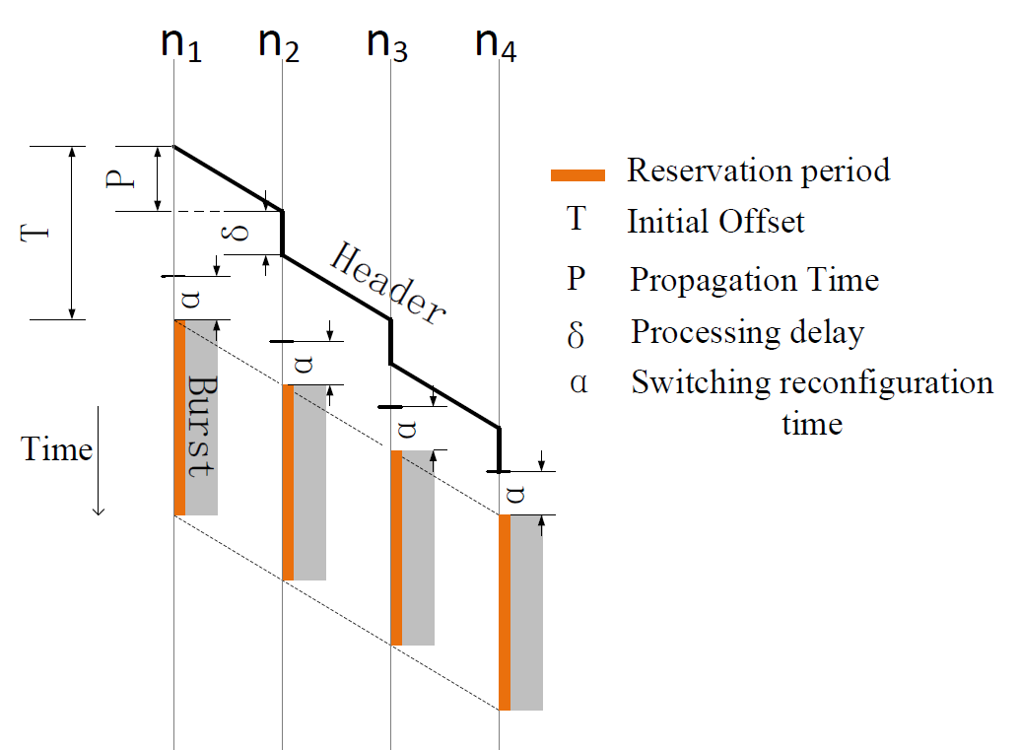
Just-Enough-Time (JET)
The burst control packet carries the information about the burst arrival time, burst length and the wavelength used
The reservation is made from the time when the first bit of the burst reaches that node until the transmission finish

Slide 34
Offset-Time-Emulated OBS (E-OBS)
An additional fiber delay unit (FDU) is inserted in the data path at every core node.
∆ is the 1-hop offset time corresponding to the queuing and processing delay of one node.
is the switching delay
Notes:
To avoid phantom bursts in the network, we use offset-time-emulated OBS in our networks. In E-OBS, an additional fiber delay unit is inserted in the data path at the end of the input port at each core node to emulate the offset time. This FDU is a piece of fiber with fixed and limited length, with no switching capability.
At the ingress node, the control packet and the burst are sent to the network together with a small gap for the switching delay. When they arrival at a core node, the control packet goes directly to the switch controller while the burst is delayed on the FDU by an offset time. This offset time is the BCP processing time and it is identical at each intermediate node. Once the burst reaches the egress node, it is disassembled and the packets are delivered to the their final destinations.

Slide 35
EBSL
A new burst with n-hop path has priority n
Its priority increases by one level every time when it accesses to a new hop
First try to find free channels
If no free channels, find lower priority bursts transmitted on the output trunk
Notes:
When we combine LRHF, segmentation and E-OBS, we get EBSL. In EBSL, when a new burst arrival, we first try to find free output channels. If there is no free channel, we then find if any bursts transmitted on the output trunk have lower priority than the new bursts. If there are such bursts, then we select the one with lowest priority, truncate it and drop the overlapped segment and then use this channel to transmit the new burst. If there is no such bursts, the new burst is dropped.

Slide 36
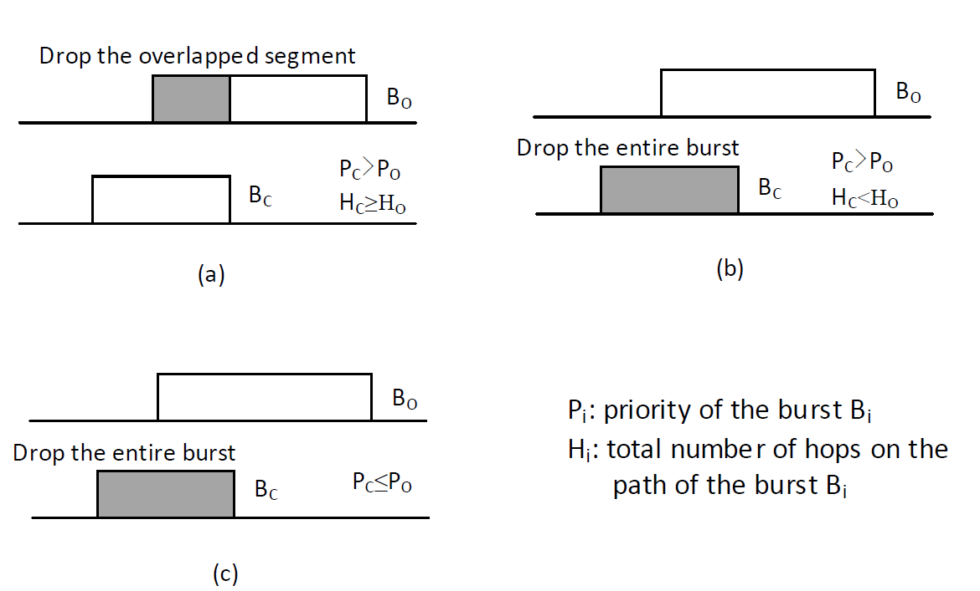
Fair EBSL (F-EBSL)
To protect bursts that require long routes
First try to find free channels
If no free channels, find if any bursts transmitted on that trunk:
have lower priority
originally require a path with an equal or lower number of hops
Notes:
To protect bursts that require long routes, we introduce the fairer version of EBSL,namely, F-EBSL.

Slide 37
Our Simulation Scenario
Independent Poisson process of arrivals
Transmission rate: 10 Gb/s
Fixed packet size: 1250 Bytes/packet
Burst size: Poisson distribution with mean 250 packets/burst
Mean burst transmission time: 0.25 ms
1-hop offset time: 10 μs
Switching time is ignored
Number of channels on each trunk – 50
Shortest path for each source-destination (SD) pair as primary route
Full wavelength conversion

Slide 38
Network Models
6-node ring

Slide 39
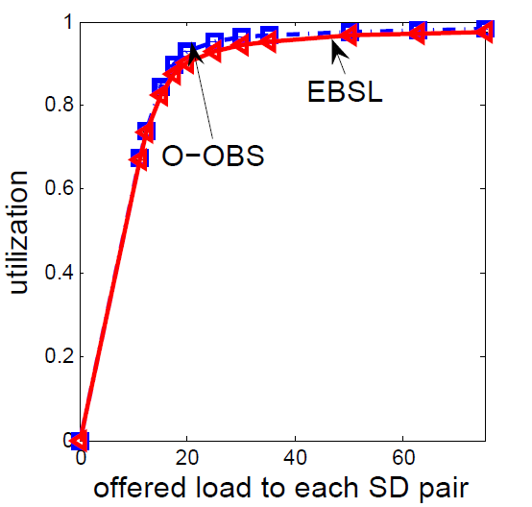
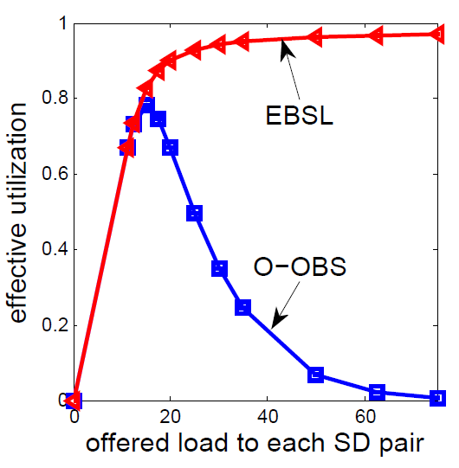
Results For EBSL
C=50
Only 3-hop SD pairs
Utilization: almost the same
Effective utilization: significantly increase in EBSL under heavy load conditions!

Slide 40
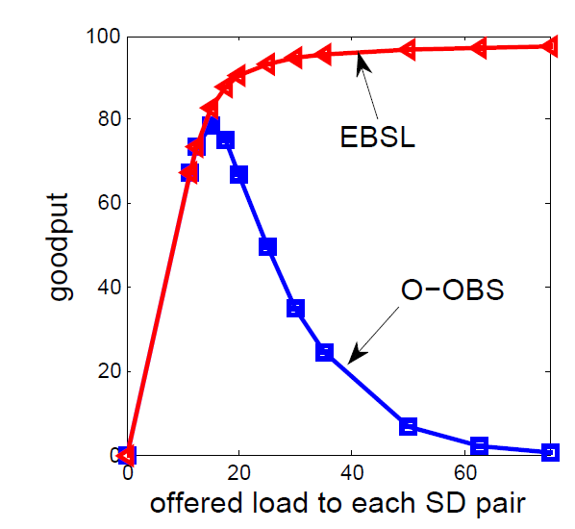
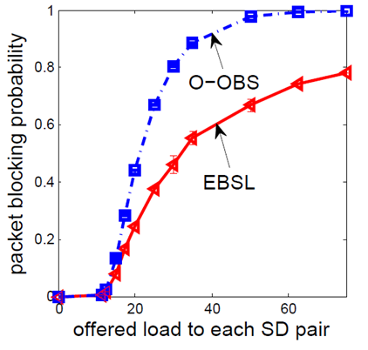
Results For EBSL
C=50
Only 3-hop SD pairs
more resources are used effectively → the goodput of the network also increases significantly
With the same offered load:
goodput is increased →
more bursts are successfully transmitted → the blocking probability is reduced
Notes:
In I-OCS, goodput asymptotically approaches the available capacity

Slide 41
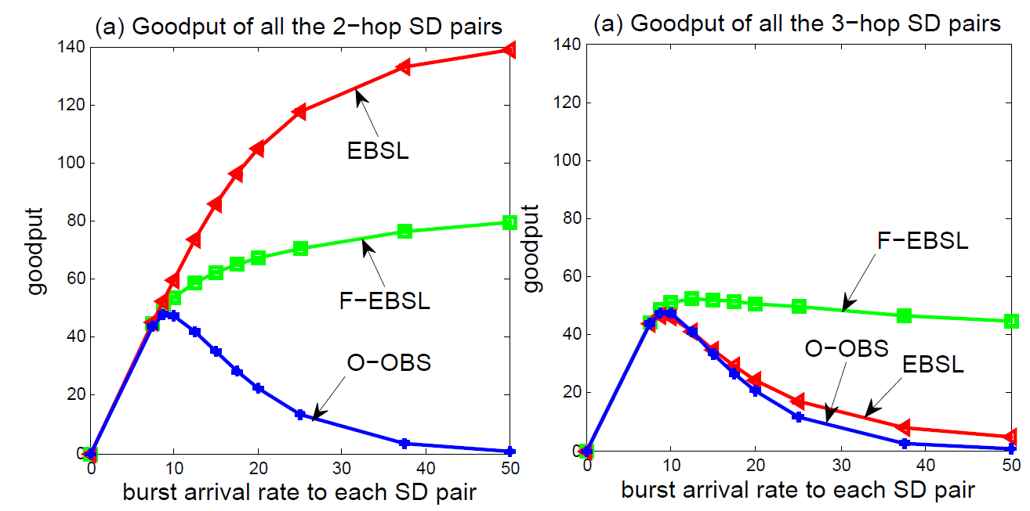
Results For F-EBSL
C=50
All 3-hop SD pairs and 2-hop SD pairs
EBSL discriminates against traffic that requires more hops in favour of traffic that requires fewer hops
Under F-EBSL, more 3-hop bursts successfully reach their destinations
Notes:
we provide goodput results obtained by applying EBSL in such a network. Each trunk in this ring network has 50 channels and the burst arrival rates to all SD pairs
are identical. We observe that the goodput of all the 2-hop bursts increases but the goodput of all the 3-hop bursts decreases when we apply the EBSL strategy. This is because in EBSL, a newly arriving 2-hop burst has preemptive priority over a newly arriving 3-hop burst, and the 2-hop burst maintains its priority over the 3-hop burst if both successfully complete the same number of hops. Accordingly, EBSL discriminates against traffic that requires more hops in favour of traffic that requires fewer hops. Next we consider the fairer version of the EBSL strategy, namely F-EBSL, where we never allow a burst to preempt the overlapped segments of a burst that originally required more hops than the preempting burst. In the case of our 6-node ring network model, 2-hop bursts can never preempt the overlapped segments of a 3-hop burst, but 2-hop bursts with higher priority (on their second hop) can still preempt the overlapped segments of 2-hop bursts with lower priority (on their first hop). The goodput results of F-EBSL are shown in Fig. 5.6; we observe that the goodput of both 3-hop SD pairs and 2-hop SD pairs increases relative to O-OBS, but the goodput of F-EBSL is lower than that of EBSL as shown in Fig. 5.7 (c). However, under F-EBSL, more 3-hop bursts successfully reach their destination and they use more network resources than the 2-hop bursts.

Slide 42
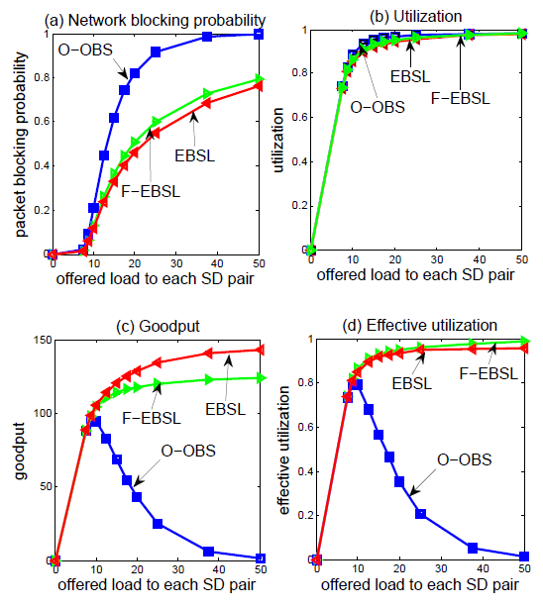
Results For F-EBSL
All 3-hop SD pairs and 2-hop SD pairs
The performance of F-EBSL is similar to I-OCS
C=50

Slide 43
Summary
We have introduced the EBSL and F-EBSL strategies to solve the burst contention problem.
Numerical results show that EBSL can significantly increase the effective utilization and eliminate the collapse of goodput, and improve QoS.
F-EBSL partly sacrifices performance to provide higher probability for the bursts that require more hops to successfully reach their destinations.

Slide 44
Outline
Background: Optical burst switching (OBS)
Bounds of the Overflow Priority Classification (OPC) for blocking probability approximation in OBS networks with deflection routing
Effective and ineffective utilizations in OBS networks
EBSL – a combination of Emulated-OBS (E-OBS), segmentation and least remaining hop-count first (LRHF)
Q & A
Notes:
In today’s presentation, I will first introduce the optical burst switching, the concept of effective utilization and some of the contention resolution strategies we use. Then I will talk about our new combining strategy, which we call EBSL. Then I will show you some numerical results which demonstrate that EBSL can significantly improve the effective utilization under heavy traffic load conditions. At last, it is the conclusion and Q and A.

Slide 45
Q & A
Thank you for your attention
^_^

Slide 46
Poisson arrival and Exponential service time
Poisson Pareto Burst Process is a good traffic model for real network traffic
In OBS networks, blocking probability is insensitive to the shape of the distribution of the service time
J. Chen, R. G. Addie and M. Zukerman, "Performance Evaluation and Service Rate Provisioning for a Queue with Fractional Brownian Input," Performance Evaluation, vol. 70, no. 11, pp. 1028-1045, November 2013
J. Zhang, Y. Peng, Eric W. M. Wong and M. Zukerman, "Sensitivity of Blocking Probability in the Generalized Engset Model for OBS," IEEE Communications Letters, vol. 15, no. 11, pp. 1243-1245, November 2011

Slide 47
Why OPCA?
In our example, OPCA needs less time than EFPA
Algorithm | Layer number | Number of iterations | Total running time in seconds
EFPA | Only 1 layer | 78 | 3006
OPCA | Layer 0 | 6 | 177.9
 | Layer 1 | 5 | 119.7
 | Layer 2 | 4 | 99.7
 | Layer 3 | 1 | 0.0024
Totally 16
Comparison of the times used by EFPA and OPCA in each layer to calculate the blocking probabilities in the NSFNet with 10000 channels per trunk
Notes:
The running time advantage of OPCA is probably due to the fact that OPCA is based on a hierarchical structure with a finite number of layers, where at each layer, a separate set of fixed-point iterations is performed. Experience shows that this divide-and-rule approach tends to reduce the total number of iterations.

Slide 48
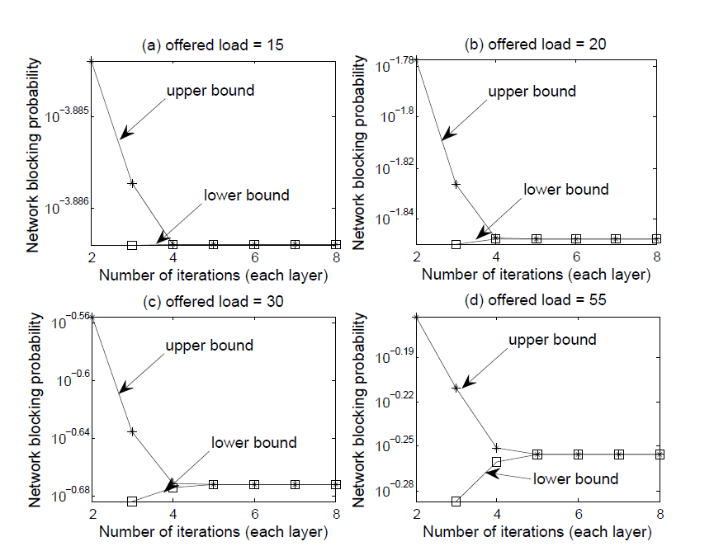
Numerical results
offered load
bounds closer speed
Bounds of OPCA blocking probabilities in the NSFNet with different offered load to each directional SD pair

Slide 49
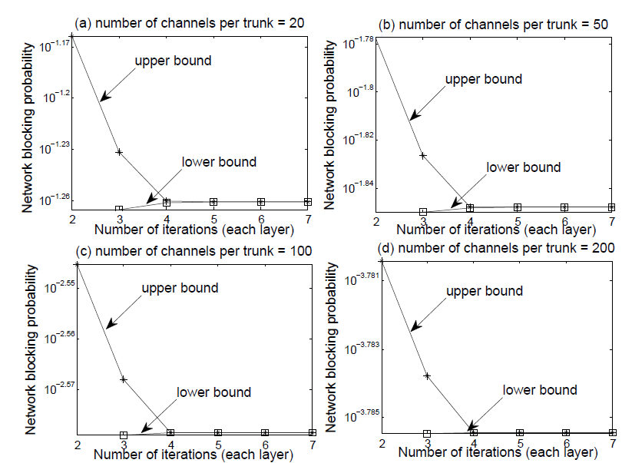
Numerical results
offered load
bounds closer speed
number of channels per trunk
bounds closer speed
Reason:
a larger number of channels per trunk→
the variance of the number of busy channels is lower →
smaller (deflected bursts/total bursts) in the networks
Bounds of OPCA blocking probabilities in the NSFNet with different number of channels per trunk (C) in which the offered load to each directional SD pair is 0.4C
Notes:
These results are related to the fact that with a larger number of channels per trunk, the variance of the number of busy channels is lower which implies fewer deflected bursts in the networks, and as already observed earlier, this makes it easier for the bounds to become closer to each other

Slide 50
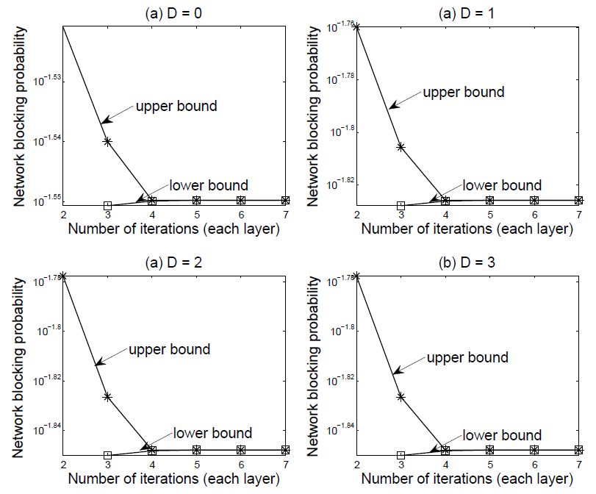
Numerical results
offered load
bounds closer speed
number of channels per trunk
bounds closer speed
D
bounds closer speed
Bounds of OPCA blocking probabilities in the NSFNet with different maximum allowable number of deflections (D) in which the offered load to each directional SD pair is 20 Erlangs

Slide 51
Summary
Prove that the upper and lower bounds draw near each other with increasing number of iterations
Numerically demonstrate that the bounds become closer to each other very fast
The speed of the bounds moving closer decreases when the proportion of the deflected traffic increases in the network, due to the growth of the offered load or the maximum allowable number of deflections, as well as the reduction of the number of channels per trunk

Slide 52
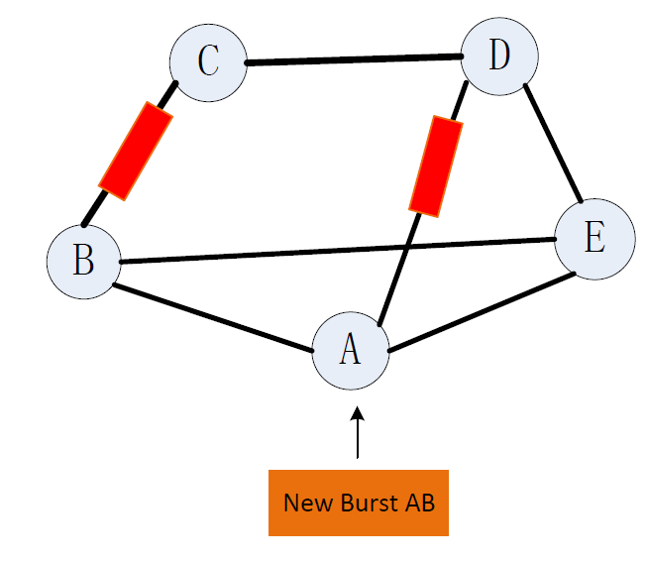
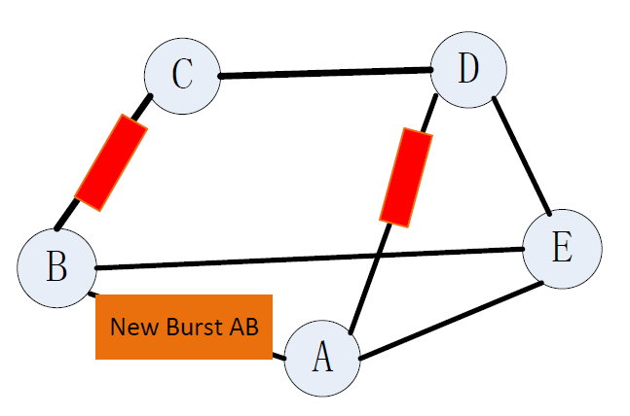
EBSL with deflection (EBSL-D)
One channel each trunk

Slide 53
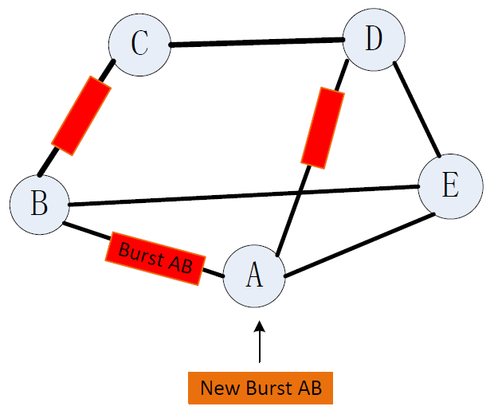
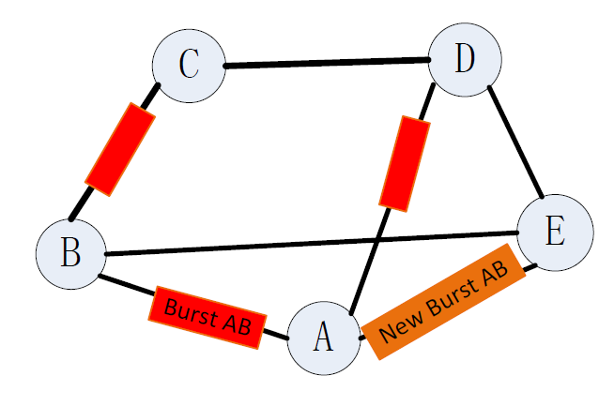
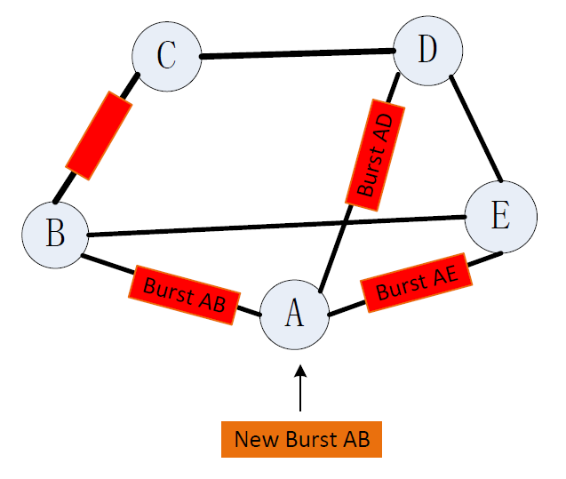
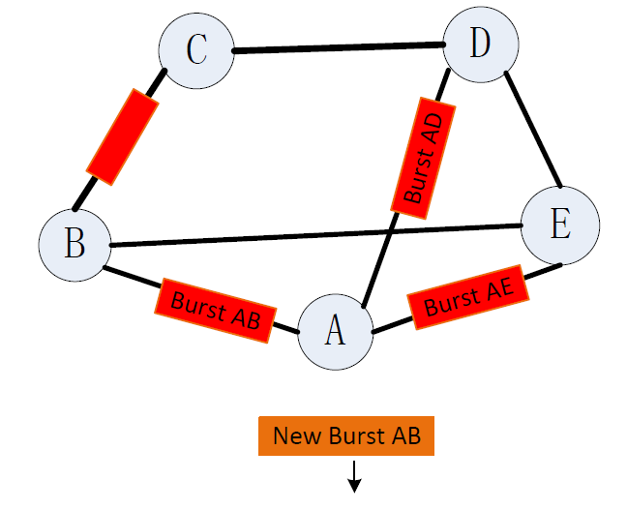
EBSL with deflection (EBSL-D)
One channel each trunk

Slide 54
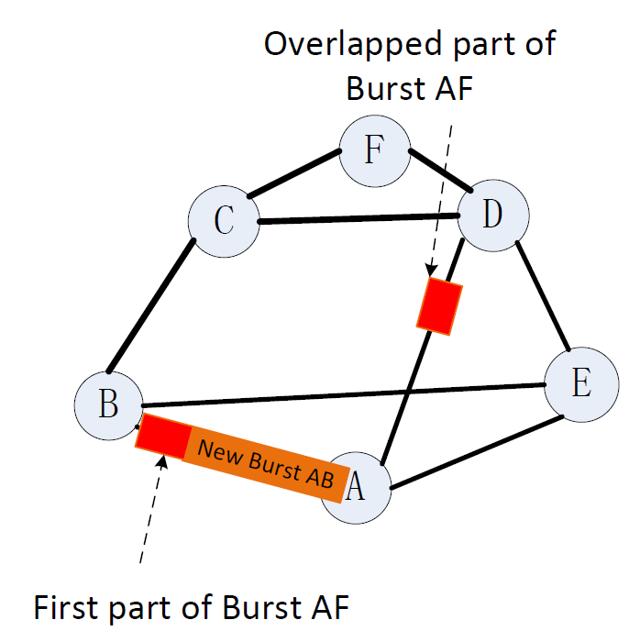
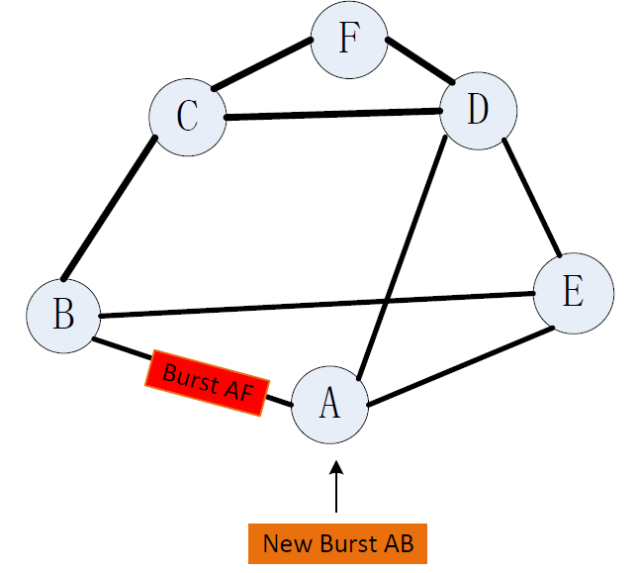
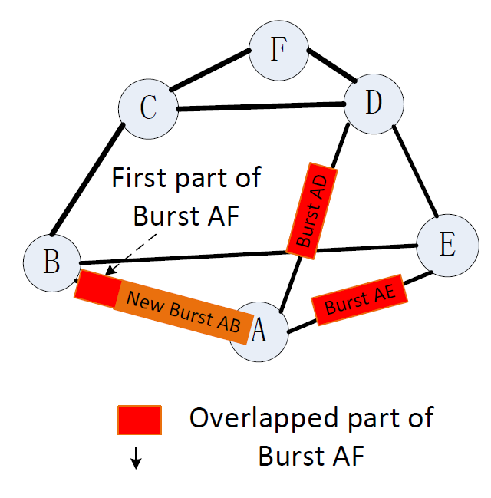
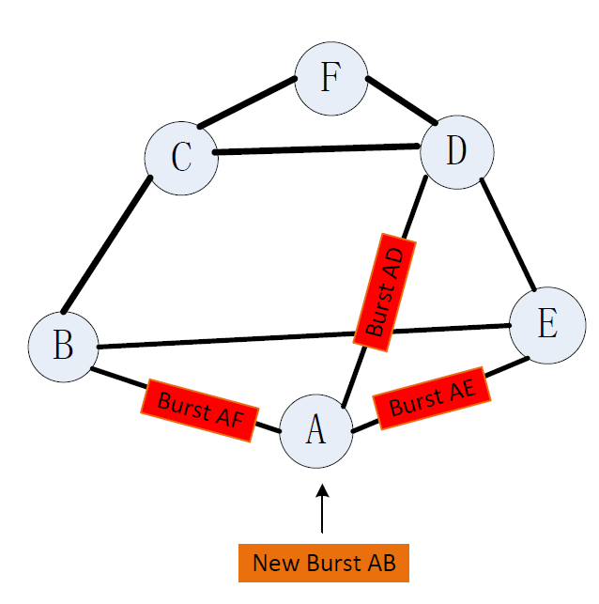
EBSL with deflection (EBSL-D)
One channel each trunk
Notes:
In EBSL-D OBS networks, when a burst arrives at a trunk j on its primary path, it will
first try to find a free channel for its transmission. If there is no free channel on trunk j,
burst contention occurs. If the burst find that all the transmitted bursts on the trunk have
higher or equal priority, the entire burst is deflected to the first overflow trunk j1 of trunk
j and the priority of the burst is set to priority L+1. If the first overflow trunk j1 is also
fully occupied, then the burst is deflected again to the second overflow trunk j2 of trunk j.
The deflection procedure repeats itself until the burst finds a free channel on the overflow
trunks. If no overflow trunk is available, or the maximum allowable number of deflections
is reached, the burst is dumped. If the burst finds one or more transmitting bursts on the
trunk that has a lower priority, it will select the transmitting burst with lowest priority (or
randomly select one among the bursts with lowest priority) and preempt the overlapped
segment of that lowest priority burst. The preempted segment is deflected to its overflow
trunk.
The overflowed bursts have the lowest priority in the network and primary bursts
always have higher priority than overflowed bursts. Therefore the overflowed bursts will
not affect the access of the primary bursts. This guarantees that there is no instability
problem under heavy traffic load.

Slide 55
Bounds for the blocking probabilities of loop based trunks
is an increasing function of
is a decreasing function of
k: number of deflection times
$β:$ a set of SD pairs
Notes:
For the look based trunks, we need

Slide 56
Bounds for network blocking probability

Slide 57
Initial values of trunk blocking probability
d=0
Calculate offered load for each trunk
Steady state probabilities
Calculate blocking probability for each trunk
Converge or not?
No
YES
d+1
No
d=D or not?
YES
Network blocking probability
D: maximum allowable number of deflection
Notes:
This picture shows the flow chat of OPCA algorithm. We first set the initial values for trunk blocking probabilities, then we start from layer d=0. In this layer, we first calculate the offered load for each trunk using the initial values of trunk blocking probability. Then using theses offered load and Erlang B formula, we calculate the blocking probability for each trunk. We repeat these two procedure until we get the steady state probability, which means the program is converge. After finishing the calculation in layer 0, we start the calculation in the next layer until we finish the last layer. At last, we calculate the network blocking probability using the offered load the trunk blocking probabilities.
A weakness of both EFPA and the original OPCA applied to OBS networks is that they require a fixed-point solution, which may require a large number of iterations. Because of the fixed-point iterations, analytical results for the computation complexities of both EFPA and OPCA are unattainable.

Slide 58
Fair EBSL (F-EBSL)
To protect bursts that require long routes
First try to find free channels
If no free channel, find if any bursts transmitted on that trunk:
have lower priority
originally required a path with an equal or lower number of hops
Notes:
To protect bursts that require long routes, we introduce the fairer version of EBSL,namely, F-EBSL.

Slide 59
EBSL with deflection (EBSL-D)
Under EBSL-D, segmentation always happens before deflection
Once a burst or a segmented part of a burst is deflected, its priority will be set to L+1 and its priority will not increase when it completes each one hop transmission
L: total number of trunks in the network
This guarantees that the deflected bursts always have the same lowest priority in the network
→ no instability problem under heavy load conditions
Notes:
Under EBSL-D, segmentation always happens before deflection and once a burst or a segmented part of a burst is deflected, its priority will be set to L+1, where L is the total number of trunks in the network, and its priority will not increase when it completes each one hop transmission. This guarantees that the deflected bursts always have the same lowest priority in the network, so they can be segmented and preempted by bursts traveling on their primary paths but themselves can never preempt other bursts.

Slide 60
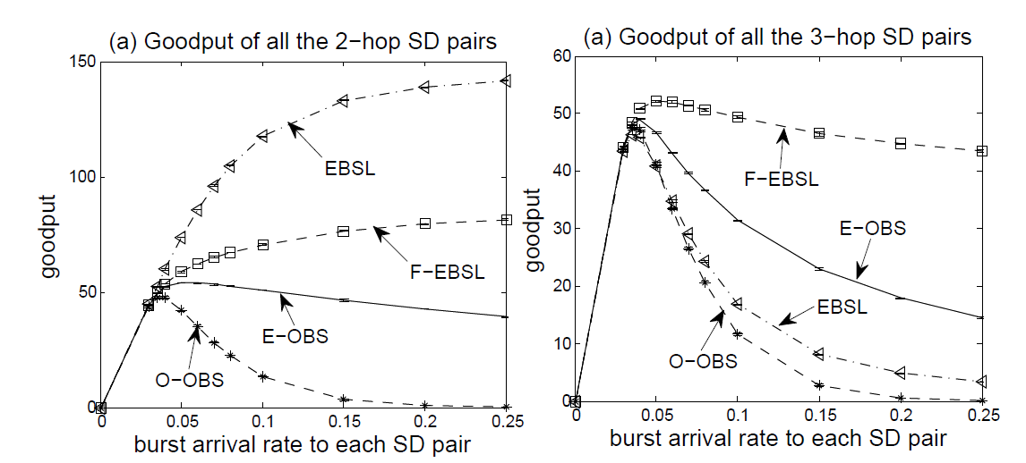
Results For F-EBSL
C=50
All 3-hop SD pairs and 2-hop SD pairs
EBSL discriminates against traffic that requires more hops in favour of traffic that requires fewer hops
Under F-EBSL, more 3-hop bursts successfully reach their destinations
Notes:
we provide goodput results obtained by applying EBSL in such a network. Each trunk in this ring network has 50 channels and the burst arrival rates to all SD pairs
are identical. We observe that the goodput of all the 2-hop bursts increases but the goodput of all the 3-hop bursts decreases when we apply the EBSL strategy. This is because in EBSL, a newly arriving 2-hop burst has preemptive priority over a newly arriving 3-hop burst, and the 2-hop burst maintains its priority over the 3-hop burst if both successfully complete the same number of hops. Accordingly, EBSL discriminates against traffic that requires more hops in favour of traffic that requires fewer hops. Next we consider the fairer version of the EBSL strategy, namely F-EBSL, where we never allow a burst to preempt the overlapped segments of a burst that originally required more hops than the preempting burst. In the case of our 6-node ring network model, 2-hop bursts can never preempt the overlapped segments of a 3-hop burst, but 2-hop bursts with higher priority (on their second hop) can still preempt the overlapped segments of 2-hop bursts with lower priority (on their first hop). The goodput results of F-EBSL are shown in Fig. 5.6; we observe that the goodput of both 3-hop SD pairs and 2-hop SD pairs increases relative to O-OBS, but the goodput of F-EBSL is lower than that of EBSL as shown in Fig. 5.7 (c). However, under F-EBSL, more 3-hop bursts successfully reach their destination and they use more network resources than the 2-hop bursts.

Slide 61
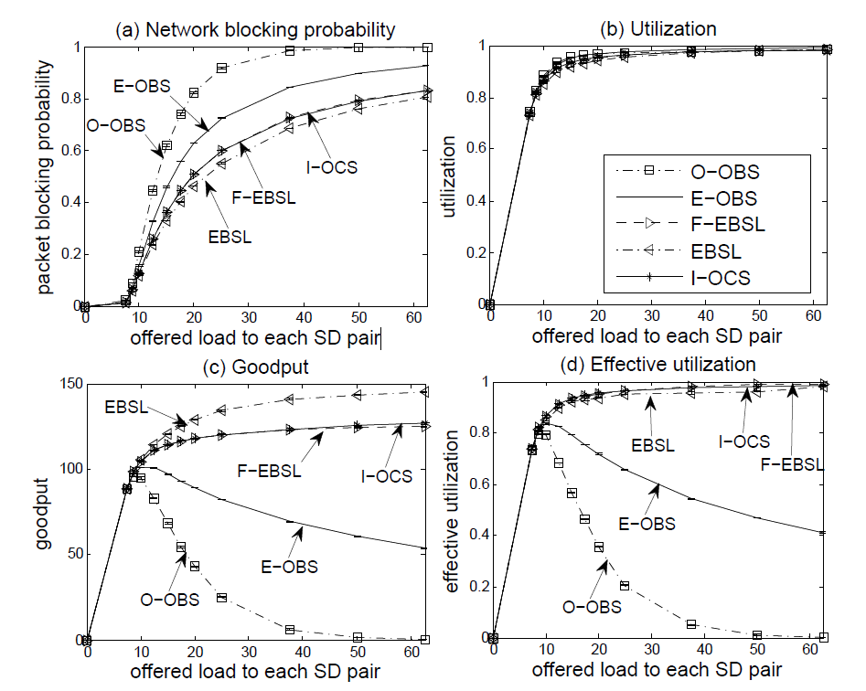
Results For F-EBSL
All 3-hop SD pairs and 2-hop SD pairs
The performance of F-EBSL is similar to I-OCS
C=50

Slide 62
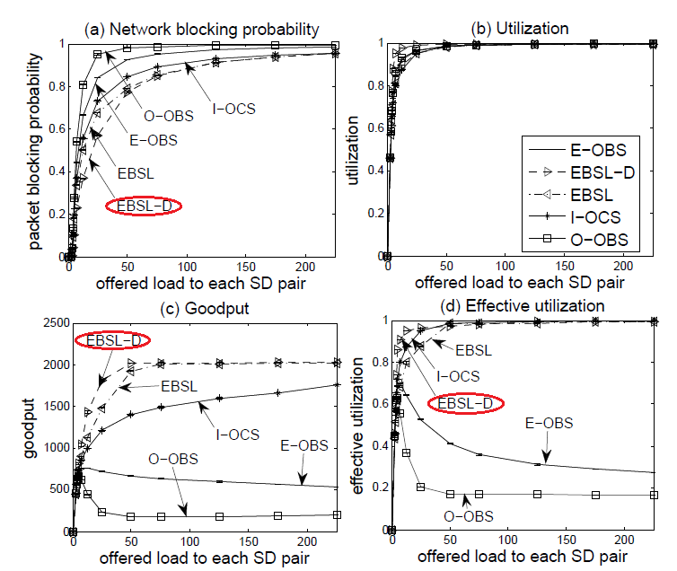
Results for EBSL-D under heavy load conditions
C=50

Slide 63
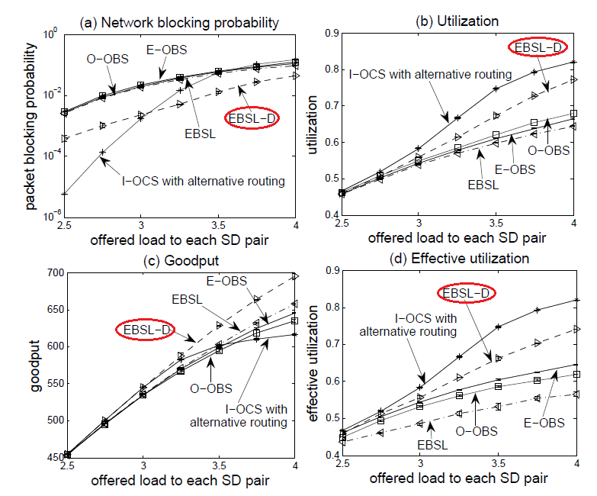
Results for EBSL-D under light and medium load conditions
C=50

Slide 64
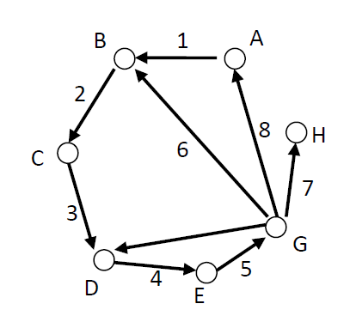
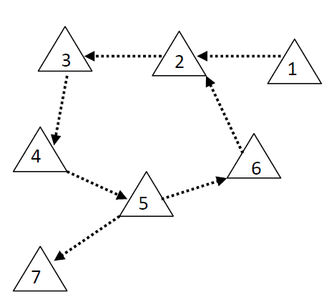
Direct trunks and loop based trunks
Loop based trunks: A set of trunks $L_{k}$ is a loop based trunk (LBT) set in layer $k$, if the following hold:
$L_{k}$ has at least one closed loop of trunks in layer $k$
If in layer $k$, trunk $α$ receives traffic from any trunk in $L_{k}$, then $α∈ L_{k}$
Direct trunks: All the trunks that are not LBTs in layer $k$ are called direct trunks in layer $k$
A trunk where there is no traffic in a trunk in layer $k$
A set of trunks that form an isolate tree structure in layer $k$
A set of trunks that feed traffic to LBTs but do not receive traffic from any LBT in layer $k$
node
trunk
3 SD pairs:
A→D D→H C→B
trunk
traffic flow
Notes:
To get the bounds for network blocking probability, we need first calculate the bounds for blocking probability of each trunk at each layer. Since OPCA is based on a hierarchical structure, we will start from layer 0. After we get the bounds for offered load to each trunk and the trunk blocking probability at layer 0, we start the calculation in layer 1 and repeat this procedure until the last layer. In each layer, the trunks can be divided into two groups: direct trunks and loop based trunks. For example, we have a network with 7 nodes and 8 trunks. The arrows show the direction of the trunks. There are three SD pairs, the first one is from node A to node D, the second one is from node D to node H and the last one is from node C to node B. Based on the traffic flow in the network, we can draw a graph like this. Here the triangle represents the trunks and the dotted line means there is traffic flow. Trunks 2,3,4,5 and 6 forms a loop and these trunks are loop based trunks. Trunk 7 receives traffic from trunk 5 which is a loop based trunks, so trunk 7 is also a loop based trunk. All the trunks that are not loop based trunks are direct trunks. Trunk 1 here only feed traffic to the loops, it is a direct trunk and trunk 8 have 0 traffic, it is also a direct trunks. If a set of trunks that form a isolate tree structure in a layer, these trunks are also direct trunks. For the direct trunks, we can directly calculate the bounds of the offered load and the trunk blocking probabilities. If the trunks form a tree structure, the calculate is from the top to the bottom of the tree.

