Slide 1

PERFORMANCE ANALYSIS OF CIRCUIT
SWITCHED NETWORKS
WANG Meiqian (51747598)
Supervisor: Dr. WONG, Eric W M
Co-supervisor: Prof. ZUKERMAN, Moshe
Jul. 4, 2013
Further Credits: V. Abramov, Li Shuo.

Slide 2
Outline
Why circuit switching?
Background on existing method
Circuit Switched Networks with long-lived and short-lived connections
Computation of blocking probability for large circuit switched networks
Circuit Switched Multi-service Multi-rate Networks with Deflection
Q & A
Notes:
I will first introduce the energy considerations of future networks and the motivation for using circuit switching.
Then I will talk about the network model and the method to evaluate the blocking probability in the model. The results will be discussed after that. Then is the conclusion and at last is the q and a time.

Slide 3
Why Circuit Switching (CS)
4-5% of global energy is consumed by Internet in 2010, 20% will be consumed in 2023
CS is more Green!!
  No need for individual treatment of packets.
  Simple in transport
    no buffering
    no table look-up
    no header processing
    no counting packets
  No dropping packets at middle of transmission.
    congestion control at the call level
1) RS Tucker, “A Green Internet”, IEEE Lasers and Electro-Optics Society, 2008.
Notes:
In CS, there is no need to for individual treatment of packets which is more energy efficient. And in circuit switching, the congestion control is at the call level. When a call arrival and it can not find a free lightpath between the origin node to the destination node, it will leave the network. But in packet switching, the packet may transmit through some trunks before it is blocked. This kind of transmission will waste resource and energy. After a lightpath connection is established for an arrival call, the switch is reconfigured such that the bits are switched from their input port to output ports with little or no buffering, and the transportation is alos simple, it does not need table look-up, header processing and counting packets, witch will use less energy and greener than PS. What is more, since we transmit the call in one lightpath, synchronization is not a problem. But CS need to find free links in each trunk along the path for an arrival call before establish the lightpath, which is no need in PS.

Slide 4
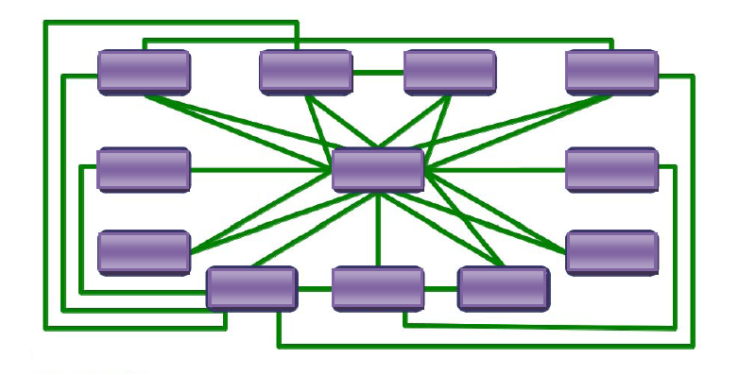
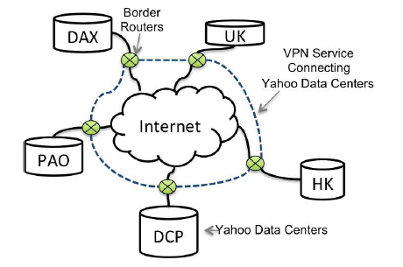
Modern applications of circuit switching
The Large Hadron Collider network
Five major Yahoo! data centers and their connectivity
          A. Barczyk, "World-wide Networking for LHC Data Processing," in National Fiber Optic Engineers Conference, OSA Technical Digest (Optical Society of America, 2012), paper NTu1E.1.
          Y. Chen, S. Jain, V.K. Adhikari, Z. Zhang, and K. Xu, "A first look at inter-data center traffic characteristics via Yahoo! datasets", ;in Proc. INFOCOM, 2011, pp.1620-1628.

Slide 5
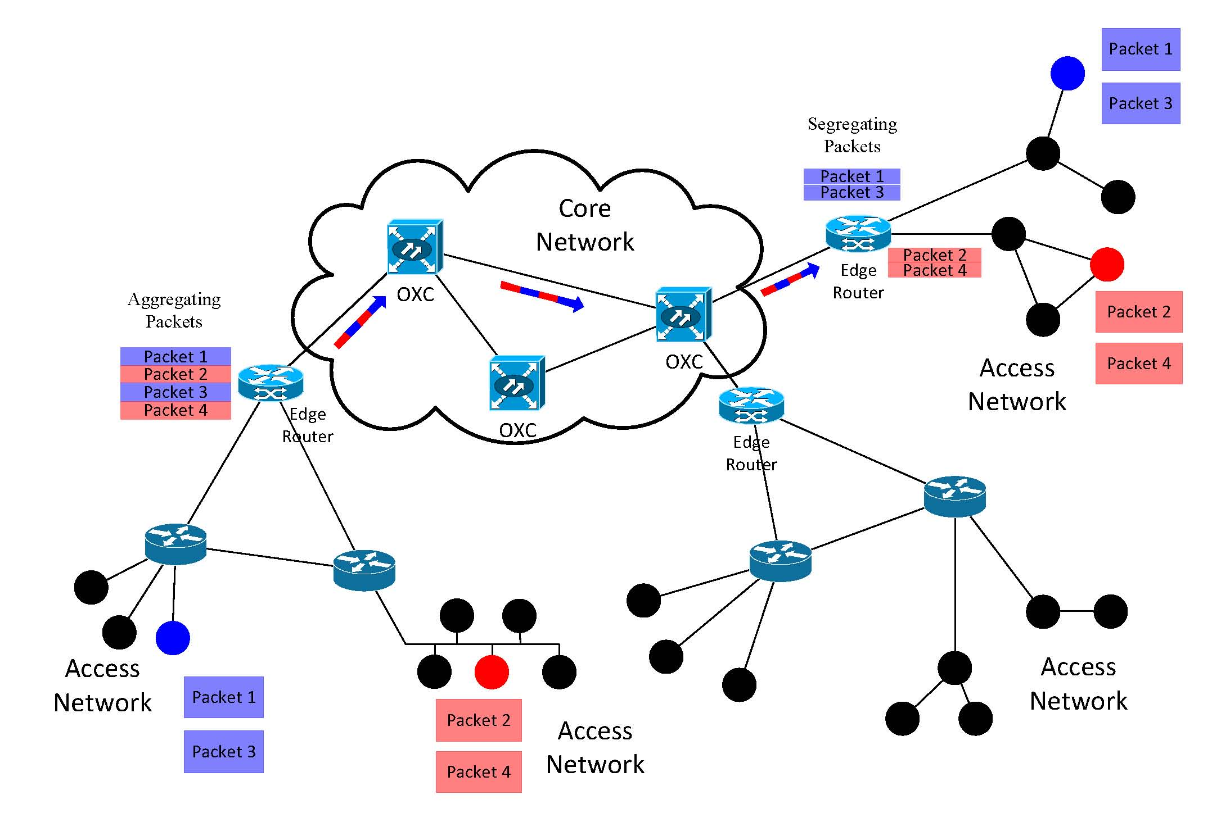
Network in the Future
Circuit switching inside core network
OXC: optical cross-connect

Slide 6
Blocking probability
Overload situations in circuit switched networks—need to block calls
Blocking probability
Adverse impact on QoS
Key performance measure for design and dimensioning

Slide 7
Alternate Routing
Primary Path
Reduce blocking probability
If the shortest path is unavailable,
the call can try other paths.
  Edge-disjoint
Problem:
1) Alternate traffic usually use more
resources than primary traffic.
2) This inefficiency may lead to increase in blocking probability.
Solution:
1) Limit the number of choices of alternate paths.
2) Add threshold to the alternate traffic-
certain capacity is exclusively reserved
for primary traffic.
Origin Node
Destination Node
Alternate path
Notes:
When the traffic load exceeds the network capacity, in such situation, there is a need to block new connections. It is very likely that for a directional OD pair m, there are multiple routes between the source and the destination. Usually we will choose the shortest path as the primary path. To reduce the blocking probability, if a shortest lightpath end-to-end is unavailable, the call can try other paths called alternate path. Alternate routes usually are more costly in terms of the use of network resources. The use of more and more costly alternate routes may adversely affect blocking probability. Therefore, the number of allowable overflow attempts by a particular call may be limited, so a call is blocked after a finite number of alternate routes attempts.

Slide 8
Alternative routing
  Hierarchical
    Ranked into several tiers
  Non-hierarchical
    More flexible and efficient
    Accommodate sudden strong increase traffic of any OD pair
    Reduce cost
    Mutual overflow
    strong dependency
    Instability
      can be mitigated by trunk reservation

Slide 9
Approximation of circuit switched networks with non-hierarchical alternative routing
Generally does not admit product form solution
Rely on accurate approximation
No robust methodology is available that captures the overflow-induced state dependency

Slide 10
Erlang Fixed Point Approximation (EFPA)
decoupling a given system into independent server groups
total traffic offered to any server follows a Poisson process
  all individual input streams
  all overflow attempts
Notes:
total traffic offered to any server group of K servers also follows a Poisson process with rate equal to the sum of the rates of all individual input streams and all overflow attempts

Slide 11
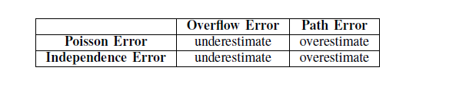
Errors in EFPA
Two effects:
overflows
connection requires a multi-hop path to be established.
Overflow error -- ignoring high variance of overflow traffic and dependence
Path error-- ignores the effect of traffic smoothing, and the positive correlation of trunk occupancy along the path that increases the probability to admit calls
Notes:
overflow errors and path errors.
While overflow errors always cause underestimation of blocking probability (ignoring high variance of overflow traffic and dependence),
the path error overestimates blocking probability because it ignores the effect of traffic smoothing, and the positive correlation of trunk occupancy along the path that increases the probability to admit calls.

Slide 12
Overflow Priority classification Approximation (OPCA)
Impose fictitious preemptive priority structure to a given model
  Junior calls
  Senior calls
Apply EFPA-like algorithm in the fictitious model
Better approximation in most cases
  Increase the proportion of junior calls in the network
  Reduce overflow error and path error

Slide 13
Construct the FM from the TM
True Model (TM)
Fictitious Model (FM)
Apply EFPA to the TM
Apply EFPA to the FM
Estimation of TM
Estimation of FM

Slide 14
Circuit Switched Networks with long-lived and short-lived connections
Permanent or semi-permanent connection between major cities
On-demand short-lived connections between individual OD pairs of users in the order of seconds or less
Long-lived connection
Short-lived connection
Notes:
where the holding times of the long-lived connections are significantly
longer than those of the short-lived connections
Are classified into long lived (static) and short lived (dynamic)
Permanent or semi-permanent connection between major cities, that are used to serve many flows of many users over a long period of time, can be considered long lived where the holding time can be in terms of hours.
On the other hand, on-demand short-lived connections between individual OD pairs of users in the order of seconds or less may be classified as dynamic.

Slide 15
Priority
long-lived connections can be booked well in advance.
long-lived connections between major cities or data centers carry traffic from many users, so it is justifiable for them to have preemptive priority over the short-lived ones.
Notes:
Long-lived circuit switched connections are likely to have priority over the short-lived ones, as long-lived connections can be booked well in advance, so it is reasonable to assume that their performance will not be affected by the loading of the short-lived circuit-switched connections.
long-lived connections between major cities or data centers carry traffic from many users, so it is justifiable for them to have preemptive priority over the short-lived ones. Otherwise, the long-lived connections have to compete with the much more frequent short-lived demands in the same pool of resources, so their blocking probability will increase significantly, which will be detrimental to the many customers they serve. Such priority is also likely to be given to connections that serve the large data bursts generated by the LHC [2] which were the key reason for the design of the LHC network. Then lower priority short-lived connections can share the remaining capacity.

Slide 16
quasi-stationary
changes in system states observed by one type of traffic, due to changes in other traffic type(s), are rare.
  The holding times of long-lived traffic are much longer than those of short-lived traffic.
  Short-lived traffic can approximately reach steady state while connections of long-lived remains unchanged.
Notes:
Often used in cases where changes in system states observed by one type of traffic, due to changes in other traffic type(s), are rare.
The holding times of priority 1 traffic are much longer than those of priority 2 traffic.
Priority 2 traffic can approximately reach steady state while connections of priority 1 remains unchanged.

Slide 17
The model
A circuit switching network with edge-disjoint alternative paths
Long-lived calls
Short-lived calls
Preemptive priority of long-lived calls
  Poisson arrival of connection requests.
  exponentially distributed holding times
  Mean holding time of long-lived calls much longer than short-lived ones (200)
  a maximum number D of overflow attempts
  trunk reservation to reserve certain resource to primary path connections
Notes:
A circuit switching network with edge-disjoint alternative paths
The calls are classified according to their priority p (p=1;2). long-lived calls (p=1) have preemptive priority over short-lived calls (p = 2).
For each directional SD pair, calls of priority p arrive according to a Poisson process with arrival rate l(m; p). The holding times of calls are assumed exponentially distributed with mean 1=μ(m; p).
a maximum number D of overflow attempts to alternate paths are set for calls from all directional SD pairs
we use trunk reservation to reserve certain number of links to primary path connections to avoid large number of overflowed connections in the network which may cause instability.

Slide 18
Network blocking probability by EFPA
Fixed-point iterations
Quasi-stationary for short-lived connection
Initial values of trunk blocking probability
Calculate offered load for each trunk
Steady state probabilities
Calculate blocking probability for each trunk
Converge or not?
No
YES
Network blocking probability
18
18

Slide 19
Network blocking probability by OPCA
Different trunk blocking probability for calls with different numbers of overflow
Calculate the blocking probability layer by layer
  Layer 0
  Layer 1
  Layer D

Slide 20
Initial values of trunk blocking probability
d=0
Calculate offered load for each trunk
Steady state probabilities
Calculate blocking probability for each trunk
Converge or not?
No
YES
d+1
No
d=D or not?
YES
Network blocking probability

Slide 21
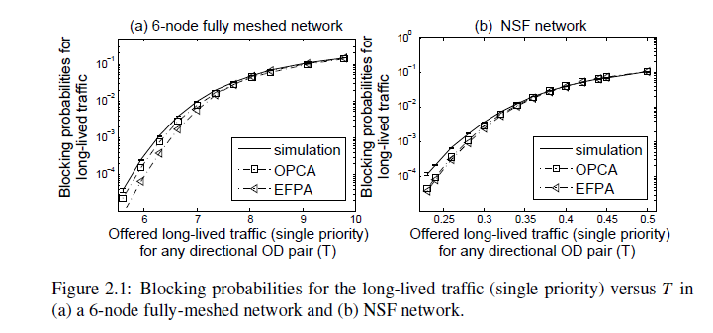
Numerical Results
Blocking probability for long-lived traffic
consider a network with a single class of traffic
EFPA and OPCA underestimate blocking probability when the offered load is low
long paths will be very rare. Accordingly, overflow error will dominate
as the traffic load increases, the underestimation for EFPA and OPCA is reduced
in NSF network, OPCA also outperforms EFPA a little

Slide 22
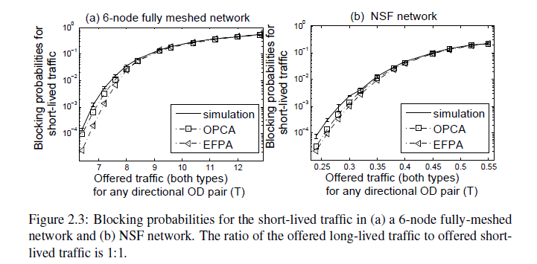
Blocking probability for short-lived traffic

Slide 23
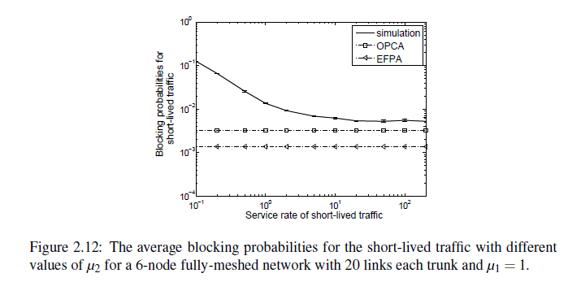
Robustness of the quasi-stationary approximation
when the holding times of short-lived calls close to those of long-lived calls
  the quasi-stationary approximation is inaccurate.
when the holding times of short-lived are significantly shorter than long-lived
  the quasi-stationary approximation accurate.
The errors shown in this condition are mainly due to overflow error and path error discussed above.
quasi-stationary approximation accurate when the average holding times of short-lived calls is less than 5% of the average holding times of long-lived calls
Notes:
when the holding times of short-lived calls are larger than or close to those of long-lived calls, the short-lived calls cannot reach steady-state while the number of long-lived calls remains unchanged, so the quasi-stationary
approximation is inaccurate.
However, when the holding times
of short-lived calls are significantly shorter than those of
long-lived calls (e.g. by more than two orders of magnitude,
namely μ2 > 100), the blocking probability for the shortlived
traffic becomes invariant to further increase in the ratio
μ2=μ1, indicating that short-lived traffic may approximately
reach steady-state while its background state (due to longlived
traffic activities) remains approximately unchanged, so
the quasi-stationary approximation can lead to accurate results.
The errors shown in Fig. 12 in this condition are mainly due
to overflow error and path error discussed above. From the
figure, we can observe that our approximation methods work
14
well when the average holding times of short-lived calls is less
than 5% of the average holding times of long-lived calls

Slide 24
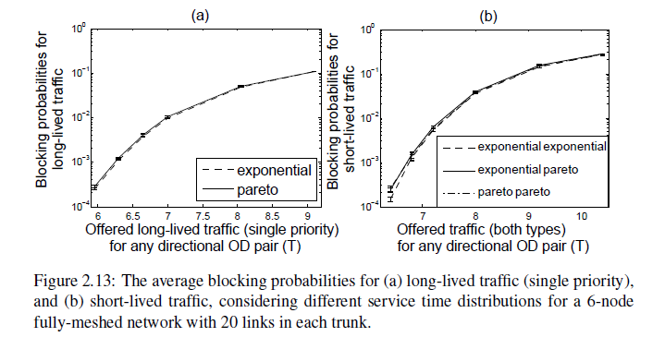
The effect of the shape of the holding time distribution
curves are very close to each other and their confidence interval are overlapped
blocking probabilities are insensitive to the holding time distributions.

Slide 25
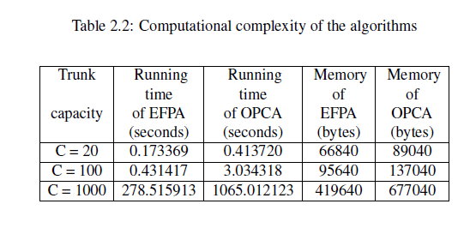
Computational complexity of the algorithms
OPCA requires more computation time and more memory than EFPA
the overall computing resources are manageable.

Slide 26
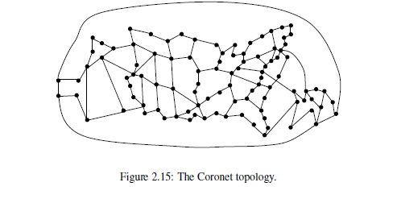
The Coronet
9900 SD pairs in the network
Simulation computationally prohibitive

Slide 27
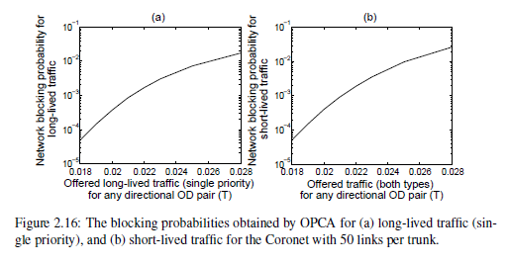
Blocking probability for the Coronet
EFPA does not converge in this case
Running times used to calculate the network blocking probabilities in the Coronet is about 121.734439 seconds by OPCA

Slide 28
Summery
A circuit-switched network with long-lived and short-lived connections where the long-lived connections can preempt the short-lived ones.
In most cases, OPCA can estimate the blocking probabilities reasonably well, and generally, better than EFPA.

Slide 29
Computation of blocking probability for large circuit switched networks

Slide 30
The model
A circuit switching network with fixed routing
Nodes connected by trunks
Calls on route r use channels from trunk j.
Independent Poisson process of rate
Holding times - independently, identically, exponentially distributed with unit mean.
Number of channels on trunk j - C

Slide 31
Objective - Finding blocking probability for realistic size circuit switching networks with large number of channels per trunk
Notes:
We consider a circuit-switched network described by a graph G(N;E) where
N is a set of n nodes and E is the set of e arcs. The e arcs correspond to trunks
where trunk i 2 E carries Ci links. The N nodes are designated 1; 2; 3; : : : ;N,
each of them has circuit switching capabilities. We assume that all the nodes
have full wavelength conversion capabilities and can switch trac from any link
on one trunk to any other link on an adjacent trunk. Number of channels per trunk ,referred to as capacity of a trunk,has a direct effect on the blocking probabiity given the same offered traffic and in all the examples and senarioes we disscuss in this talk, the capacity of all the trunks in a network is the same. So we just call it capacity for simplicity.
Circuit-switched networks may encounter trac overload situations when the
oered trac load exceeds the network capacity, and in such situations, there is
a need to reject (block, or drop) new connections. Such blocking (or dropping)
has adverse implication on QoS perceived by users and therefore the likelihood
or probability of such events should not exceed a certain predetermined values.
Accurate evaluation of blocking probability is important for trac management
as well as for network design and dimensioning, so that there are sucient resources
available to meet QoS requirements.

Slide 32
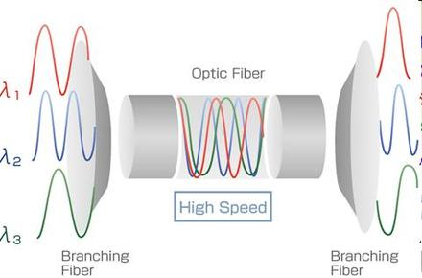
Millions of channels per trunk!
Nearly hundred wavelengths per optical fiber
Hundreds optical fibers per trunk
Further subdivided a wavelength into hundreds of TDM channels
Millions of channels per trunk is a realistic scenario.
http://www.fiberstore.com/Research-work-of-transmission-systems-CWDM-VS-DWDM-aid-63.html

Slide 33

Existing methods
Simulation
Erlang fixed-point approximation (EFPA)
?
Notes:
Two conventional mrthods can be used to obtain the bp for a cS network. When the capacity is less than a hundred, discrete event simulation can be used directly to get the result. With the increase of the capapcity to several thousands, the computation time of simulation will be too large to tolerate and that is when EFPA, short for erlang fixed point approxiamation is applied. We observe that when the capacity is small, errors introduced by the assumptions of EFPA is ovious and the accuacy of EFPA increased with the increasing capacty. This has been proved by kelly in 1986 that EFPA is asymptoticlly accurate when the capacity is large which give us the confidence to apply EFPA when the capapcity is several thousands. The same thind will happen to EFPA if we further raise the capacity to tens of thousands which in a practical problem nowadays. Today’s DWDM networks
with nearly hundred wavelengths per optical fiber and
hundreds optical fibers per cable yielding tens of thousands
wavelength channels per cable. If a wavelength is further subdivided
into hundreds of TDM channels, millions of channels
per cable is a realistic scenario. Using the conventional EFPA which repeatedly computes the
link blocking probability by applying a recursive procedure
to the Erlang-B formula, will be computationally infeasible
for such networks with many channels per cable.
A relay race is a good description for our current situation. Simulation is our first athlete who will run a few miles, but not long, and paa the baton to EFPA, which is more capable and can continue for some distance and we need to find some person to get the baton from EFPA where EFPA is computationally prohibitive,we need some person who can get a comparable accurate result and fast.
Relay race; baton

Slide 34

Erlang fixed point approximation(EFPA)
Decouple the network into independent trunks
Traffic on each link to follow a Poisson process
Erlang B formula – blocking probability of a M/M/K/K queueing system
  Arrival process - Poisson with parameter λ.
  Service duration - exponentially with parameters µ.
  Offered traffic under M/M/k/k is
  Number of channels – C.

Slide 35
EFPA(cont.)
Initial values of trunk blocking probability
Calculate offered load for each trunk
Erlang B
Calculate blocking probability for each trunk
Converge or not?
No
YES
Network blocking probability

Slide 36
Kelly results for EFPA- Accuracy
Circuit switching
Fixed-routing
Large number of channels per trunk
EFPA is asymptotically exact !!!
F.P.Kelly, “Blocking probabilities in large circuit switched networks,” Adv. in Appl. Probab., vol. 18, no. 2, pp. 473–505, Jun. 1986.

Slide 37
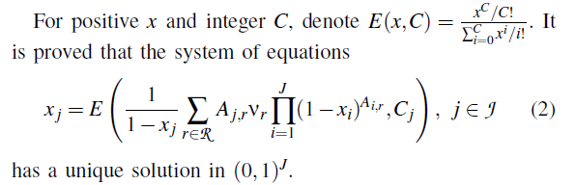
Kelly results for EFPA- uniqueness
F.P.Kelly, “Blocking probabilities in large circuit switched networks,” Adv. in Appl. Probab., vol. 18, no. 2, pp. 473–505, Jun. 1986.

Slide 38

asymptotic expansion of Erlang B formula
Notes:
Give us the idea of implrmenting an asymptotixc EFPA. And Kelly study and result of EFPA provide an theoretical support of this idea. So let ‘s discuss kelly result first.

Slide 39
Our Asymptotic EFPA (A-EFPA)
Initial values of trunk blocking probability
Calculate offered load for each trunk
Calculate blocking probability for each trunk
Asymptotic expansion
Converge or not?
No
YES
Network blocking probability

Slide 40
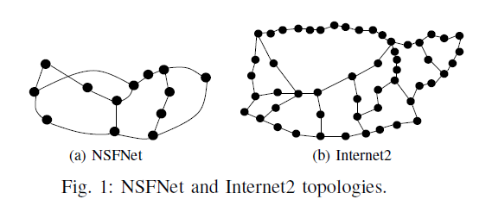
Numerical results
NSFNet - the principal Internet backbone network in US.
Internet2 - backbone network provided for research and education communities in US.
Notes:
Internet2 provides the U.S. research and education community with a network that satisfies their bandwidth-intensive requirements. The network itself is a dynamic, robust and cost-effective hybrid optical and packet network. It furnishes a 100 Gbit/s network backbone to more than 210 U.S. educational institutions, 70 corporations and 45 non-profit and government agencies.

Slide 41
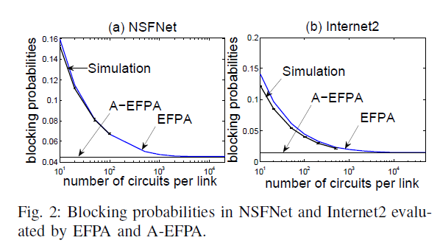
Blocking probabilities in NSFNet and Internet2
For C =20,000, the relative discrepancy of EFPA and A-EFPA is less than 0.2%.
Simulations confirm that the accuracy of EFPA increases with increasing number of circuits per trunk
Notes:
when the capacity is sufficiently
large, the A-EFPA results are very close to those of EFPA.
For C 20; 000, the relative discrepancy is less than 0:2%.
Simulations confirm that the accuracy of EFPA increases with
increasing number of circuits per link.
For NSFNet, there are 156 OD pairs. For each OD pair, the
offered load is set to be 0:025C, so that the total load offered
to some of the links is larger than the capacity (note that in
the NSFNet example, some links serve almost 100 OD pairs).

Slide 42
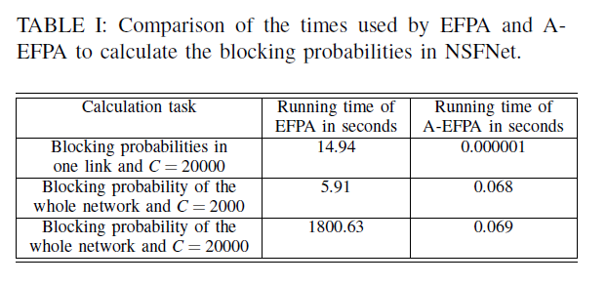
Comparison of the times used by EFPA and A-EFPA in NSFNet
For C = 20,000, A-EFPA saves 99. 9999% of the time used by the EFPA.
Notes:
provides the running time used to calculate the
blocking probability in NSFNet for different C values. Observe

Slide 43
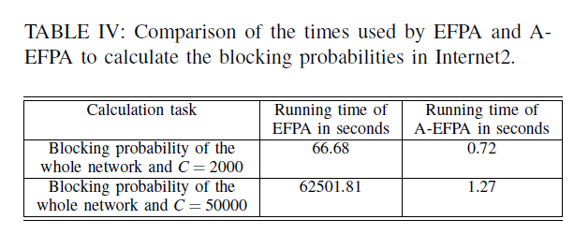
Comparison of the times in Internet2
A-EFPA can save 99.9999% of the time
Trends and behaviors consistent with NSFNet

Slide 44
Conclusion
Implement A-EFPA and EFPA for Circuit Switching networks with fixed routing
When trunk capacity is large, A-EFPA results are very close to those of EFPA.
A-EFPA saves approximately 99.9999% of the computing time.
Together with simulation and EFPA, A-EFPA can give accurate blocking probability estimation in an computationally efficient manner over all ranges of system parameters.
Notes:
We have considered A-EFPA and EFPA implementation
for CS networks with fixed routing based on asymptotic link
blocking probability derivation. From the numerical results
obtained using NSFNet and Internet2 networks, we observe
that when link capacity is large, A-EFPA results are very close
to those of EFPA, but A-EFPA saves approximately 99.9999%
of the computing time. We have demonstrated very accurate
calculations of the blocking probability using simulations,
EFPA and A-EFPA. Complementing each other, these three
methods are used for different ranges of parameter values.

Slide 45
Performance analysis of Circuit Switched Multi-service Networks with non-hierarchical alternate Routing

Slide 46
The model
A circuit switched network with edge-disjoint alternative paths
Different service classes of calls offered to the network
Poisson process
Exponentially distributed holding time
Different bandwidth requirements
maximum number of overflow attempts D
Trunk reservation

Slide 47
Difference with the first model
First model
  Two classes
  Same bandwidth requirement
  Long-lived have priority over short-lived
This model
  A general number of classes
  Different bandwidth requirements
  Fair opportunity to compete in a pool of resources

Slide 48
Approximations
EFPA
OPCA
  Priority over more senior calls belonging to any class
Service-based OPCA
  Priority over more senior calls belonging to the same class
Max(EFPA, service-based OPCA)
  difference in behavior of EFPA versus service-based OPCA under different scenarios

Slide 49
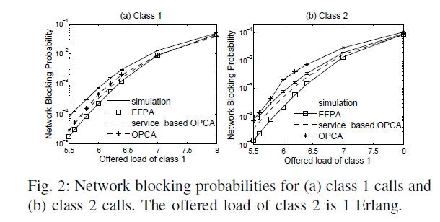
Network Blocking probabilities
all the three approximations tend to underestimate
Proportion of junior calls OPCA> service-based OPCA > EFPA
Service-based OPCA is more accurate for class 2 traffic than for class 1 traffic
OPCA exceeds the simulation result as the traffic increases
  the offered load of the class that require low-bandwidth far exceeds that of the class that requires high-bandwidth
  when the difference of bandwidth requirements is large.
  High sensitivity of OPCA
Max(EFPA, service-based OPCA)

Slide 50
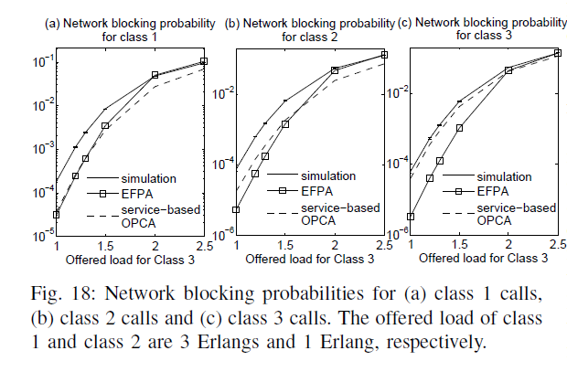
The three classes case
Similar behavior with the 2 class case
Service-based OPCA is more accurate, in most cases

Slide 51
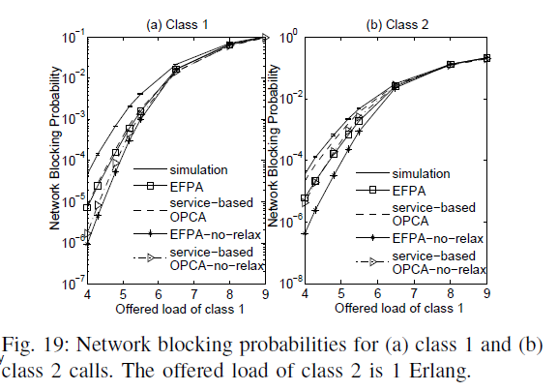
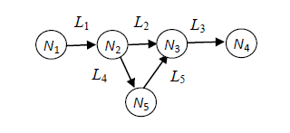
The cases with non-disjoint paths
The only difference is the calculation of offered load to each trunk
Dependent on the common trunks and their positions, need to be calculated case by case
Estimate by the equivalent disjoint path will underestimate, allowing more traffic to overflow

Slide 52
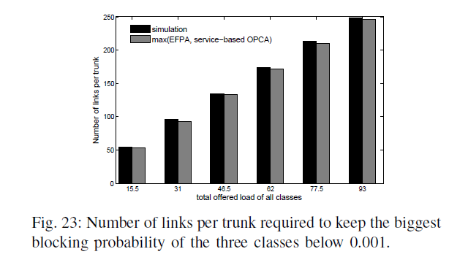
Dimensioning
Increase the total offered load of all classes
Dimensioning the network
The biggest relative error is less than 4%

Slide 53
Conclusion
circuit-switched multiservice networks with deflection routing and trunk reservation.
Introduced two new approximations, OPCA and service-based OPCA
Demonstrated that in most cases, service-based OPCA can estimate the network blocking probabilities reasonably well and is generally more accurate and more conservative than EFPA.
OPCA can significantly overestimate the network blocking probabilities under certain scenarios
max(EFPA, service-based OPCA), as an improvement over EFPA and service-based OPCA which is accurate and conservative.
When max(EFPA, service-based OPCA) used for dimensioning, relative error is acceptable.
Notes:
We have considered a circuit-switched multiservice multirate
network with deflection routing and trunk reservation, and
introduced two new approximations, OPCA and service-based
OPCA, for the estimation of the network blocking probabilities
of various traffic classes
demonstrated that in most cases, service-based OPCA can estimate
the network blocking probabilities reasonably well and is
generally more accurate and more conservative than EFPA.
We have also observed that OPCA can significantly overestimate
the network blocking probabilities under certain scenarios and
the performance of OPCA is not as robust as service-based
OPCA and EFPA.
Furthermore, we have proposed max(EFPA,
service-based OPCA), as an improvement over EFPA and
service-based OPCA, and demonstrated that it gives accurate
and conservative estimation of the network blocking probabilities.
The results have also demonstrated the robustness of the
approximations to the shape of the holding time distribution.
Finally, we have shown that max(EFPA, service-based OPCA)
is applicable to the network blocking probabilities estimation
in large networks such as the Coronet, for which the simulation
results are computationally prohibitive.

Slide 54
Q&A
Thank you so much.

Slide 55
Errors in EFPA
The Poisson error
  an overflow stream is known to have higher variance
  traffic offered to a sequence of trunks on a path may be smoothed out
The independence error
  dependency of trunks on the primary path and the alternative path
  dependency of trunks on the same path
Notes:
The Poisson error — EFPA assumes that the traffic offered to any trunk follows a Poisson process whereas in fact the traffic offered by an overflow stream is known to have higher variance than a Poisson process [55], while traffic offered to a sequence of trunks on a path may be smoothed out when offered to one trunk due to blocking in another trunk. Note that in their original work, the authors of [42] considered an improvement of accuracy by matching both the mean and the variance. However, a common use of EFPA, henceforth referred to as the basic version of EFPA, is based on only matching the mean and the Poisson assumption.
The independence error — EFPA assumes that servergroups are mutually independent, whereas they are in factstatistically dependent because a large number of busyservers in a server group may indicate a heavy trafficperiod and potential overflow to other server groups, sothat other server groups are also likely to be heavilyloaded at that time. Dependence between trunks alsooccur even if overflowed is not allowed (i.e. in fixed routing networks); if for example there is high load on one trunk on a certain end-to-end path, it may be a result of high load on this path, in which case, other trunks on this path will also have high load.
Two effects:
overflows
connection requires a multi-hop path to be established.
overflow errors and path errors.
While overflow errors always cause underestimation of blocking probability (ignoring high variance of overflow traffic and dependence),
the path error overestimates blocking probability because it ignores the effect of traffic smoothing, and the positive correlation of trunk occupancy along the path that increases the probability to admit calls.

Slide 56



Network blocking probability for long-lived traffic by OPCA

Slide 57
Network blocking probability for long-lived traffic by OPCA

