Slide 1
Cost Effective and Survivable Submarine Cable Path Planning
Qing WANG
07 August 2019
Supervisor: Prof. Moshe ZUKERMAN
Notes:
Good morning, my name is Qing WANG, and welcome to my thesis defence.

Slide 2
Outline
Background
Optimal laying of a cable between two given nodes on the Earth’s surface
Terrain constrained path planning for long-haul cables
Submarine cable network extension
Conclusion
Notes:
Here are the Outlines of this presentation.
First is the background.
Then, I will talk about how to lay a cable between two given nodes on the Earth’s surface.
Next, the discussion is extended to Terrain constrained path planning for long-haul cables.
Then, I will talk about Submarine cable network extension.
The last is the Conclusion.

Slide 3
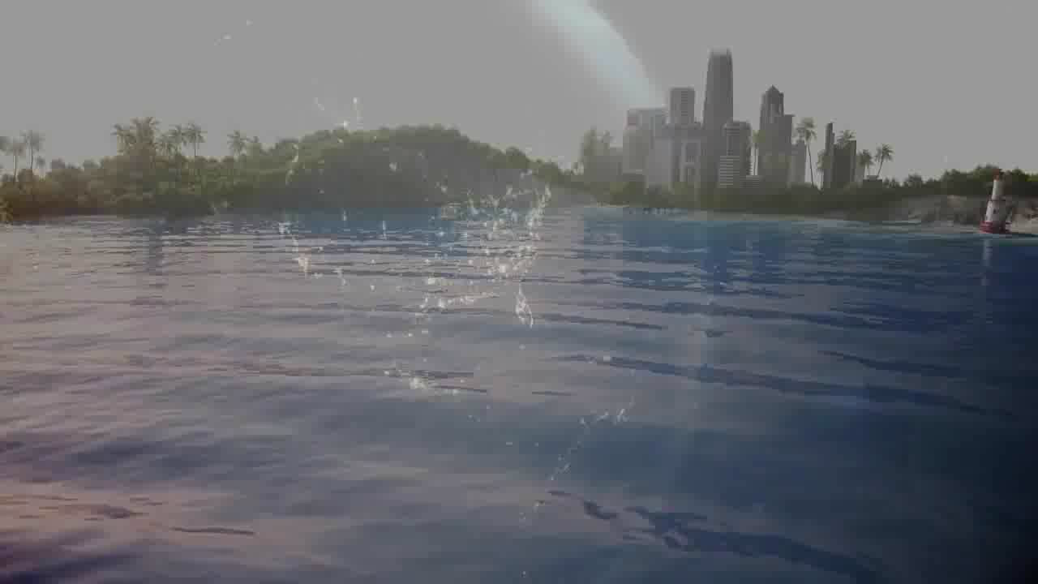
Telecom cables around the world
Source: www.makai.com

Slide 4
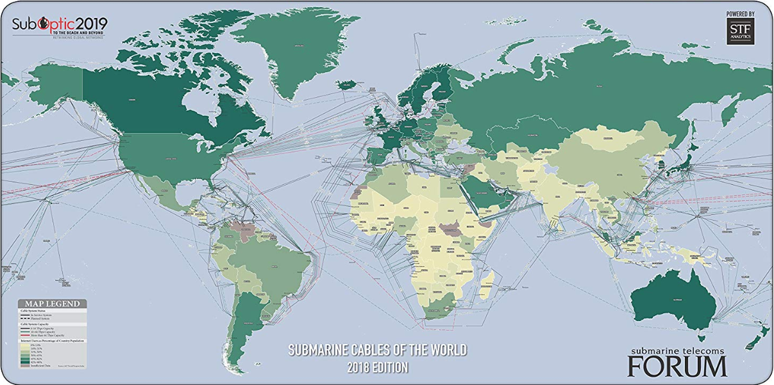
Background
Submarine Cable Map, source: Submarine Telecoms Forum
1. Carry more than 99% of the international voice and data traffic nowadays.
2. A total of 378 submarine cables in service as of early 2019.
3. Total length: over 1.2 million km.
4. Significant impact on economy and society. Huge investments in new cables.
Notes:
Please look at this map. This map is the submarine cable map. All the lines in this map are submarine cables.
In short, submarine cables have a significant impact on the economy and society. This impact has led to huge investments in new submarine cable systems.
Submarine cable is one of critical infrastructure. These cables carry more than 99% of the international voice and data traffic nowadays.
There are a total of 321 submarine cables (293 in-service and 28 planned) by the year 2016.
The total length of these cables is over eight hundred thousand km.
In short, submarine cables have a significant impact on the economy and society. This impact has led to huge investments in new submarine cable systems.

Slide 5
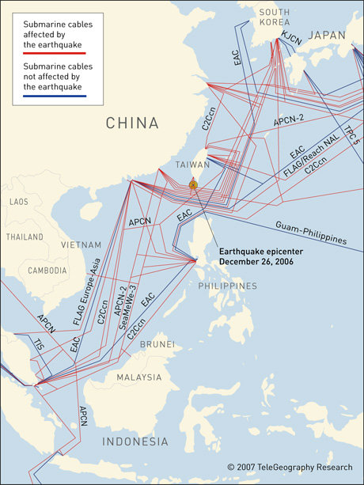
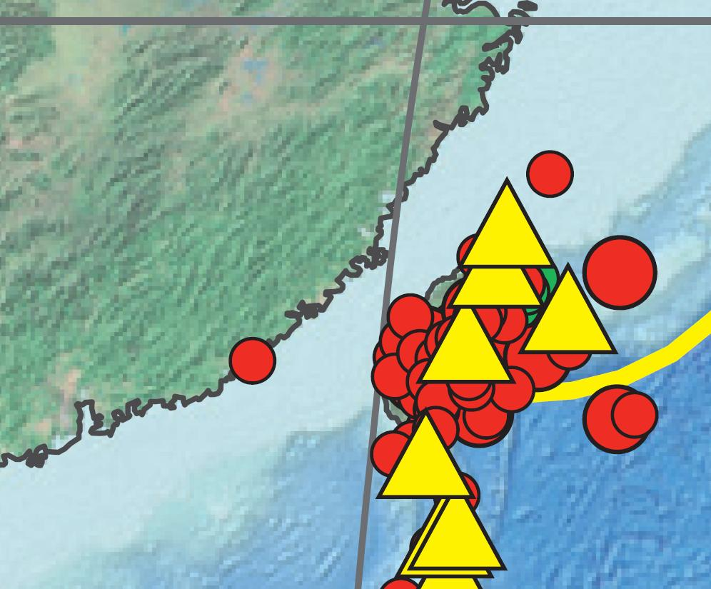
Hengchun (Taiwan) earthquake 2006
Credit: TeleGeography
Credit: U.S. Geological Survey
Eight submarine cables damaged with a total of 18 cuts.
Severe disruption of Internet and phone services in south east Asia for several weeks.
ETH 2005: reduction of over 1% GDP per week of Internet blackout.
Notes:
The survival of a cable rely on many factors, in early stages of this research work, Earthquakes were considered as major hazard to the cable survivability. In 2006 Hengchun Earthquake caused submarine landslides that led to a severe disruption in the internet and phones services in SEA. The disruption lasted several weeks. An incident like that causes a reduction of >1% of GDP per week in a developed country like Switzerland.
Why would this people to do this? Because the cable owners want to save money. They lay cables along the shortest path.

Slide 6
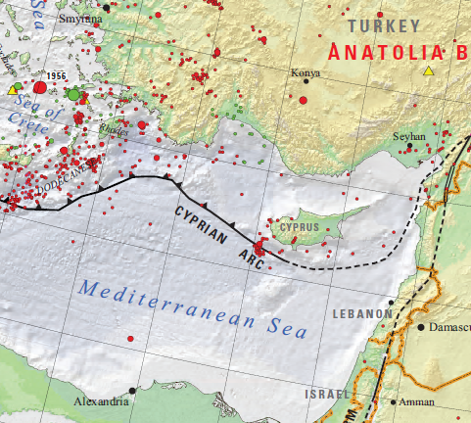
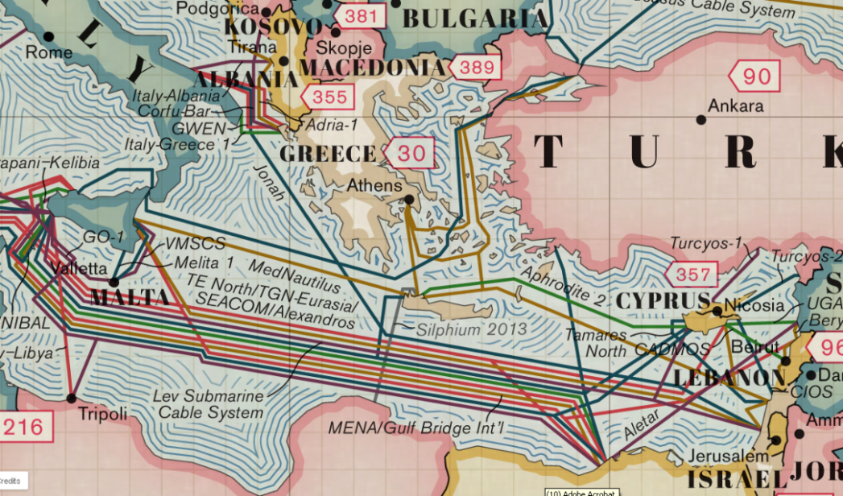
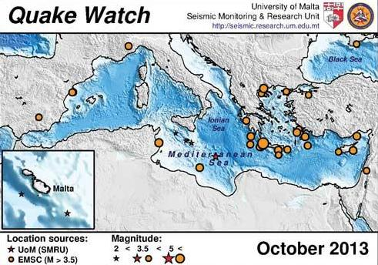
Mediterranean area
Credit: U.S. Geological Survey
Credit: TeleGeography
Credit: University of Malta
Notes:
In the Mediterranean Region, earthquakes are common along the Mediterranean ridge and Cyprus arc. Submarine landslides are common on the continental slopes especially in areas with high sedimentation rate like over the Egyptian continental shelf in front of the Nile Delta or the Algerian Shelf.
Ask Joyce for type of fault near Malta

Slide 7
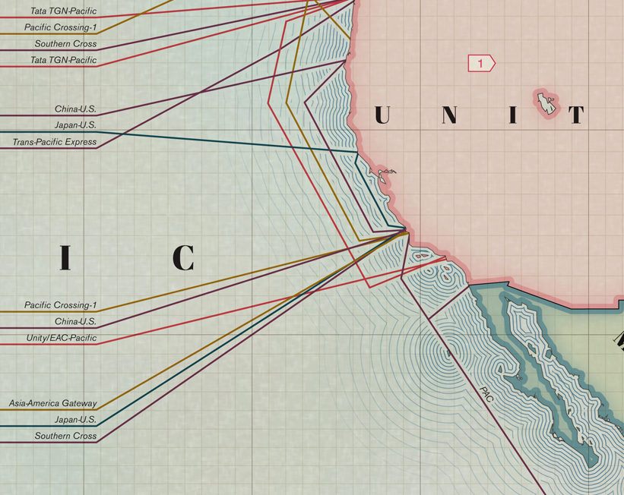
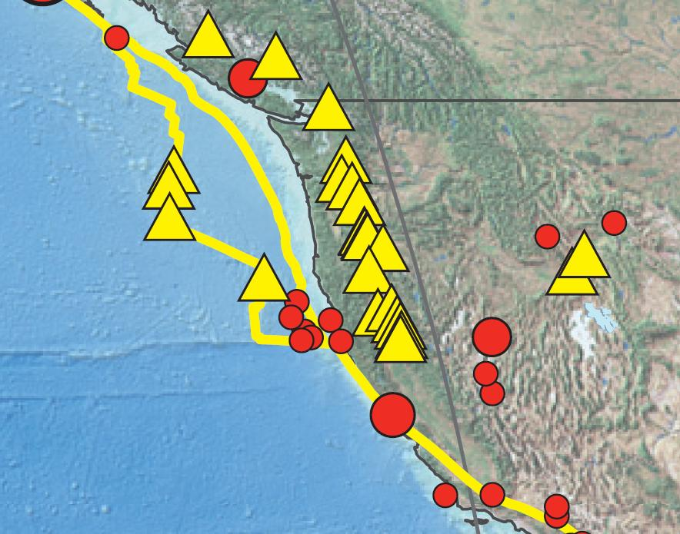
West coast USA
Credit: TeleGeography
Credit: U.S. Geological Survey
Notes:
On the west coast of the US the San Andreas Fault complex is active and life threatening. International cables that transport valuable data between the biggest economy on the planet are always threatened by cable faults due to earthquakes.
How are we mitigating this? By planning for more cables!

Slide 8
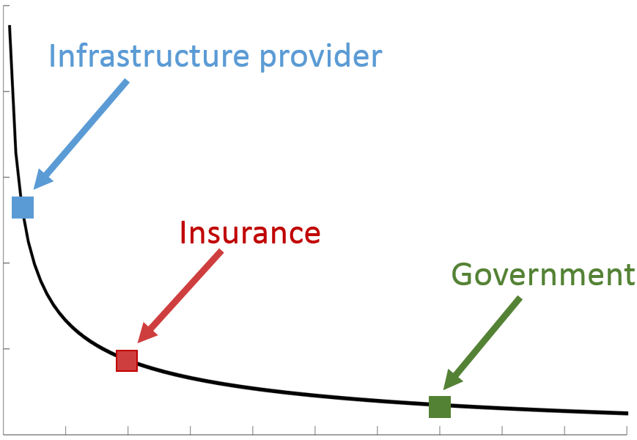
Trade-off between the construction cost and the survivability
Risk
Cost
Notes:
Stand at different angles to consider how to lay a cable.
Government pay more attention on the public safety, which means government can spend more money to reduce the cable risk.
For the infrastructure provider, they focus on the cost saving, that is to say they prefer use less budget to lay the cable. So that the cable may have a high risk.

Slide 9
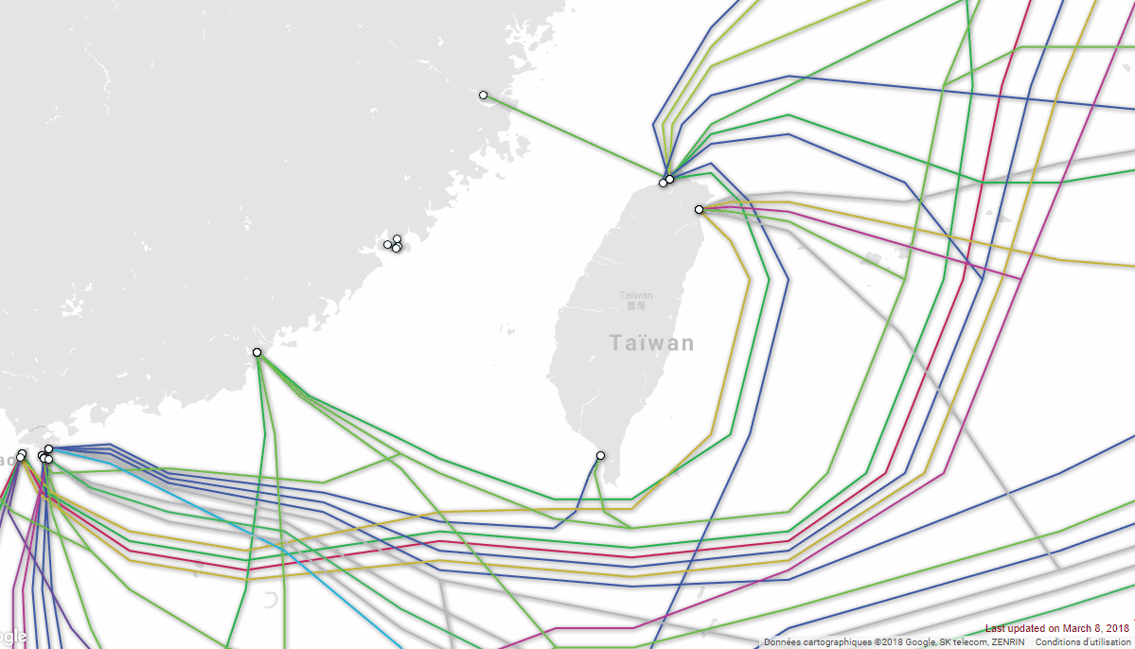
Back to the Hengchun earthquake
Hengchun earthquake, 20:26 Dec. 26, 2006 (M7.0)
APCN, APCN-2, C2C, China-US CN, EAC, FLAG FEA, FNAL/RNAL and SMW3, CH-US(W2), SMW3(S1.8) break at 20:27
Southwestern Ryukyu Islands earthquake, 05:49 Aug. 17, 2009 (M6.7 + Tsunami Warning)
new cable systems:
TPE and TGN
Without consequences !!!!!
Map of cables around Taiwan, source: TeleGeography Submarine Cable Map
Notes:
Let’s go back to Hengchun Earthquake which is the inspiration of this work, the incident generated faults on 8 systems, which were damaged again by the Ryuku Islands earthquake. New cable system off Taiwan are now being planned differently to mitigate the risk from earthquake and their subsequent hazards. The 2 cable systems (i.e. TPE and TGN) laid in 2008 and 2009 were not affected by the Ryukyu Islands earthquake.
Our cable planning takes into consideration other factors as well or problematic areas -> next slide

Slide 10
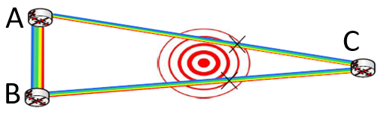
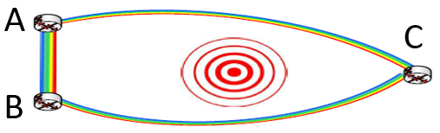
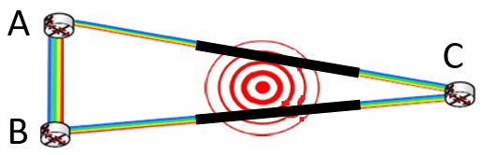
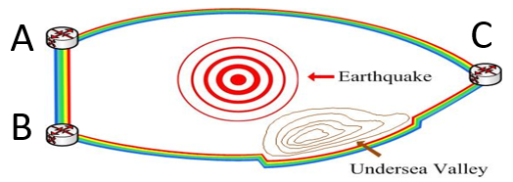
Curving cables or strengthening cables can improve cable network survivability.
How to lay cables between two sites in risk areas to improve network survivability?
Credit: CRF Interview Presentation by Prof. M. Zukerman
(Conflict between cable construction cost and survivability)

Slide 11
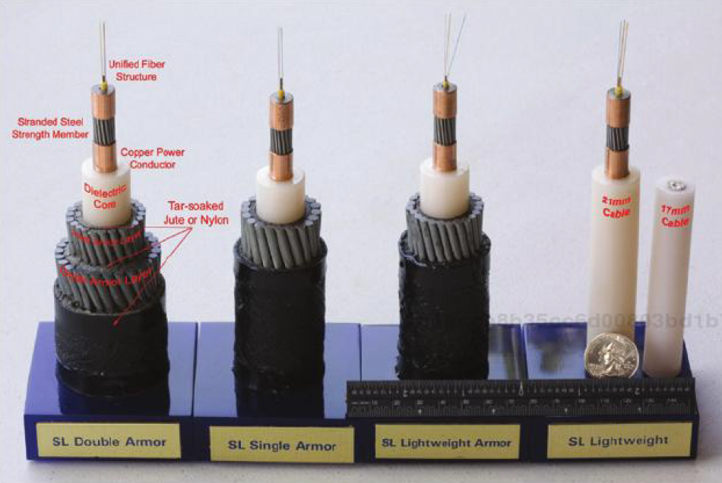
Cable protection
In practice, there are several types of cables (e.g. lightweight cable, single armored, double armored.) can be chosen depending on the laying environment and realistic topography.
Modern telecommunication fiber optical cables
(https://www.unep-wcmc.org/resources-and-data/submarine-cables-and-the-oceans--connecting-the-world)
Notes:
Another way to reduce the failure rate is to add protection to the cable. So we need to conceive an algorithm for that but before we need to understand the type of protection that the cable can have.
In practice, there are several types of cables (e.g. light weight cable, single armored, double armored. etc) that can be chosen depending on the laying environment and realistic topography. So we take into consideration both the path planning and the non-homogeneous construction of the cable to provide special shielding or extra protection as appropriate to strengthen the cable in sensitive areas.
We consider both the path planning and the non-homogeneous construction of the cable to provide special shielding or extra protection as appropriate to strengthen the cable in sensitive areas.

Slide 12
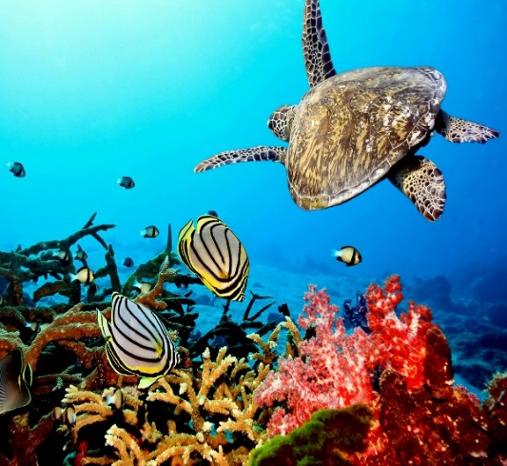
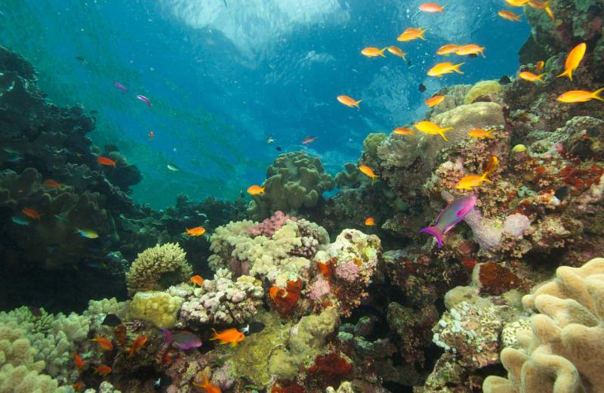
Other problematic areas
Very hard seabed (https://i.ytimg.com/)
Steep slopes (http://smashingtops.com/)
Marine protected areas (https://www.artisanathai.com/)
Reef and seagrass (http://www.great-barrier-reef.com/blog/reef-on-tour.html)
Notes:
The various considerations and restrictions include environmental factors such as very hard seabed, areas with very steep slope, marine protected areas, reef and seagrass.

Slide 13
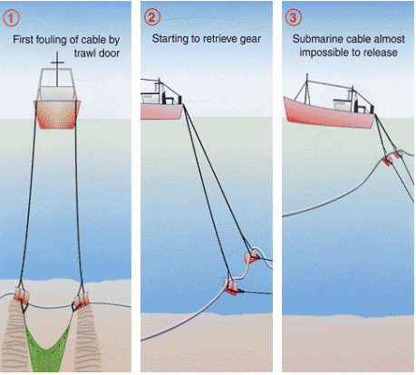
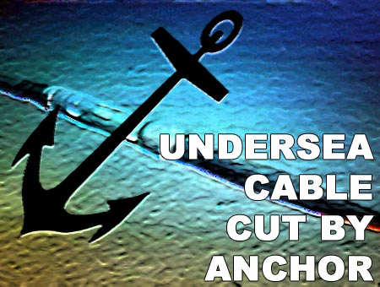
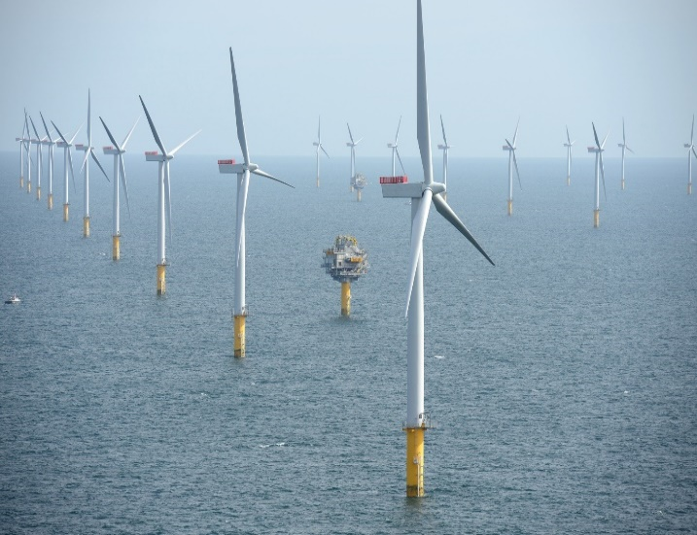
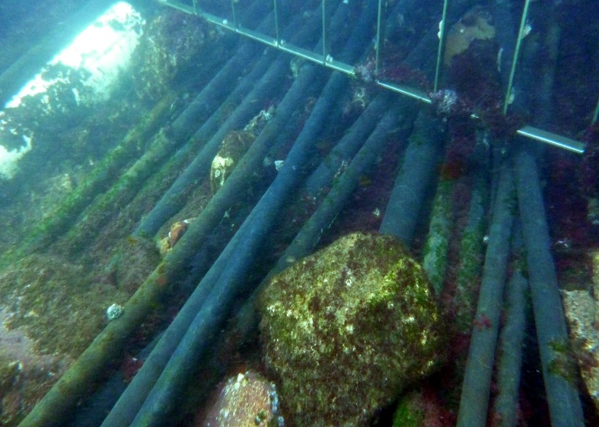
Other problematic areas
Fishing activities (http://dkcpc-kort.dk/)
Anchors (https://www.fs.com/blog/things-you-probably-didnt-know-about-submarine-cables.html)
Offshore renewable energy generation and hydrocarbon exploitation (http://www.industrytap.com/)
Existing cables and pipelines (http://www.divingco.com.au/)
Notes:
And also include areas with frequent human activities like fishing, anchorage, renewable energy parks and existing cables and pipelines. So from all these various factors that we call parameters we start building models

Slide 14
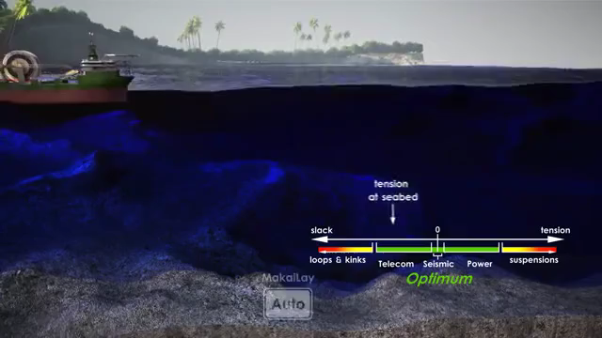
Laying cables and importance of geodesic
Source: www.makai.com
Notes:
Installing cable with high slack can result in using more cable that is unnecessary and increase the chance of unwanted loops.
On the other hand, installing a cable with tension that is too high will result in suspensions of the cable at the contact point. At these contact points, the cable has a high risk to break.
(On the other hand, installing a cable with tension that is too high will result in suspensions leading to extreme forces at the contact point. This exposes the cable to higher current forces which vibrate the cable causing where and in some cases failure at the heavily loaded contact points.)

Slide 15
Main aim
To develop methodologies based on real data for cable path planning on the Earth’s surface to optimize both construction costs and survivability.
Notes:
To develop methodologies and working tools for cost-effective design of a survivable submarine cable path optimizing the shapes and the protection levels of the telecommunication cables considering real earthquake effects, geography, and various restrictions.

Slide 16
Outline
Background
Optimal laying of a cable between two given nodes on the Earth’s surface
Terrain constrained path planning for long-haul cables
Submarine cable network extension
Conclusion

Slide 17
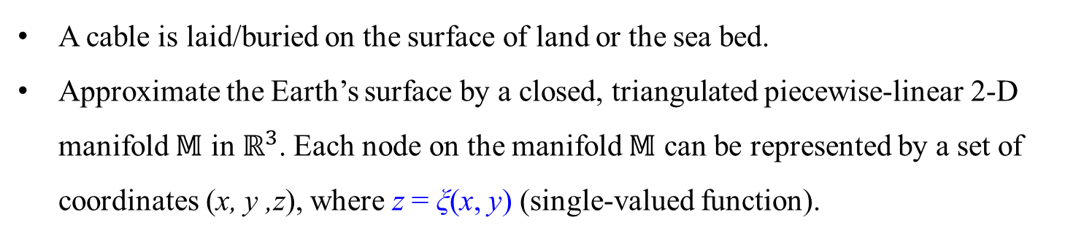
Landform model
A cable is laid/buried on the surface of land or the sea bed.
Approximate the Earth’s surface by a closed, triangulated piecewise-linear 2-D manifold $𝕄$ in $ℝ^{3}$. Each node on the manifold $𝕄$ can be represented by a set of coordinates (x, y ,z), where z = ξ(x, y) (single-valued function).
Notes:
Landform model: A cable is surface laid or buried. The surface of the cable route or in our jargon, the corridor, is triangulated into 2-D manifold represented in 3-D. The corridor can be defined from data available at the DTS stage with lower resolution or post survey data that is with higher resolution. This is uniquely represented by a continuous single valued function Z or Elevation data, a function of (X,Y) set of coordinates.

Slide 18
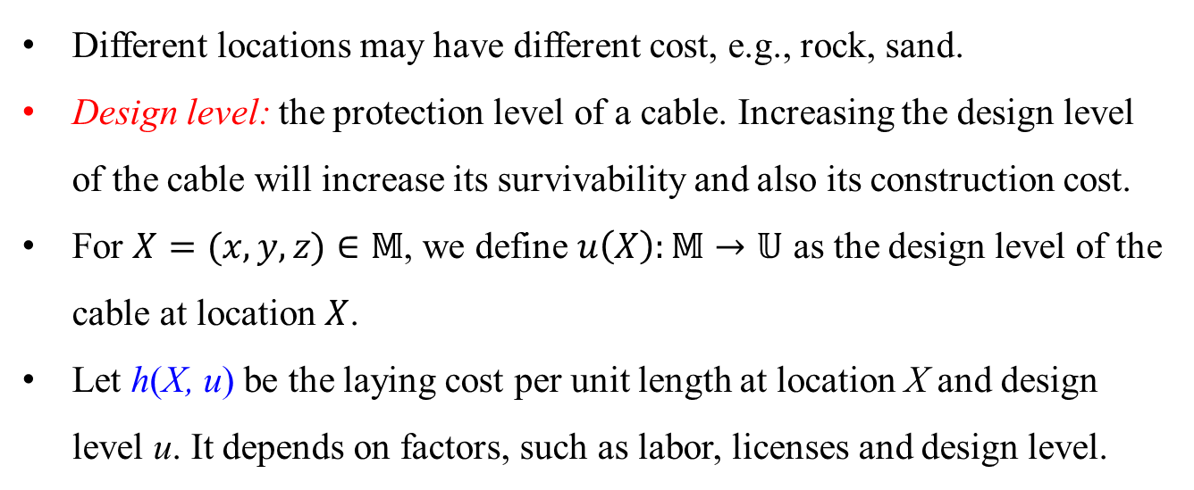
Laying cost model
Different locations may have different cost, e.g., rock, sand.
Design level: the protection level of a cable. Increasing the design level of the cable will increase its survivability and also its construction cost.
For $X=(x,y,z)∈𝕄$, we define $u\left(X\right):𝕄→𝕌$ as the design level of the cable at location $X$.
Let h(X, u) be the laying cost per unit length at location X and design level u. It depends on factors, such as labor, licenses and design level.
Very hard seabed (https://i.ytimg.com/)
Notes:
Another model is designed for the laying cost of the cable. Different locations may have different cost, such as rock, sand, protected areas. A cost function h is then established in relation to x,y and z (elevation). Gamma is considered as a continuous path (portion) of a cable under Lipschitz condition. Lipschitz condition guarantees not only the existence but also the uniqueness of the solution of an initial value problem. So the capital cost H is a function of Gamma. The laying cost is cumulative, the more we lay cable the higher the cost is. So in problematic areas the cost of the cable is set to infinite and the area is avoided. A problematic area is not just limited to hazardous areas where earthquakes or fishing activity, amongst others, occur. Problematic areas include areas that require permit such as military zone, protected natural park, etc…
Actually, the “problematic areas” do not exactly means “risk areas”. Problematic areas include regions in slide 8 and slide 9 which need to permit such as military areas and marine protected areas, where maybe not risk for cable laying but still cannot go through. In this presentation, the “risk areas” means that the region may damage cable caused by earthquake (e.g. you can think that landslide is triggered by earthquake but obviously fishing activity does not have relationship with earthquake). Therefore, for the “problematic areas”, we set to infinite. But for the “risk areas”, we use risk model in slide 12 and 13 to evaluate

Slide 19
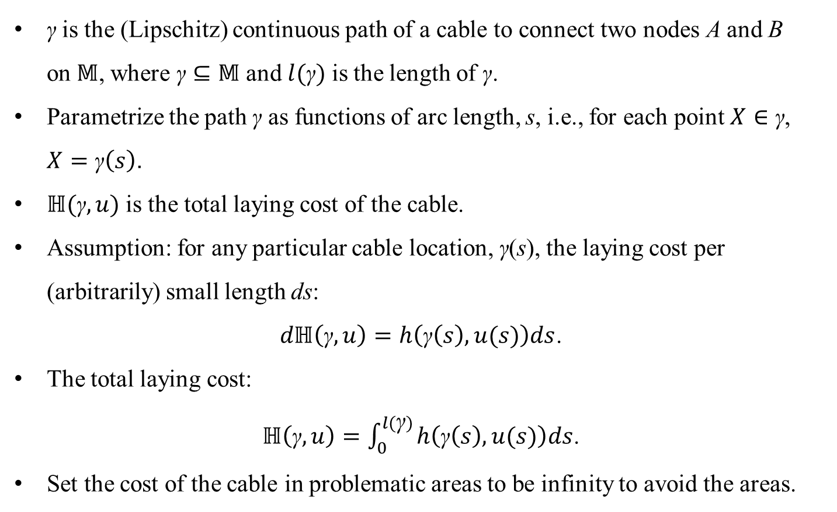
Laying cost model (cont.)
$\text{γ}$ is the (Lipschitz) continuous path of a cable to connect two nodes A and B on$𝕄$, where $\text{γ}⊆𝕄$ and $l(\text{γ})$ is the length of γ.
Parametrize the path $\text{γ}$ as functions of arc length, s, i.e., for each point $X∈\text{γ}$, $X=\text{γ}\left(s\right)$.
$ℍ(\text{γ},u)$ is the total laying cost of the cable.
Assumption: for any particular cable location, $\text{γ}$(s), the laying cost per (arbitrarily) small length ds:
$dℍ\left(\text{γ},u\right)=h\left(\text{γ}\left(s\right),u(s)\right)ds$.
The total laying cost:
$ℍ\left(\text{γ},u\right)=\int_{0}^{l(\text{γ})}{h\left(\text{γ}\left(s\right),u(s)\right)ds}$.
Set the cost of the cable in problematic areas to be infinity to avoid the areas.
Notes:
Another model is designed for the laying cost of the cable. Different locations may have different cost, such as rock, sand, protected areas. A cost function h is then established in relation to x,y and z (elevation). Gamma is considered as a continuous path (portion) of a cable under Lipschitz condition. Lipschitz condition guarantees not only the existence but also the uniqueness of the solution of an initial value problem. So the capital cost H is a function of Gamma. The laying cost is cumulative, the more we lay cable the higher the cost is. So in problematic areas the cost of the cable is set to infinite and the area is avoided. A problematic area is not just limited to hazardous areas where earthquakes or fishing activity, amongst others, occur. Problematic areas include areas that require permit such as military zone, protected natural park, etc…
Actually, the “problematic areas” do not exactly means “risk areas”. Problematic areas include regions in slide 8 and slide 9 which need to permit such as military areas and marine protected areas, where maybe not risk for cable laying but still cannot go through. In this presentation, the “risk areas” means that the region may damage cable caused by earthquake (e.g. you can think that landslide is triggered by earthquake but obviously fishing activity does not have relationship with earthquake). Therefore, for the “problematic areas”, we set to infinite. But for the “risk areas”, we use risk model in slide 12 and 13 to evaluate

Slide 20
Risk model
Repair rate: the average number of potential cable repairs (or failures) per unit length over a certain time period in the future. It is widely used to assess reliability of water supply networks and gas distribution networks.
2006 Hengchun earthquake, damaged 8 cable systems, 18 failures.
Repair rate has a high correlation with ground motion intensities, e.g., Peak Ground Velocity (PGV) and Peak Ground Acceleration (PGA) for which extensive data is available.
Notes:
In addition to the landform model and laying cost model, a risk model is designed that can take into consideration the direct losses such as repair cost, cable damage at multiple points that require cable rerouting and replacement. Indirect losses such as interruption of network services and long latencies. An index is then set to represent the level of damage (expected damage) and the total number of failures (or repairs) over the lifetime of the cable. This index number is already widely used to assess reliability of water supply networks and gas distribution networks. So for example, the 8 damaged cables in Taiwan earthquake in 2006 had a HIGH Index value. Like the laying cost function h, the repair (or failures) rate function, set g here, is a function of x,y and z (elevation). The number of repairs is cumulative as well, the more failures and repairs the higher the price is.
The index (total number of failures) is for cable, not for an earthquake.
For example, when the Hengchun earthquake happened, the total number of failures of three cables A, B and C caused by the earthquake are G_{A} = 0.7, G_{B}= 2.2 and G_{C} = 8.5. So we can say, Cable C has the highest possibility to be damaged and also Cable C is most likely to be damaged severely.

Slide 21
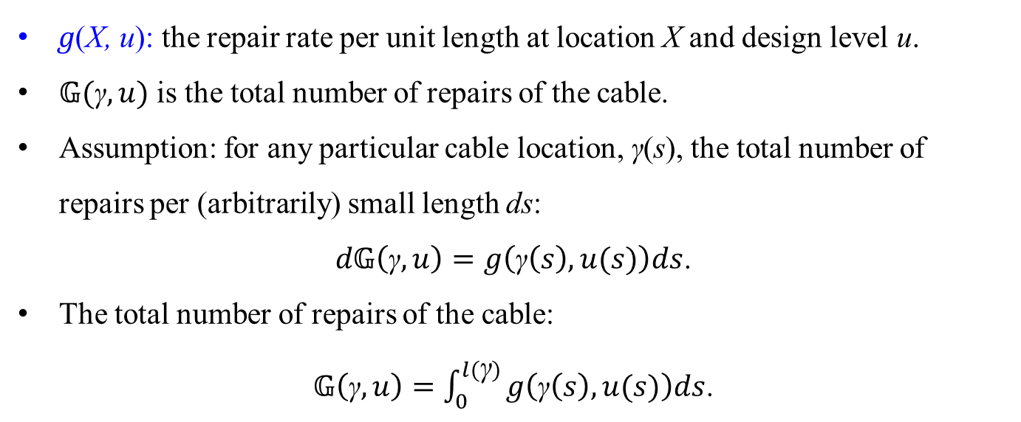
Risk model (cont.)
g(X, u): the repair rate per unit length at location X and design level u.
$𝔾(\text{γ},u)$ is the total number of repairs of the cable.
Assumption: for any particular cable location, $\text{γ}$(s), the total number of repairs per (arbitrarily) small length ds:
$d𝔾\left(\text{γ},u\right)=g\left(\text{γ}\left(s\right),u(s)\right)ds$.
The total number of repairs of the cable:
$𝔾\left(\text{γ},u\right)=\int_{0}^{l(\text{γ})}{g\left(\text{γ}\left(s\right),u(s)\right)ds}$.
Notes:
In addition to the landform model and laying cost model, a risk model is designed that can take into consideration the direct losses such as repair cost, cable damage at multiple points that require cable rerouting and replacement. Indirect losses such as interruption of network services and long latencies. An index is then set to represent the level of damage (expected damage) and the total number of failures (or repairs) over the lifetime of the cable. This index number is already widely used to assess reliability of water supply networks and gas distribution networks. So for example, the 8 damaged cables in Taiwan earthquake in 2006 had a HIGH Index value. Like the laying cost function h, the repair (or failures) rate function, set g here, is a function of x,y and z (elevation). The number of repairs is cumulative as well, the more failures and repairs the higher the price is.
The index (total number of failures) is for cable, not for an earthquake.
For example, when the Hengchun earthquake happened, the total number of failures of three cables A, B and C caused by the earthquake are G_{A} = 0.7, G_{B}= 2.2 and G_{C} = 8.5. So we can say, Cable C has the highest possibility to be damaged and also Cable C is most likely to be damaged severely.

Slide 22
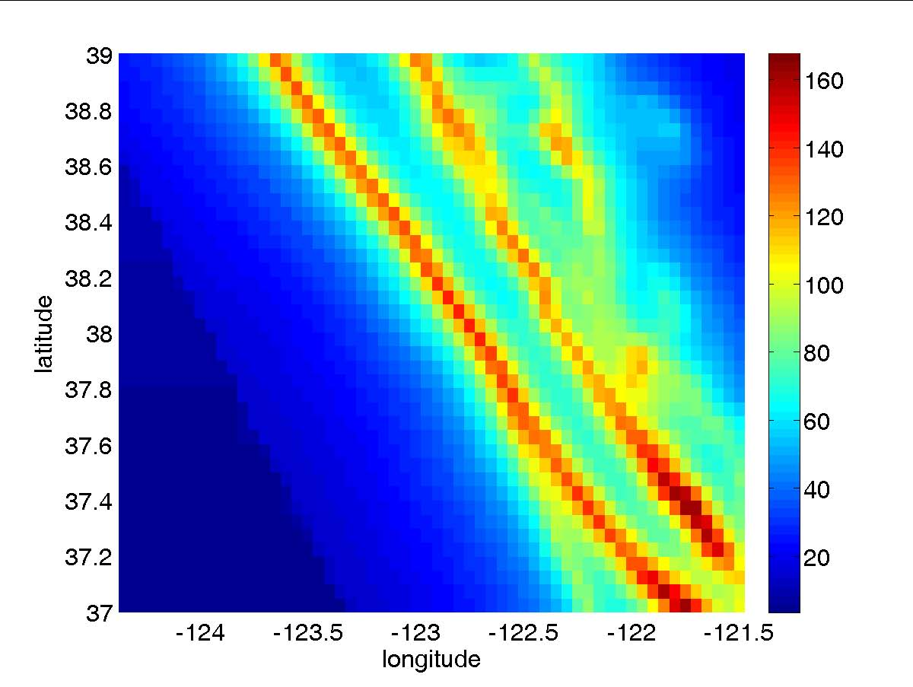

Risk model (cont.)
Repair rate g(X, u) is a function of the cable material, diameter, ground movement (e.g., PGV) and design level.
American Lifelines Alliance provides an empirical equation:
$$g\left(X,u\right)=k∙PGV(X)$$
k is determined by the cable material, cable diameter and design level.
PGV map in CA, USA
Notes:
We can obtain the repair rate from some ground motion intensities such as PGV, PGA and SA.
The ground motion intensity is used to measure the intensity of a seismic movement.
The failure rate of the cable is a function of the cable material, diameter and ground movement. We use existing failure rate function developed by the American Lifelines Alliance. K is a parameter determined by the cable material and diameter.
The American Lifelines Alliance (ALA) is a public-private partnership project funded by the Federal Emergency Management Agency (FEMA) and managed by the National Institute of Building Sciences (NIBS), with the goal of reducing risks to lifelines from hazards.
$g\left(X,u\right)$ is expressed in repair/km and PGV is given in cm/s

Slide 23
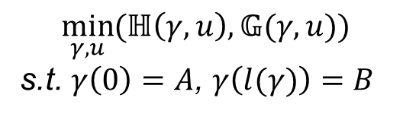
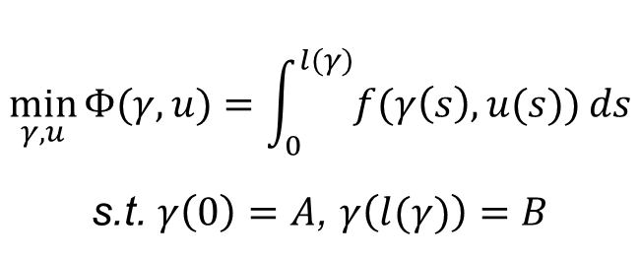
Problem formulation and solutions
A multi-objective variational optimization problem. Intuitively, objectives are conflicting: Pareto optimal solutions.
$$\min_{γ,u}{(ℍ\left(γ,u\right),𝔾(γ,u))}$$
s.t. $γ\left(0\right)=A$, $γ\left(l(γ)\right)=B$
(Problem 1)
Transfer Problem 1 into a single-objective problem by weighting the two objectives:
$$\min_{γ,u}{Φ(γ,u)}=\int_{0}^{l(γ)}{f(γ\left(s\right),u(s))}ds$$
s.t. $γ\left(0\right)=A$, $γ\left(l(γ)\right)=B$
(Problem 2)
where $f(γ\left(s\right),u(s))\text{=}h\left(γ\left(s\right),u(s)\right)+c∙g\left(γ\left(s\right),u(s)\right)$ and $c≥0$.
Notes:
Then we set the problem… Minimum risk doesn’t go well with minimum cost, it is a multi-objective variational optimization problem. So we bring the H (Cost) and G (Fault) and put them together in a formula to get a single objective variational problem where Gamma is γ is the (Lipschitz) continuous path of a cable.
This lead us to solve 1 variational problem.
Pareto Optimal is a state that means it is impossible to make one objective better without making at least another objective worse.

Slide 24
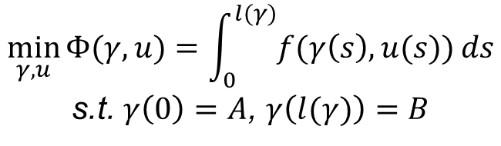
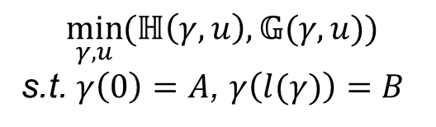
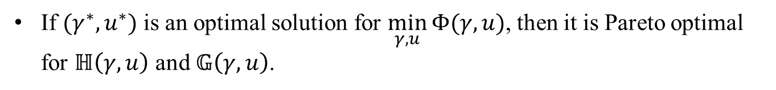
Problem formulation and solutions
If ${(γ}^{∗},u^{∗})$ is an optimal solution for $\min_{γ,u}{Φ(γ,u)}$, then it is Pareto optimal for $ℍ\left(γ,u\right)$ and $𝔾\left(γ,u\right)$.
$$\min_{γ,u}{(ℍ\left(γ,u\right),𝔾(γ,u))}$$
s.t. $γ\left(0\right)=A$, $γ\left(l(γ)\right)=B$
(Problem 1)
Therefore, we need to solve
$$\min_{γ,u}{Φ(γ,u)}=\int_{0}^{l(γ)}{f(γ\left(s\right),u(s))}ds$$
s.t. $γ\left(0\right)=A$, $γ\left(l(γ)\right)=B$
(Problem 2)
Notes:
Then we set the problem… Minimum risk doesn’t go well with minimum cost, it is a multi-objective variational optimization problem. So we bring the H (Cost) and G (Fault) and put them together in a formula to get a single objective variational problem where Gamma is γ is the (Lipschitz) continuous path of a cable.
This lead us to solve 1 variational problem.
Pareto Optimal is a state that means it is impossible to make one objective better without making at least another objective worse.

Slide 25
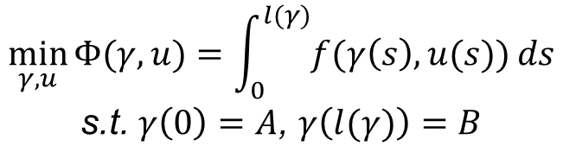
Problem formulation and solutions
$$\min_{γ,u}{Φ(γ,u)}=\int_{0}^{l(γ)}{f(γ\left(s\right),u(s))}ds$$
s.t. $γ\left(0\right)=A$, $γ\left(l(γ)\right)=B$
(Problem 2)
The solution paths that minimize the integral are the minimum weighted cost paths.
The Fast Marching Method (FMM) is adopted.
FMM converges to the continuous physical solution as the grid step size tends to zero.
FMM has the same computational complexity as the Dijkstra’s algorithm, i.e., O(NlogN), where N is the number of discretized grid nodes.
Notes:
Then we set the problem… Minimum risk doesn’t go well with minimum cost, it is a multi-objective variational optimization problem. So we bring the H (Cost) and G (Fault) and put them together in a formula to get a single objective variational problem where Gamma is γ is the (Lipschitz) continuous path of a cable.
This lead us to solve 1 variational problem.
Pareto Optimal is a state that means it is impossible to make one objective better without making at least another objective worse.

Slide 26
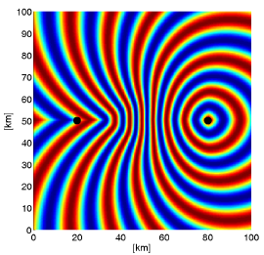
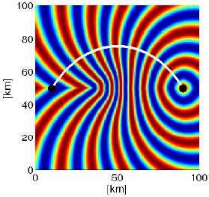
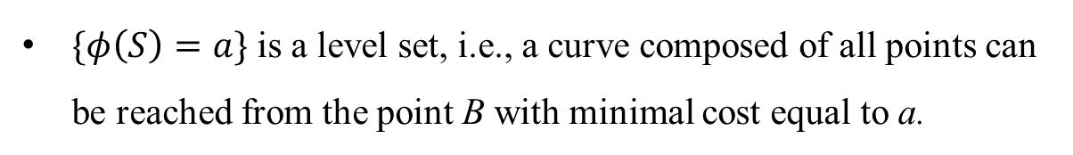


Problem formulation and solutions
Define a new cost function:
$$φ(S)=\min_{β,u}{\int_{0}^{l(β)}{f\left(β\left(s\right),u(s)\right)ds}, β\left(0\right)=B,β\left(l\left(β\right)\right)=S}$$
$φ\left(S\right)$is the viscosity solution of the Eikonal equation:
$$|\left|∇φ\left(S\right)\right||=\min_{u}f(S,u)$$
$\{φ\left(S\right)=a\}$ is a level set, i.e., a curve composed of all points can be reached from the point B with minimal cost equal to a.
Construct the optimal path by tracking backwards from A to B, solving the following ordinary differential equation
$$\frac{dX(s)}{ds}=−∇φ, given X\left(0\right)=A$$
i.e., orthogonal to the level curves.
Notes:
So variational problem is a continuous problem that requires a solution continuously. The continuous solution is to generate a path where the cost and failure are always in their optimal states. For that we use Fast Marching Method which have the continuous physical solution and a powerful computational complexity as the Dijkstra Algorithm. Dijkstra's algorithm is used to find the shortest path between 2 nodes. However this algorithm generate huge amount of interim data compared to the FMM. So we stick to FMM.
$$\text{where} \text{S} \text{can} \text{be} \text{any} \text{node} \text{on} \text{the} \text{target} \text{manifold} \text{and} \text{B} \text{is} \text{the} \text{End} \text{point}\text{, }β \text{is} \text{a} \text{path} \text{between} \text{S} \text{and} \text{B}\text{.}$$
$β \text{is} \text{a} \text{path} \text{between} \text{S} \text{and} \text{B}$; $φ(S)$ represents the minimum weighted cost to travel from End point B to point S on the manifold.
Applying calculus of variations, $φ\left(S\right)$is the solution of the Eikonal equation:

Slide 27
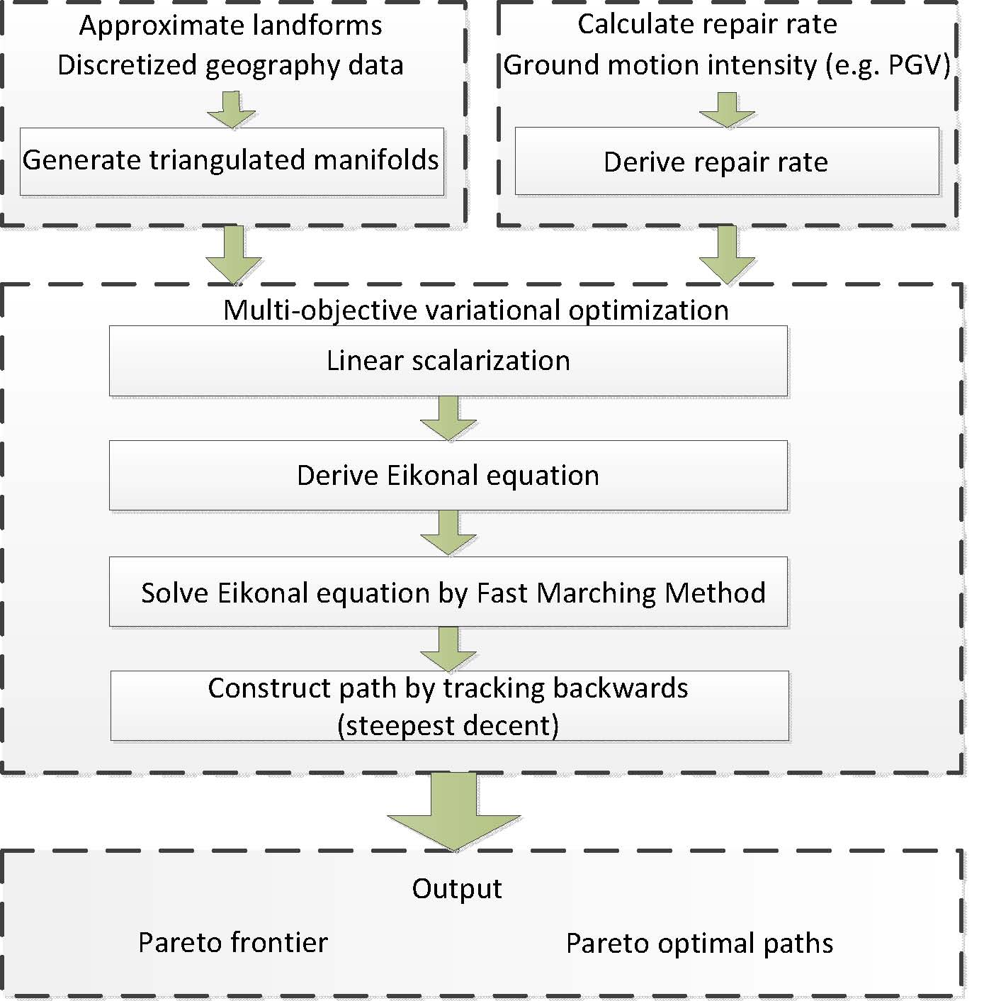
Framework

Slide 28
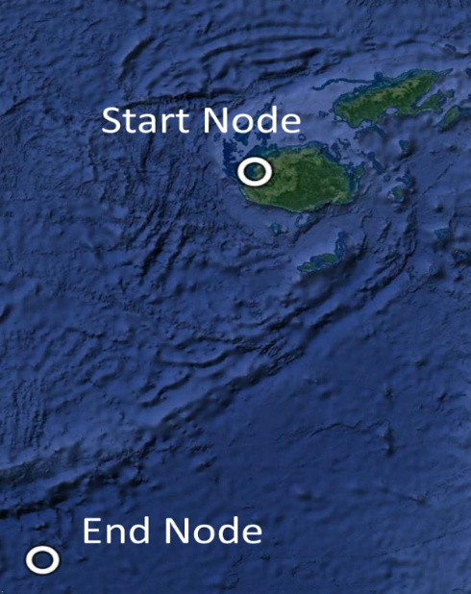
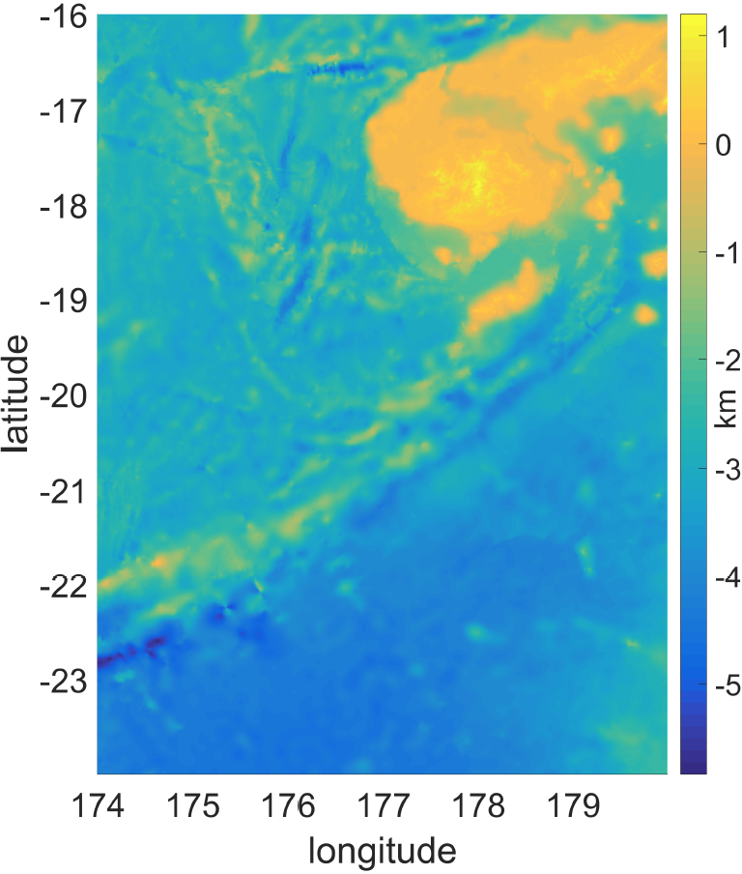
Numerical results
Target region: In South Pacific Ocean, from the southwest corner (24.00°S, 174.00°E) to the northeast corner (16.00°S, 180.00°E)
Aim: Cable path from Start Node (17.70°S, 177.40°E) to End Node (23.50°S, 174.30°E)
Geography. Source: Google Earth.
Elevation map
Notes:
Applications: Let’s take an example over land in an earthquake prone area such as California. All necessary data is available on the web. We aim to plan a cable from Davis to LA. We have the DTM and PGA data downloaded

Slide 29
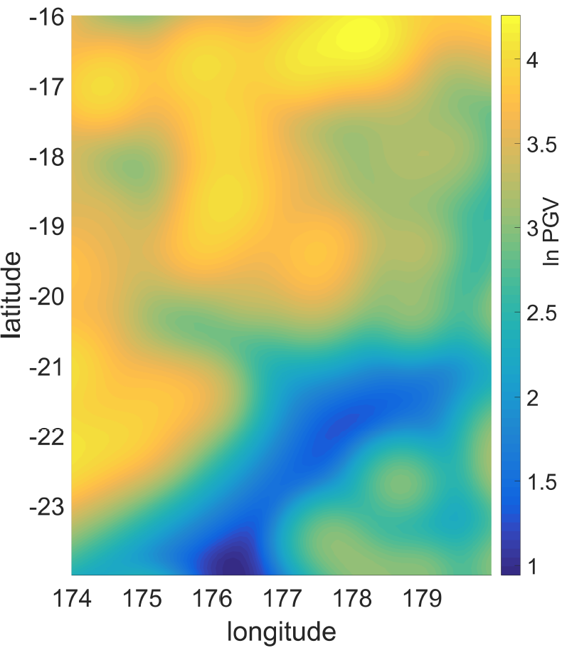
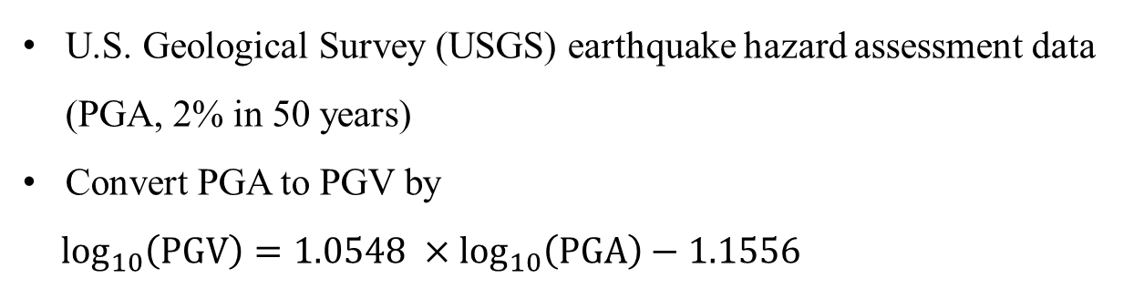
Numerical results
U.S. Geological Survey (USGS) earthquake hazard assessment data (PGA, 2% in 50 years)
Convert PGA to PGV by
$\log_{10}\left(PGV\right)=1.0548 ×\log_{10}\left(PGA\right)−1.1556$
PGV map (unit: cm/s)
Notes:
We convert PGA to PGV using this equation and we convert PGV to failure rate using the American Lifelines Alliance formula.

Slide 30
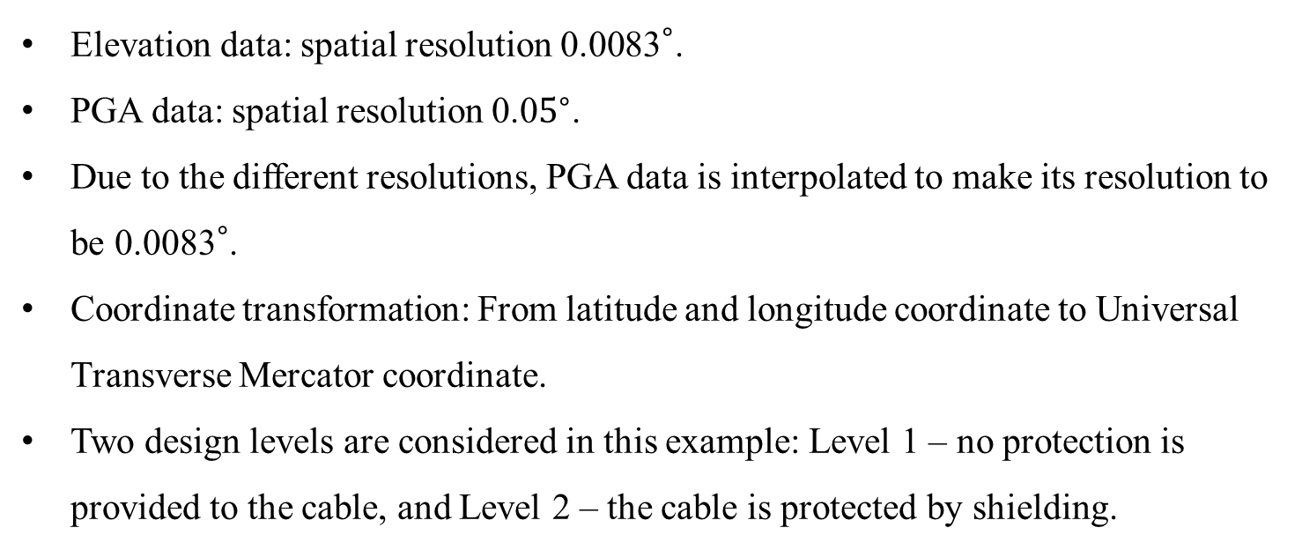
Numerical results
Elevation data: spatial resolution ${\text{0.0083}}^{∘}$.
PGA data: spatial resolution ${\text{0.0}5}^{∘}$.
Due to the different resolutions, PGA data is interpolated to make its resolution to be ${\text{0.0083}}^{∘}$.
Coordinate transformation: From latitude and longitude coordinate to Universal Transverse Mercator coordinate.
Two design levels are considered in this example: Level 1 – no protection is provided to the cable, and Level 2 – the cable is protected by shielding.
Notes:
The elevation data and the PGA data have similar resolution. Geographic coordinates are transformed into UTM then the Digital terrain model is produced using triangulation

Slide 31
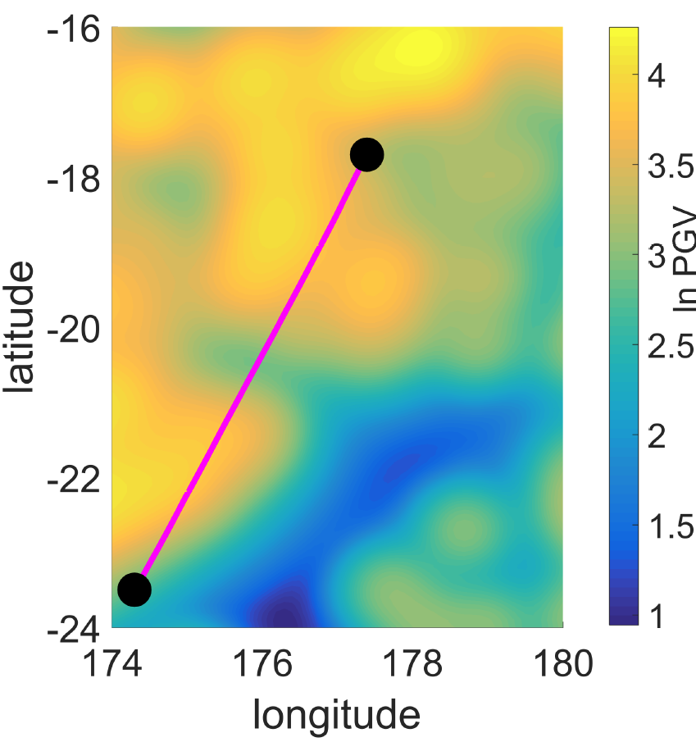
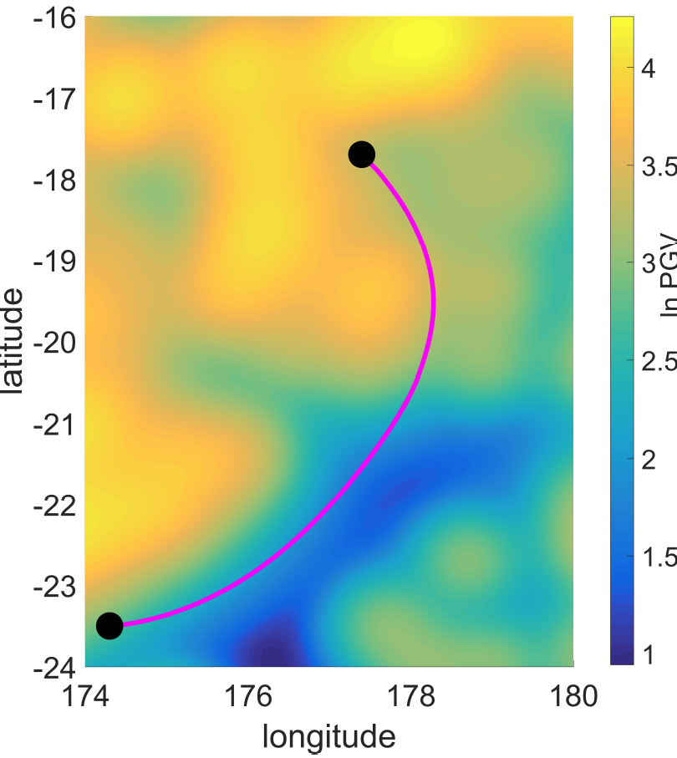
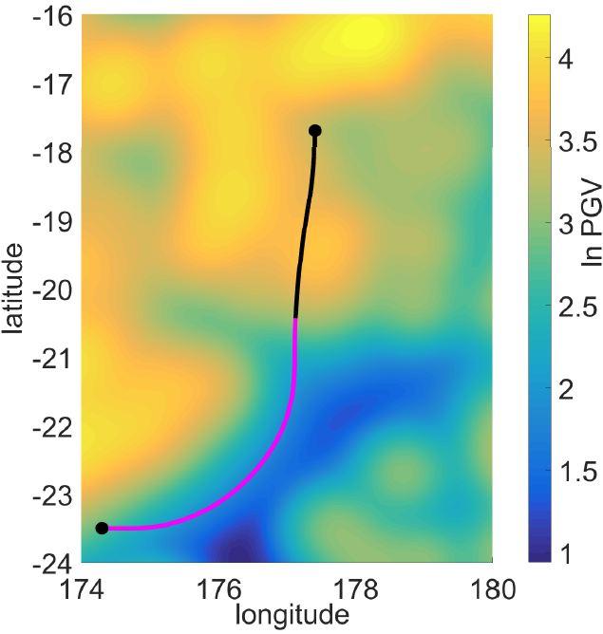

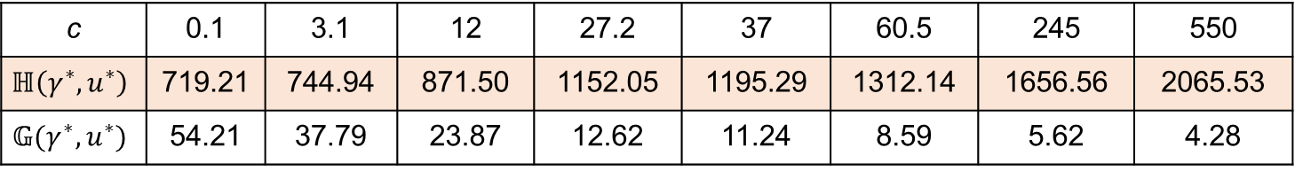
Numerical results
The two objectives of eight Pareto optimal paths.
c | 0.1 | 3.1 | 12 | 27.2 | 37 | 60.5 | 245 | 550
$$ℍ\left(γ^{∗},u^{∗}\right)$$ | 719.21 | 744.94 | 871.50 | 1152.05 | 1195.29 | 1312.14 | 1656.56 | 2065.53
$$𝔾(γ^{∗},u^{∗})$$ | 54.21 | 37.79 | 23.87 | 12.62 | 11.24 | 8.59 | 5.62 | 4.28
c = 0.1
c = 12
c = 37
c = 550
The magenta lines: design level 1. The black lines: design level 2.
Notes:
Et voila… The problem was to lay a cable from LA to Davis over the fault. So we set the weight “c” to go from 0.001 to 10 (very large value). For each c value, there is a Pareto optimal path and corresponding values G and H. If c = 0, that means we only consider the repair rate (risk). If c tends to infinite, that means we only consider the laying cost. Here we only show three paths on the surface because it is messy to show all the paths.
The magenta and the black lines represent the path or path segments that adopt design Level 1 and design Level 2, respectively.

Slide 32
Numerical results
Weight 0 ~ 1600 to obtain the Pareto front.
The cost saving of the FMM-based method relative to the Dijkstra’s algorithm reaches up to 20.3%.
Billions of dollars are invested globally and annually in submarine cable systems. The cost saving is significant.
Notes:
Again, the variation of the weight c from a very small value to a very large value allows us to find the Pareto optimal solutions and get the Pareto front. If for example the budget is 610 dollars, the node located in the black rectangular with cost 610 has a total number of repairs 53(maybe). As we saw on the previous slide, the path in the middle (triangle) can be considered as an optimal path (Previous slide) but the other path are as well optimal depending on the operator preference, >cost or > risk!!!. The circle and the plus are on the extreme of the Pareto Front.
Because there may be so many paths, all the data is in the storage memory. When we input a cost (or total number of repairs), the corresponding total number of repairs (or cost) and the path will be produced.

Slide 33
Outline
Background
Optimal laying of a cable between two given nodes on the Earth’s surface
Terrain constrained path planning for long-haul cables
Submarine cable network extension
Conclusion

Slide 34
Why do we need to consider the terrain?
Cable burying by using a remotely operated vehicle (ROV) is another primary method to protect a cable from being damaged.
Steep slopes increase the likelihood of capsize of an ROV as it buries the cable in an uneven terrain.
Consider this instability risk by defining a direction-dependent laying cost that depends on the direction of the path and the slope of the terrain.
Direction-independent laying cost: h(X, u), depends on factors, such as labor, licenses and design level.
Notes:
The laying cost consists of two components: (1) a direction-dependent laying cost that depends on the direction of the path and the slope of the terrain in order to account for instability risk of the ROV; (2) a direction-independent laying cost that encompasses all other costs, such as labor, licenses and protection level mentioned above.
In current industry practice, cable burying by using a Remotely operated vehicle (ROV) is a major method to protect a cable from being damaged by human activities.
Remotely operated vehicle (ROV), which is designed to assist burial of cables in water depths of less than 1000 m where seabed conditions allow.
The laying cost consists of two components: (1) a direction-dependent laying cost that depends on the direction of the path and the slope of the terrain in order to account for instability risk of the ROV; (2) a direction-independent laying cost that encompasses all other costs, such as labor, licenses and protection level mentioned above.

Slide 35
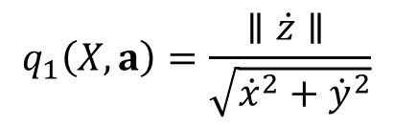
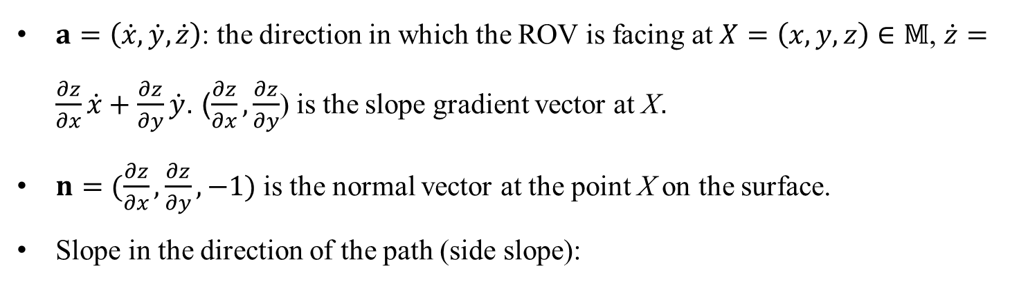

Cost Model
$a=\left(\dot{x}, \dot{y},\dot{z}\right)$: the direction in which the ROV is facing at $X=\left(x,y,z\right)∈𝕄$, $\dot{z}=\frac{∂z}{∂x}\dot{x}+\frac{∂z}{∂y}\dot{y}$. ($\frac{∂z}{∂x}, \frac{∂z}{∂y}$) is the slope gradient vector at X.
$n=(\frac{∂z}{∂x}, \frac{∂z}{∂y}, −1)$ is the normal vector at the point X on the surface.
Slope in the direction of the path (side slope):
$$q_{1}\left(X,a\right)=\frac{∥\dot{z}∥ }{\sqrt{{\dot{x}}^{2}+{\dot{y}}^{2}}}$$
Slope perpendicular to the path:
$$q_{2}\left(X,a\right)=\frac{∥{\left(n×a\right)}_{3}∥}{∥{\left(n×a\right)}_{1,2}∥}=\frac{∥\frac{∂z}{∂x}\dot{y}−\frac{∂z}{∂y}\dot{x}∥ }{\sqrt{{\left(\frac{∂z}{∂y}\dot{z}+\dot{y}\right)}^{2}+{\left(\frac{∂z}{∂x}\dot{z}+\dot{x}\right)}^{2}}}$$

Slide 36

Cost Model (cont.)
We use an exponential function to model the direction-dependent part of the cable laying cost:
$${\text{h}}_{1}\text{(}\text{X}\text{, }a \text{,}\text{u}\text{)}=e^{q_{1}\left(X,a\right)−θ_{1}}+e^{q_{2}\left(X,a\right)−θ_{2}}$$
Include the direction-independent laying cost:
$${\text{h}}_{t}\text{(}\text{X}\text{, }a \text{,}\text{u}\text{)}={\text{h}}_{1}\text{(}\text{X}\text{, }a \text{,}\text{u}\text{)}+h(X,u)$$
Total laying cost:
$ℍ\left(\text{γ},a,u\right)=\int_{0}^{l(\text{γ})}{{\text{h}}_{t}\left(\text{γ}\left(s\right),a\left(s\right),u(s)\right)ds}$.
Notes:
To incorporate the two considerations of the side slope and the slope perpendicular to the path, we use an exponential function to model the direction-dependent part of the cable laying cost related to terrain slopes which is defined as follows,
Inclusion of the direction-independent component h2(x, u) gives the unit-length laying cost function h(x, a, u) as

Slide 37
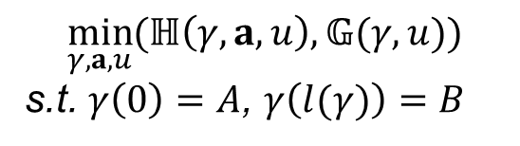

Problem formulation and solutions
A multi-objective optimization problem
$$\min_{γ,a,u}{(ℍ\left(γ,a,u\right),𝔾(γ,u))}$$
s.t. $γ\left(0\right)=A$, $γ\left(l(γ)\right)=B$
(Problem 3)
Transfer into a single-objective problem by weighting the two objectives:
$$\min_{γ,a,u}{Φ′(γ,a,u)}=\int_{0}^{l(γ)}{f′(γ\left(s\right),a\left(s\right),u(s))}ds$$
s.t. $γ\left(0\right)=A$, $γ\left(l(γ)\right)=B$
(Problem 4)
$f′(γ\left(s\right),a\left(s\right),u(s))\text{=}h_{t}\left(γ\left(s\right),a\left(s\right),u(s)\right)+c∙g\left(γ\left(s\right),u(s)\right)$ and $c≥0$.
Notes:
Then we set the problem… Minimum risk doesn’t go well with minimum cost, it is a multi-objective variational optimization problem. So we bring the H (Cost) and G (Fault) and put them together in a formula to get a single objective variational problem where Gamma is γ is the (Lipschitz) continuous path of a cable.
This lead us to solve 1 variational problem.
Pareto Optimal is a state that means it is impossible to make one objective better without making at least another objective worse.

Slide 38


Problem formulation and solutions
If $(γ^{∗},a^{∗},u^{∗})$ is an optimal solution for $\min_{γ,a,u}{Φ′(γ,a,u)}$, then it is Pareto optimal for $ℍ\left(γ,a,u\right)$ and $𝔾(γ,u)$.
Therefore, we need to solve
$$\min_{γ,a,u}{Φ′(γ,a,u)}=\int_{0}^{l(γ)}{f′(γ\left(s\right),a\left(s\right),u(s))}ds$$
s.t. $γ\left(0\right)=A$, $γ\left(l(γ)\right)=B$
(Problem 4)
Notes:
Then we set the problem… Minimum risk doesn’t go well with minimum cost, it is a multi-objective variational optimization problem. So we bring the H (Cost) and G (Fault) and put them together in a formula to get a single objective variational problem where Gamma is γ is the (Lipschitz) continuous path of a cable.
This lead us to solve 1 variational problem.
Pareto Optimal is a state that means it is impossible to make one objective better without making at least another objective worse.

Slide 39




Problem formulation and solutions
Define a new cost function:
$$φ′(S)=\min_{β,a,u}{\int_{0}^{l(β)}{f′\left(β\left(s\right),a\left(s\right),u(s)\right)ds}, β\left(0\right)=B,β\left(l\left(β\right)\right)=S}$$
$φ′\left(S\right)$is the viscosity solution of the Hamilton-Jacobi-Bellman (HJB) equation:
$$\min_{a∈𝔸;u∈𝕌}\left\{\left(∇φ′\left(S\right)∙a\right)+f^{′}\left(S,a,u\right)\right\}=0, X∈𝕄,$$
$$φ′\left(B\right)=0,$$
Ordered Upwind Method (OUM) is adopted to obtain a set of Pareto optimal solutions.
If $f^{′}\left(S,a,u\right)$=$f^{′}\left(S,u\right)$ (i.e., weighted cost function is isotropic), HJB equation is reduced to Eikonal equation:
$$|\left|∇φ′\left(S\right)\right||=\min_{u}f^{′}\left(S,u\right)$$
Notes:
Then we set the problem… Minimum risk doesn’t go well with minimum cost, it is a multi-objective variational optimization problem. So we bring the H (Cost) and G (Fault) and put them together in a formula to get a single objective variational problem where Gamma is γ is the (Lipschitz) continuous path of a cable.
This lead us to solve 1 variational problem.
Pareto Optimal is a state that means it is impossible to make one objective better without making at least another objective worse.

Slide 40



Numerical results
Target region: In State of California and Nevada, from the northwest corner (38.000°N, -119.000°E) to the southeast corner (35.500°N, -117.700°E)
Aim: Cable path from Start Node (37.900°N, -118.900°E) to End Node (35.600°N, -117.950°E)
Geography. Source: Google Earth.
PGV map
Slope map
Notes:
Applications: Let’s take an example over land in an earthquake prone area such as California. All necessary data is available on the web. We aim to plan a cable from Davis to LA. We have the DTM and PGA data downloaded

Slide 41







Numerical results
The two objectives of six Pareto optimal paths.
c | 0 | 3.2 | 11 | 22 | 45 | 570
$$ℍ\left(γ^{∗},{a,u}^{∗}\right)$$ | 772.45 | 806.35 | 900.15 | 1082.14 | 1146.46 | 1200.78
$$𝔾(γ^{∗},u^{∗})$$ | 46.68 | 31.32 | 20.98 | 9.36 | 6.12 | 5.02
c = 0
c = 3.2
c = 11
c = 22
c = 45
c = 570

Slide 42

Numerical results
Weight 0 ~ 2000 to obtain the Pareto front.
The cost saving of the OUM-based method relative to the Dijkstra’s algorithm reaches up to 6.0%.
Notes:
Again, the variation of the weight c from a very small value to a very large value allows us to find the Pareto optimal solutions and get the Pareto front. If for example the budget is 610 dollars, the node located in the black rectangular with cost 610 has a total number of repairs 53(maybe). As we saw on the previous slide, the path in the middle (triangle) can be considered as an optimal path (Previous slide) but the other path are as well optimal depending on the operator preference, >cost or > risk!!!. The circle and the plus are on the extreme of the Pareto Front.
Because there may be so many paths, all the data is in the storage memory. When we input a cost (or total number of repairs), the corresponding total number of repairs (or cost) and the path will be produced.

Slide 43
Outline
Background
Optimal laying of a cable between two given nodes on the Earth’s surface
Terrain constrained path planning for long-haul cables
Submarine cable network extension
Conclusion

Slide 44

How to lay a cable from a given site to an existing submarine cable system?
Two choices:
(1) Cable landing station: an interface between the submarine cable system and the overland terrestrial transmission system.
(2) Branching unit: a device used for connecting cables that enables splitting a cable to multiple destinations.
Asia Pacific Gateway (APG) submarine cable system (http://www.nec.com)

Slide 45

Cost Model
Life-cycle cost: the total cost over entire life span of a cable and it includes cost induced by the risk and its potential adverse effect on users. It depends largely on various natural and human factors that are of concern to the submarine telecoms industry: design considerations.
The life-cycle cost incurred in the construction, maintenance and repair of submarine cables is significant.

Slide 46



Cost Model
A dollar cost is ascribed to each design consideration to evaluate its budget effects.
The life-cycle cost of a cable at location X:
$$h\left(X\right)= \sum_{mεN}{w_{m}h_{m}(X)},$$
where N denotes the indexed set of the considered design considerations, $w_{m}$ represents the weight value specified for the m^{th} cost item $h_{m}(X)$ attributed to the m^{th} design consideration.
The total life-cycle cost:
$ℍ\left(\text{γ}\right)=\int_{0}^{l(\text{γ})}{h\left(\text{X}\left(s\right)\right)ds}$.

Slide 47

Problem formulation and solutions
$\min_{γ}{ℍ\left(\text{γ}\right)}=\int_{0}^{l(γ)}{f(X(s))}ds$,
such that $γ\left(A\right)=A$, $γ\left(B\right)=B$, node B belongs to one of the existing cables $γ_{t}$, $t=1,2,…,k,$ given $γ_{1},γ_{2},…,γ_{k}$.
(Problem 5)
Define a new cost function:
$$φ(S)=\min_{β}{\int_{0}^{l(β)}{f\left(β\left(s\right)\right)ds}}$$
Eikonal equation:
$$|\left|∇φ\left(S\right)\right||=h(S)$$
Fast Marching Method (FMM) is adopted.
Notes:
Then we set the problem… Minimum risk doesn’t go well with minimum cost, it is a multi-objective variational optimization problem. So we bring the H (Cost) and G (Fault) and put them together in a formula to get a single objective variational problem where Gamma is γ is the (Lipschitz) continuous path of a cable.
This lead us to solve 1 variational problem.
Pareto Optimal is a state that means it is impossible to make one objective better without making at least another objective worse.

Slide 48

Numerical results
Target region: In Philippine, from the southwest corner (7.5000°N, 122.8000°E) to the northeast corner (11.5000°N, 125.8000°E).
Aim: Cable path from Start Node (9.728700°N, 124.4516°E) to the existing cable network.
Start
Geography. Source: Google Earth.
Notes:
Applications: Let’s take an example over land in an earthquake prone area such as California. All necessary data is available on the web. We aim to plan a cable from Davis to LA. We have the DTM and PGA data downloaded

Slide 49
Numerical results
Weight values for design considerations
Design considerations | Weight values
Water depth | 0.046
Earthquakes | 0.405
Volcanic eruptions | 0.046
Seabed slope | 0.180
Sediment hardness | 0.046
Basic construction cost | 0.142
Coral and seagrass | 0.046
Fishing | 0.046
Anchoring | 0.046
The weights in this case are obtained with the help of our industry partners.

Slide 50
Numerical results
We consider three cases:
Case 1: The destination can be an arbitrary location on an existing cable with the addition of a new branching unit.
Case 2: The destination can be an installed branching unit or a landing station.
Case 3: The destination can only be a landing station.
Notes:
Case 1 suits a submarine cable system that allows inserting a branching unit on an existing cable. Though less practical, this case enables us to obtain a lower bound on the cost of cable laying, a matter of significant practical importance. Case 2 works for the practical case in which unused branching units exist in the cable system and the main trunk allows some of the transmission capacity to be diverted from these unused branching units. Case 3 is more appropriate for an end-to-end system and does not affect the provision of capacity to the current cable system.

Slide 51





Elevation map
Sediment map
Coastline map
Elevation contour map
Slope map

Slide 52
Numerical results
Comparison between the Dijkstra’s algorithm and FMM
 | Case 1 |  | Case 2 |  | Case 3
 | Dijkstra | FMM | Dijkstra | FMM | Dijkstra | FMM
Length (km) | 66.40 | 50.58 | 117.36 | 110.76 | 160.37 | 144.02
Cost (10⁶ dollars) | 14.78 | 12.59 | 20.88 | 19.98 | 27.46 | 25.54
Running time (s) | 10.26 | 17.06 | 10.28 | 17.17 | 10.71 | 22.74
Relative difference in cost | 17.4% |  | 4.5% |  | 7.5%
Notes:
Et voila… The problem was to lay a cable from LA to Davis over the fault. So we set the weight “c” to go from 0.001 to 10 (very large value). For each c value, there is a Pareto optimal path and corresponding values G and H. If c = 0, that means we only consider the repair rate (risk). If c tends to infinite, that means we only consider the laying cost. Here we only show three paths on the surface because it is messy to show all the paths.
The magenta and the black lines represent the path or path segments that adopt design Level 1 and design Level 2, respectively.

Slide 53
Conclusions
The Internet as a “human right” is becoming essential to our daily lives and we can try to make it stable as much as possible.
Path planning of cables includes considerations of topography, problematic areas, earthquakes and other risks, and shielding.
We have provided different/alternative approaches for cable path planning.
Our approaches based on trianguated manifolds will contribute to cost saving and a more resilient Internet.

Slide 54
Future work
Include more design considerations that affect cable path planning.
Apply simulation, machine learning and modeling techniques to obtain best estimates of ground motion distribution in areas of unknown hazard.
Develop software for automated and accurate path planning of submarine cables by implementing the path planning algorithms introduced in this thesis.

Slide 55
Publications
Z. Wang, Q. Wang, M. Zukerman, J. Guo, Y. Wang, G. Wang, J. Yang, and B. Moran, “Multiobjective path optimization for critical infrastructure links with consideration to seismic resilience,” Computer-Aided Civil and Infrastructure Engineering, vol. 32, no. 10, pp. 836–855, Oct. 2017.
Z. Wang, Q. Wang, M. Zukerman, and B. Moran, “A seismic resistant design algorithm for laying and shielding of optical fiber cables,” IEEE/OSA Journal of Lightwave Technology, vol. 35, no. 14, pp. 3060–3074, Jul. 2017.
Z. Wang, Q. Wang, B. Moran, and M. Zukerman. “Application of the Fast Marching Method for Path Planning of Long-haul Optical Fiber Cables With Shielding.” IEEE Access, vol. 6, no. 1, pp. 41356-41378, Jul. 2018.
Z. Wang, Q. Wang, B. Moran, and M. Zukerman. “Terrain Constrained Path Planning for Long-Haul Cables.” Optics Express, vol. 27, no. 6, pp. 8221-8235, Mar. 2019.
Q. Wang, J. Guo, Z. Wang, E. Tahchi, X. Wang, B. Moran, and M. Zukerman. “Cost-Effective Path Planning for Submarine Cable Network Extension.” IEEE Access, vol. 7, no. 1, pp. 61883-61895, May 2019.
Q. Wang, Z. Wang, J. Guo, E. Tahchi, X. Wang, B. Moran, and M. Zukerman, "Path planning of submarine cables", invited, Proc. ICTON 2019, Angers, France, Jul. 2019.

Slide 56

Thank you!
Q & A

Slide 57

Laying cables and importance of geodesic
Source: www.makai.com
Notes:
Installing cable with high slack can result in using more cable that is unnecessary and increase the chance of unwanted loops.
On the other hand, installing a cable with tension that is too high will result in suspensions of the cable at the contact point. At these contact points, the cable has a high risk to break.
(On the other hand, installing a cable with tension that is too high will result in suspensions leading to extreme forces at the contact point. This exposes the cable to higher current forces which vibrate the cable causing where and in some cases failure at the heavily loaded contact points.)

Slide 58
Construction cost
Construction cost: around $28,000/km.
FLAG Europe-Asia: $720 million.
CHINA-US: $1.1 billion.
ACE: $700 million.
Repair cost for a cut: $1 million to $3 million and around 7 work days.
TeleGeography: $8.8B will be invested in new cables between 2018 and 2020.

Slide 59
Magnitude, PGV, and PGA
Magnitude is the relative size of an earthquake, or how much energy it exerts.
Peak ground velocity is the greatest speed of shaking recorded at particular point during an earthquake.
Peak ground acceleration is the largest increase in velocity recorded by a particular station during an earthquake.
While magnitude can be a predictor of seismic loss, scientists have found that damage to buildings and infrastructure during earthquakes relates more to ground motion than to magnitude itself.

Slide 60

Hazard map
Suppose the map on the right is the map given:
A 50-year time interval
A 5% chance of exceedance
A PGA map
Source: USGS
We would read the shaking hazards for Nowhere City as:
The earthquake peak ground acceleration (PGA) that has a 5% chance of being exceeded in 50 years has a value between 4 and 8% g.

Slide 61

Landform model
Approximate by triangulated piecewise-linear 2-D manifold in $ℝ^{3}$.
The triangulated gird model is complete
  There are no isolated vertices.
  Each edge belongs to exactly one triangle or is shared by just two triangles. Any two triangles intersect in a common vertex or edge, or not at all.
  Any two points on the surface, are connected by a path on the surface connecting the two points.
Notes:
Landform model: A cable is surface laid or buried. The surface of the cable route or in our jargon, the corridor, is triangulated into 2-D manifold represented in 3-D. The corridor can be defined from data available at the DTS stage with lower resolution or post survey data that is with higher resolution. This is uniquely represented by a continuous single valued function Z or Elevation data, a function of (X,Y) set of coordinates.

Slide 62
How does FMM work?
First phase:
Start from the Start Point A and consider other nodes in order according to their distance (cost) from the Start Point A.
A wave is generated at the Start Point A and moves outward.
When the wavefront touches a point, the point is tagged and its cost (its distance from the Start Point A) is recorded.
The speed of the wavefront moving outward from a point is the reciprocal of the cost on the point.
The process continues until the wave reaches the End Point B.
Notes:
Cost = combine cost.

Slide 63
How does FMM work? (cont.)
Second phase:
Start from the End Point B tracking back to the Start Point A using the information obtained in the first phase.
However, the path back does not exactly visit the points on the path back, but crosses a line between the nodes and their closest neighbours that have been tagged based on the steepest descent principle.
This phase continues until the backward path reaches the Start Point A. This path backwards is the planned path.
Notes:
Cost = combine cost.

Slide 64

Side slope and slope perpendicular to the path

Slide 65

Comparison matrix
Notes:
The priorities in this case are based on the experience of cable route engineering obtained from several industry partners.
We then apply AHP [16] to translate the qualitative prioritization into weight values for the corresponding design considerations.

Slide 66

Analytical hierarchical process (AHP)
Based on the Saaty’s ranking method, we use an $n×n$ comparison matrix to rank the priorities of the design considerations. An element $n_{i,j}$ of the matrix represents the importance of the ith design consideration relative to the jth design consideration. That is, if $n_{i,j}>1$, the ith design consideration is more important than the jth design consideration, whereas if $n_{i,j}<1$, the ith design consideration is less important than the jth design consideration. A higher value of $n_{i,j}$ indicates a higher priority of the ith design consideration relative to the jth design consideration.
We then apply AHP to translate the qualitative prioritization into weight values for the corresponding design considerations.

Slide 67

Dijkstra, FMM and OUM
 | Computational complexity
Dijkstra | O(NlogN) | O(logN) for reordering the mesh points to be determined in the process of computation.
FMM | O(NlogN) | O(logN) for reordering the mesh points to be determined in the process of computation.
OUM | $$O(\frac{F_{2}}{F_{1}}NlogN)$$ | $$F_{1} ≤ f(X,a,u) ≤F_{2}$$
In the Dijkstra’s algorithm, a node’s value is updated by summing the value of an adjacent node and the value of the edge connecting the current node and the adjacent node.
In FMM (OUM), to update the value of one node, we need to solve the partial differential Eikonal (HJB) equation which consumes much more time.

Slide 68

Why FMM better?
Different from the usual “discrete” Dijkstra’s algorithm which imposes the path to travel exclusively on the edges of triangles in $𝕄$, FMM enables the path to traverse through the interiors of triangles to find better solutions. Comparing with discrete optimization methods such as the Dijkstra’s algorithm that compute the weighted cost on a discretized grid of the region of interest, FMM can be proved to converge to the continuous physical (viscosity) solution as the grid step size tends to zero, i.e., achieving global optimality.

Slide 69
Data source
Rectangularly gridded data of elevation and water depth is downloaded from the General Bathymetric Chart of the Oceans (GEBCO, http://www.gebco.net/) with 30 arc-second increments in longitude and latitude.
Historical earthquake data is available from United States Geological Survey (USGS, https://earthquake.usgs.gov/).
Volcano locations are downloaded from National Oceanic and Atmospheric Administration (NOAA, https://www.ngdc.noaa.gov/).
The seabed sediment situation is obtained from a map called “Surface sediments and topography of the North Pacific”, created by J. Frazer et al. (http://nla.gov.au/nla.obj-234313983).
The seagrass and coral regions are extracted from two databases, Global Distribution of Seagrasses and Global Distribution of Coral Reefs (http://data.unepwcmc.org/datasets/), respectively.

Slide 70

Pareto Optimal
Definition: Pareto optimal is a state, where it is impossible to make one objective better off without making the other objective worse off.
The red points are examples of Pareto-optimal solutions. Points off the frontier, such as N and K, are not Pareto optimal.

