Slide 1
Cost Effective and Survivable Cabling Design under Major Disasters 大災難下具有成本效益和生存能力的佈線設計
Name: Cong CAO
Supervisor: Prof. Moshe ZUKERMAN
Date: November 2015
Notes:
Hello, everyone. The title of my PhD thesis is Cost Effective and Survivable Cabling Design under Major Disaster.

Slide 2
Outlines
Introduction
Optimal Laying of a Single Cable Across an Earthquake Fault Line
Three Connected Segments
Hook with Right Angles
Survivable Topology Design for 2-Node Networks
Rectangular Topology
Other simple Topologies
Survivable Topology Design for N-Node Networks
An N-Node Convex Polygon Topology
An General N-Node topology
Conclusion
Notes:
Here are the Outlines of this presentation.
First is the introduction.
Then, I will talk about how to lay a single cable across an Earthquake fault line.
Next, I will talk about Survivable Topology Design for 2-Node Networks.
Then, the discussion is extend to N-Node Networks.
The last is the Conclusion.

Slide 3
Introduction: Submarine fiber-optic cables
Carry almost 99% of the international voice and data traffic nowadays.
A total of 285 submarine cables by the year 2014.
263 are currently in service.
22 will be in used by the end of 2015.
Total length: over 550,000 miles (885139.2km).
enough to circle the Earth 22 times.
Average $2.2 billion worth of investment and 50,000 kilometers of deployment per year.
Notes:
Nowadays, the Internet plays an important role in modern society.
Today’s Submarine fiber-optic cables handle almost 99% of the international voice and data traffic, because they are provide high capacities and they are quite cheap.
To the best of my knowledge, by the year 2014, there are total 285 submarine cable systems around the world, of which 263 are currently in service and 22 will be in used by the end of this year. The total length of the cables is over half million miles, which is enough to circle the Earth 22 times.
These numbers are still increasing. According to statistics, every year, there are 2.2 billion dollars are spent on fiber-optic fibers, and the total cable length is increasing with the speed of 50 thousands kilometers every year.

Slide 4
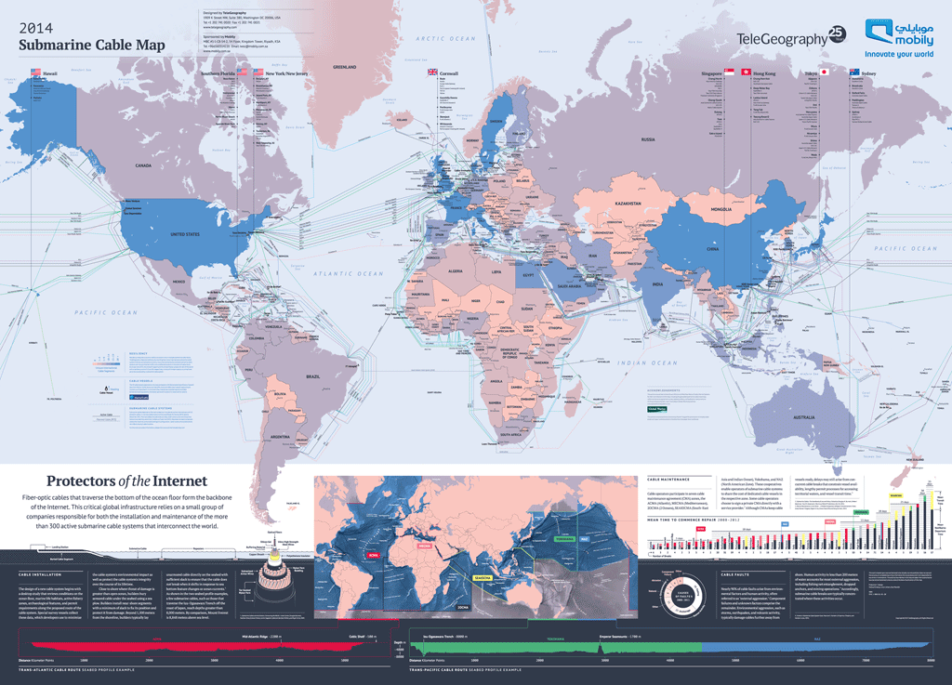
Submarine cable map (2014)
Source: TeleGeography, URL: www.telegeography.com
Notes:
Submarine fibre-optic cables can provide more capacity, better reliability and sceurity, at lower cost of communication than satellites.
Nowadays more than 95 percent of international and intercontinental telecommunications rely on submarine cables.
This world map shows all of the main submarine cables laid or to be laid by year 2014.
However, most submarine cables are laid unprotected on ocean floor. They are easy to be damage by fishing nets or ship anchors or even shark bites.
Another main cause is unpredictable disasters, such as earthquakes, tsunamis or even nuclear explosions, which pose significant large-scale threats to submarine cables.

Slide 5
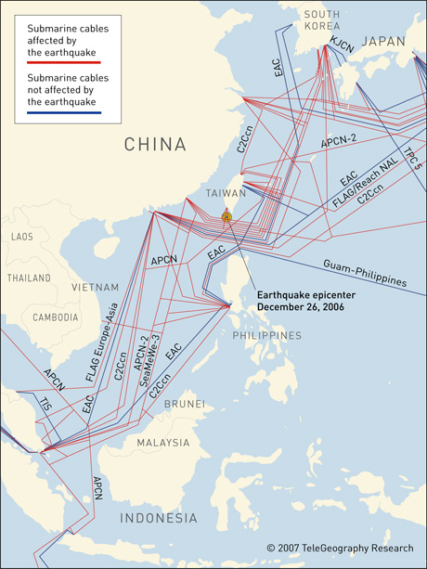
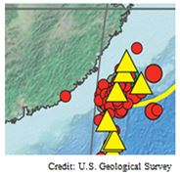
Taiwan (Hengchun) Earthquake 2006
26th December 2006
7.1-magnitude
South of Taiwan
7 submarine cables were knocked out of service
Disruption of Internet services in Southeast Asia for several weeks
Source: TeleGeography, URL: www.telegeography.com
Notes:
A series of earthquakes over the last few years has adversely affected the ability of millions of people to use the Internet.
For instance, an earthquake of 7.1-magnitude on 26th December 2006 just south of Taiwan caused huge damage to submarine network systems.
This incident disrupted international communication services to Taiwan, China, Japan, Hong Kong, Korea and other southeast Asia countries for several weeks, which cost billions of dollars lost.
cables are situated in close proximity of each other and are laid in earthquake-prone zones.
In the right figure shows the epicenter of this earthquake. All the red lines are the affected submarine cables.
Taiwan is located on an area where many earthquakes and volcanoes occurred in the last 100 years.
Here, the yellow line is an earthquake fault, the red disks show the locations of the Earthquakes and the triangles are volcanoes.

Slide 6
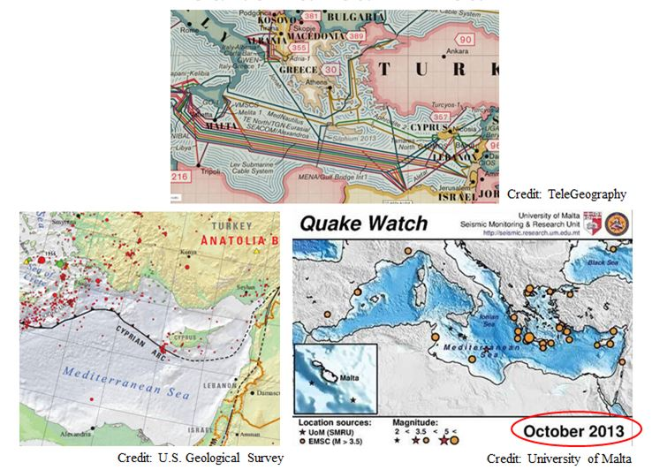
Another example : Mediterranean Area
Notes:
Another similar example is in the Mediterranean Area,
Where the submarine cables are connected between Europe, Africa and Asia in a small area.
In 2008, multiple-cable breaks happened twice here because of earthquakes.
Therefore, it very important to design a good topology to lay submarine cables in order to improve the reliability of the networks.
It is therefore important to develop good cabling design methodologies that guarantee cable survivability with high probabilities.

Slide 7
Overview
How to lay cables between a given set of nodes positioned in a 2-dimensional plane considering major disasters?
A multi-objective optimization problem with the two objectives:
Cost
Network (or cable) Survival Probability
Although the work is presented in the context of cabling, it has many other applications:
fuel or gas pipelines
roads, railway tracks
power lines
Notes:
Our work addresses the important problem of how to optimize cabling between
a given set of nodes positioned in a 2-dimensional plane under geographically correlated
failures.
Although the work is presented in the context of cabling, it has many other applications, such as designing fuel or gas
pipelines, roads, railway tracks and power lines. The organization of this thesis is presented next.
We consider two objectives: cable cost and network survival probability in the case of a disaster.
We aim to either minimize cost subject to maintaining a required
network survival probability, or alternatively, maximize the network survival probability
subject to a given cost budget, in an event of a disaster.

Slide 8
Approaches
Develop tractable disaster models.
disaster location
disaster effects on the cables
Consider various sets of network topology alternatives.
or single cable shape alternatives
Derive explicit expressions for the two objectives, or rely on simulations to evaluate them.
Provide Pareto Fronts.
Pareto Fronts: a set of points where it is impossible to make one objective better off without making the other objective worse off.
Notes:
Our approach is to develop tractable disaster models based on the probability distributions of the
disaster location and the disaster effects on the cables. Then, we consider various sets
of network topology (or single cable shape) alternatives. For each set of alternatives,
we either derive explicit expressions for the network survival probability and the cost
based on the disaster models, or rely on simulations to evaluate them. For a given set
of nodes, we aim to provide a cost effective and survivable cabling design solution.

Slide 9
The Fundamental Problem: Optimal Laying of a Single Cable Across an Earthquake Fault Line

Slide 10
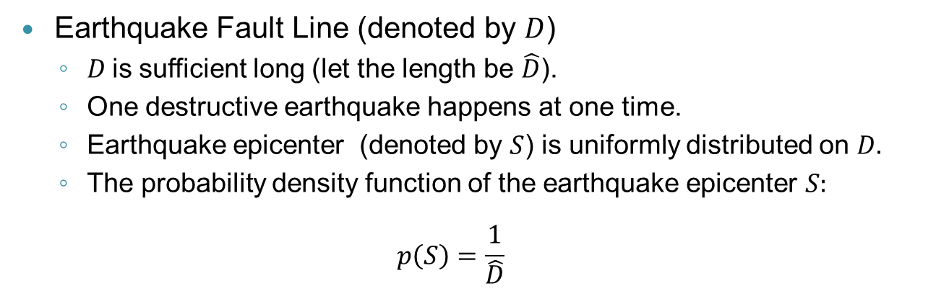
Optimal Laying of a Single Cable Across an Earthquake Fault Line
Earthquake Fault Line (denoted by $D$)
$D$is sufficient long (let the length be $\hat{D}$).
One destructive earthquake happens at one time.
Earthquake epicenter (denoted by $S$) is uniformly distributed on $D.$
The probability density function of the earthquake epicenter $S:$
$$p\left(S\right)=\frac{1}{\hat{D}}$$

Slide 11
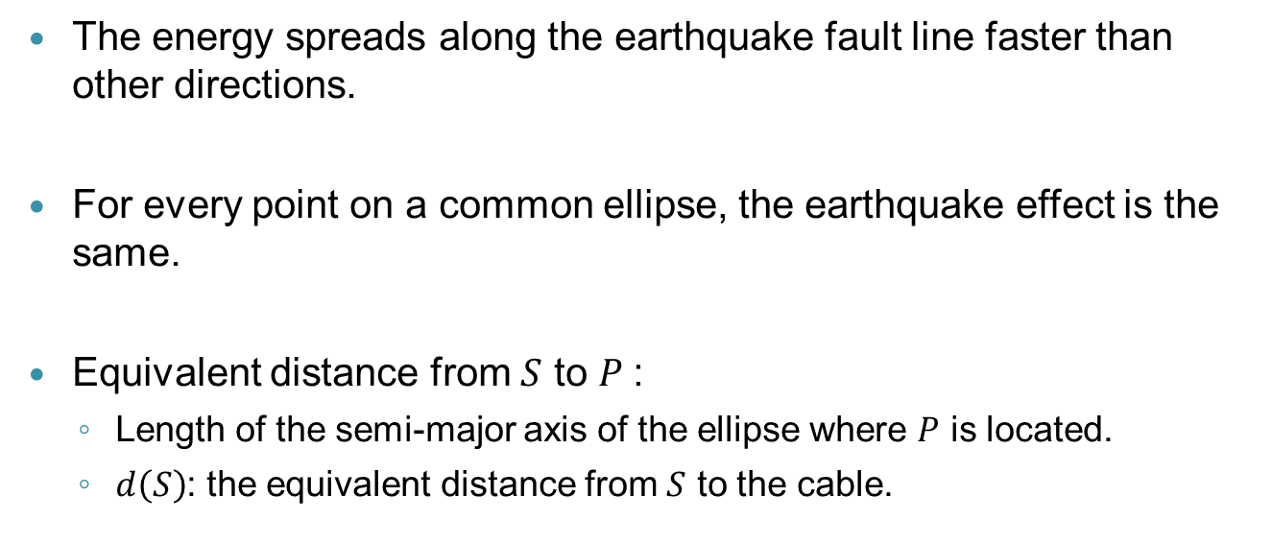
Disaster Model: Elliptical Failures
The energy spreads along the earthquake fault line faster than other directions.
For every point on a common ellipse, the earthquake effect is the same.
Equivalent distance from $S$ to $P$:
Length of the semi-major axis of the ellipse where $P$ is located.
$d\left(S\right)$: the equivalent distance from $S$ to the cable.
Notes:
The energy spreads along the earthquake fault line fast than other directions.

Slide 12
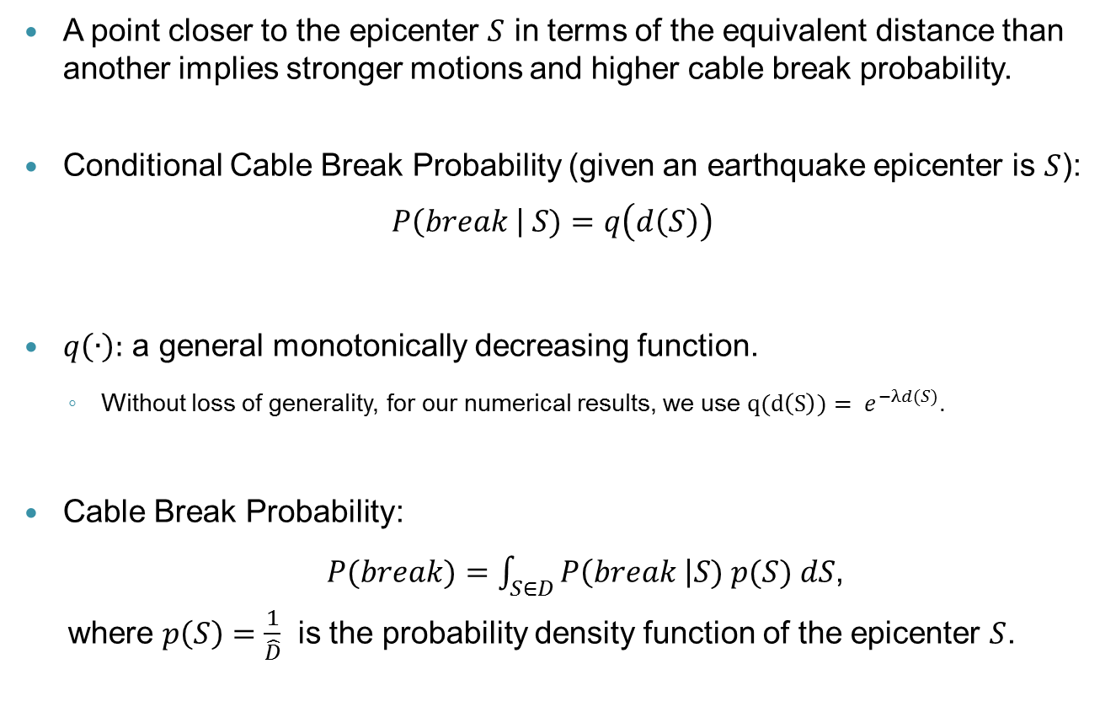
Disaster Model: Cable Break Probability
A point closer to the epicenter $S$ in terms of the equivalent distance than another implies stronger motions and higher cable break probability.
Conditional Cable Break Probability (given an earthquake epicenter is $S$):
$$P\left(break \right| S)=q\left(d\left(S\right)\right)$$
$q\left(∙\right):$ a general monotonically decreasing function.
Without loss of generality, for our numerical results, we use $q(d\left(S\right))= e^{−λd(S)}$.
Cable Break Probability:
$P(break)=\int_{S∈D}{P\left(break \right|S) p(S) dS}$,
where $p\left(S\right)=\frac{1}{\hat{D}}$ is the probability density function of the epicenter $S$.
Notes:
The energy spreads along the earthquake fault line is fast than other directions.

Slide 13
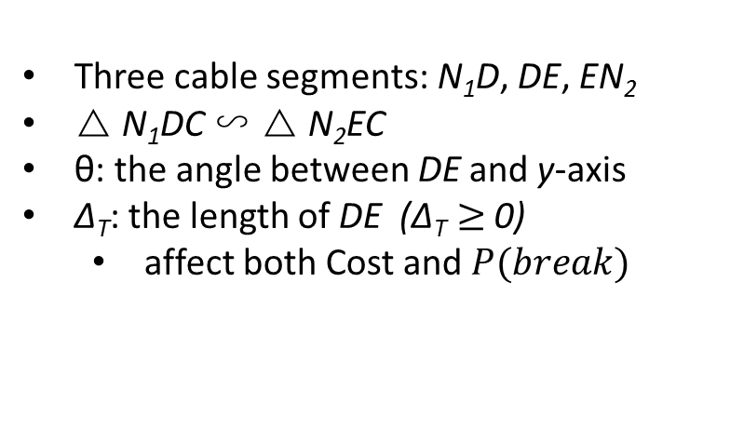
Cable Shape Alternative: Three Connected Segments (TCS)
Three cable segments: N₁D, DE, EN₂
△ N₁DC ∽ △ N₂EC
θ: the angle between DE and y-axis
∆_{T}: the length of DE (∆_{T} $≥$ 0)
affect both Cost and $P(break)$
Notes:
The pareto front is a set of point where it is impossible to make both the objective better withous

Slide 14
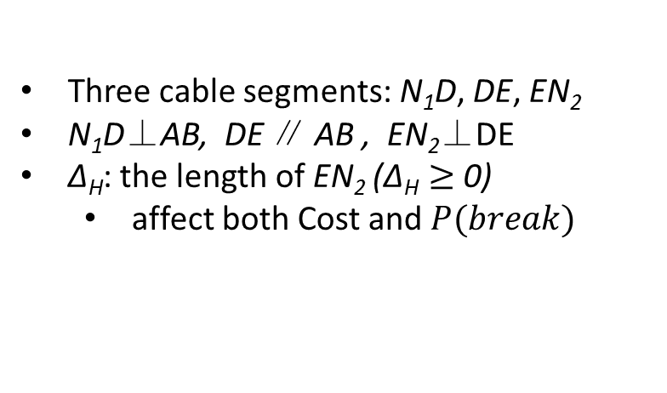
Cable Shape Alternative: Hook with Right Angles (HRA)
Three cable segments: N₁D, DE, EN₂
N₁D⊥AB, DE ∥ AB , EN₂⊥DE
∆_{H}: the length of EN₂ (∆_{H} $≥$ 0)
affect both Cost and $P(break)$

Slide 15
Survivable Topology Design for 2-Node Networks

Slide 16
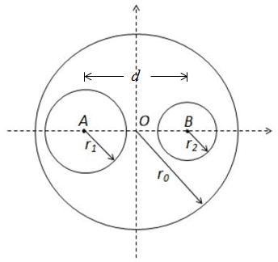
Survivable Topology Design for 2-Node Networks: Problem Description
Design cable topologies
where best to lay multiple cables in a cost effective way to maintain connectivity following a major disaster.
Network Survival Probability:
It represents the probability that all nodes in the network are still connected, when a disaster happens.
Another related concept is the Network Disconnection Probability.
Cost: multiple types
undersea cable cost.
inland cable cost.
Notes:
intuitively, keeping cables away from each other increases network survival probability. On the other hand longer cables cost more.

Slide 17
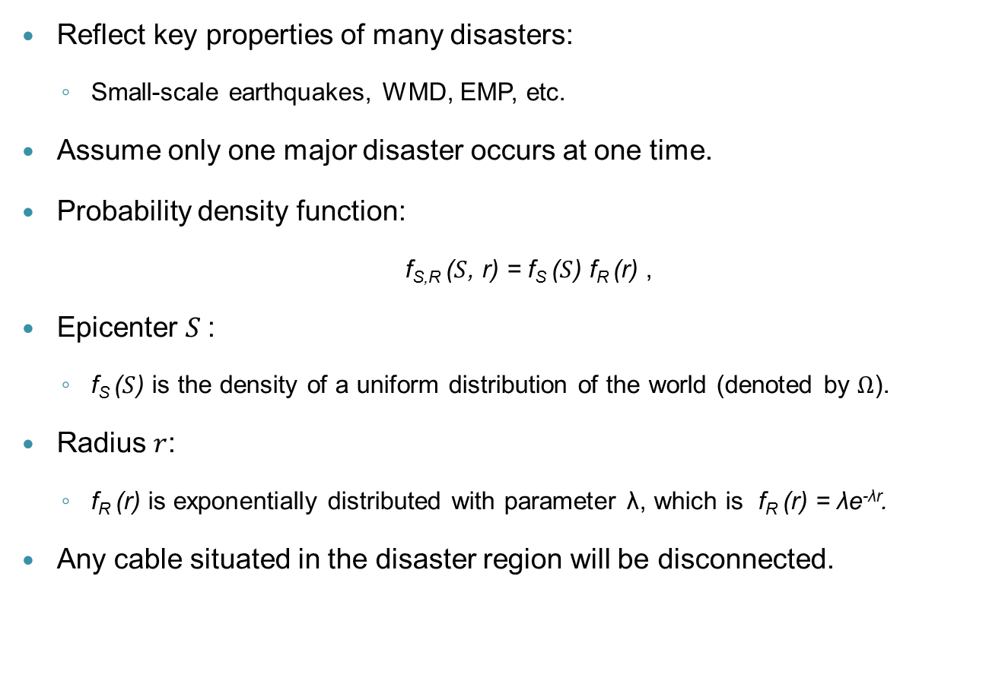
Disaster Model: Circular Disk Failures
Reflect key properties of many disasters:
Small-scale earthquakes, WMD, EMP, etc.
Assume only one major disaster occurs at one time.
Probability density function:
f_{S,R} ($S$, r) = f_{S} ($S$) f_{R} (r) ,
Epicenter $S$:
f_{S} ($S$) is the density of a uniform distribution of the world (denoted by $Ω$).
Radius $r$:
f_{R} (r) is exponentially distributed with parameter λ, which is f_{R} (r) = λe^{-λr}.
Any cable situated in the disaster region will be disconnected.
S

Slide 18
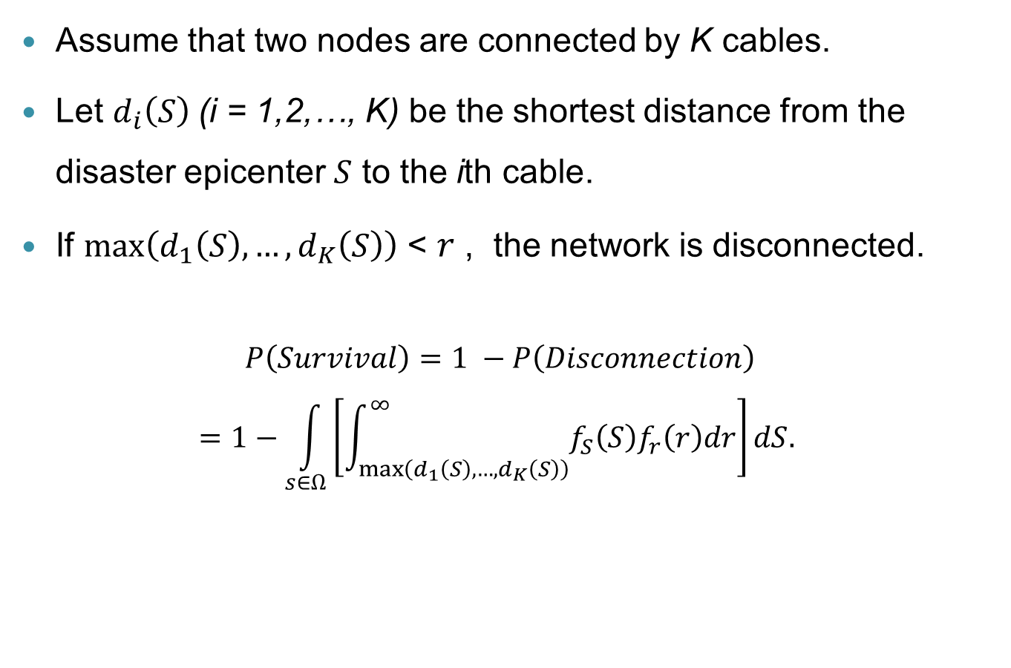
Network Survival Probability
Assume that two nodes are connected by K cables.
Let $d_{i}\left(S\right)$(i = 1,2,…, K) be the shortest distance from the disaster epicenter $S$ to the ith cable.
If $\max\left(d_{1}\left(S\right),…, d_{K}\left(S\right)\right)$ < $r$ , the network is disconnected.
$$P\left(Survival\right)=1 −P\left(Disconnection\right)$$
$$=1−\int_{s∈Ω}{\left[\int_{\max\left(d_{1}\left(S\right),…, d_{K}\left(S\right)\right)}^{∞}{f_{S}\left(S\right)f_{r}\left(r\right)dr}\right]dS.}$$
Notes:
Multiple cables are laid between two cities, in order to decrease the probability that all cables are destroyed simultaneously.

Slide 19
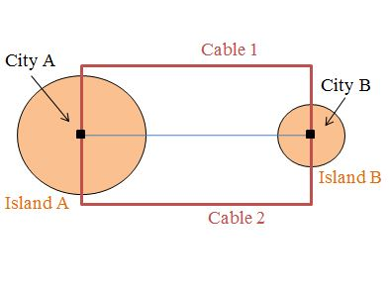
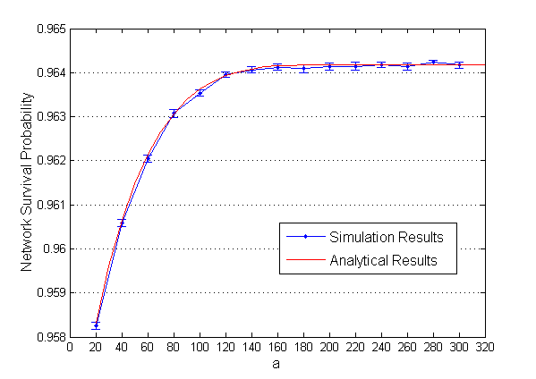
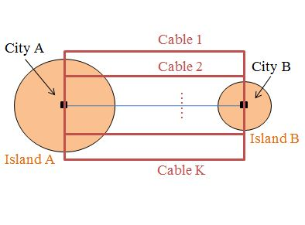
Rectangular Topology
a
K = 2
Recall the assumptions:
Only one major disaster at one time.
All cables within disaster area break.
Unlimited capacity of each cable.
Then, P_{K}(Survivability) = P₂(Survivability).
K > 2

Slide 20
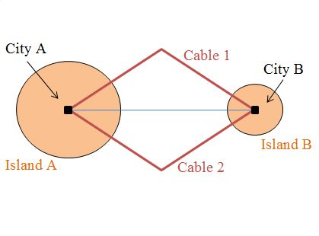
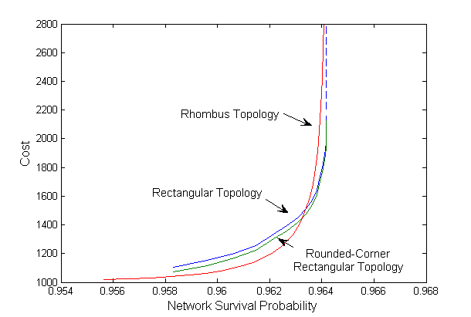
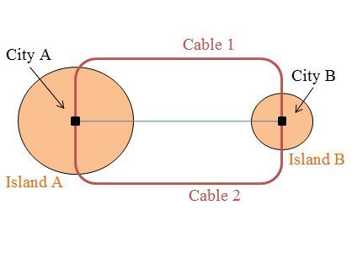
Other Network Topologies
Rhombus topology
Rounded-corner
rectangular topology
Pareto Fronts for the three topologies
Notes:
This demonstrates a Pareto optimum solutions of cost versus network survival probability for three cable topologies.

Slide 21
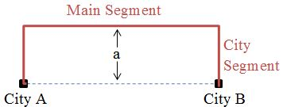
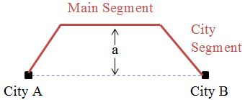
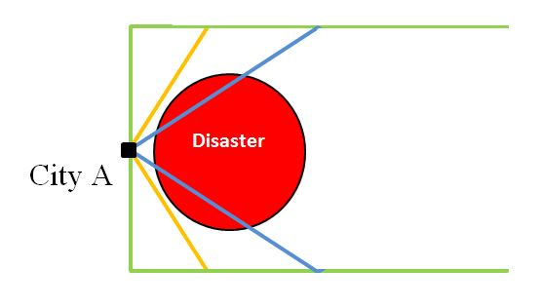
Insights Gained From 2-Node Cases
Cable Segmentation:
City Segment
Main Segment
Variable a :
The distance between main segment and the line that connects two cities.
Affect both cost and network survival probability.
Angle between two city segments
Notes:
The main part of a cable, called the main segment, is laid in parallel to the
line that connects the two cities.
We will use the term city segment for the part of the cable that connects the main
segment to a city.

Slide 22
Survivable Topology Design for N-Node Networks

Slide 23
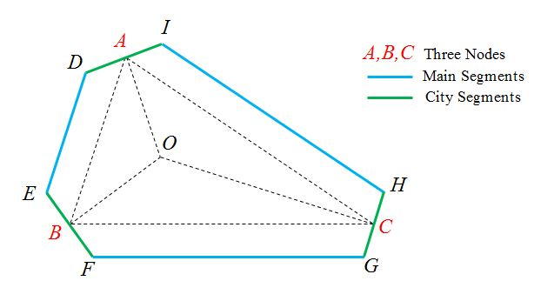
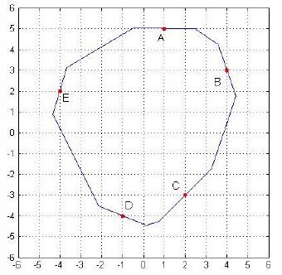
Survivable Topology Design for N-Node Networks: An N-node Convex Polygon Topology
For N-node (N ≥ 3) models (the N nodes must form a convex polygon) :
The main segments are laid parallel to the corresponding edges of the polygon with distance a.
The city segments are laid perpendicular to the bisector of each angle of the polygon.
Obtain the optimal value of variable a subject to meeting network survival probability requirement.
The hexagon topology for a general triangle.
Notes:
To illustrate our algorithm, we simulate a scenario of five nodes A,B,C,D and E
The network survival probability requirement is set at 0.93.
Here, we set the world radius as 10 and the mean disaster radius as 1.
For this requirement, we obtain using bisection a = 0.8.

Slide 24
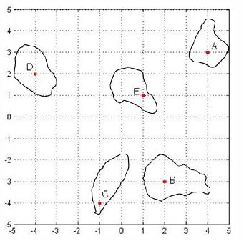
Survivable Topology Design for N-Node Networks: A General N-Node Case
How to lay cables for a general N-Node case,
if the N nodes can’t form a convex polygon?
For Example :
y
The network survival probability requirement is given 0.93.
x

Slide 25
A general N-node case (cont’d)
Even all cables between any pair of nodes are straight lines, the number of possible topologies is 2^{N(N-1)/2} .
We allow cables to be segmented (not to be straight lines).
Difficult to obtain analytical results. Rely on simulations.
The optimization problem (where a simulation is used to compute the value of the objective function) is computationally prohibitive.
Therefore, we resort to a heuristic algorithm.
due to limited computing time and computing power.
get feasible solutions (not optimal solution).
can be further improved by human sense.
Notes:
computations by simulations of individual network survival probabilities require considerable
computation time.

Slide 26
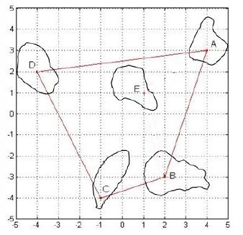
The Heuristic Algorithm Stage 1: connecting the external nodes
Divide N nodes into two set.
External Nodes: The maximal set of nodes that can form a convex polygon.
Internal Nodes: The remaining nodes that are located inside the polygon.
Connect all external nodes by using the previous approach.
the approach of N-Node Convex Polygon Topology.
Find the minimum a_{out} such that the survival probability meets the requirement.
When a_{out} = 0, the network survival probability is 0.936.
Meet the requirement (0.93).
Notes:
The set of external nodes is defined as the maximal set of nodes that
form a convex polygon such that all the remaining nodes are located
inside this polygon.

Slide 27
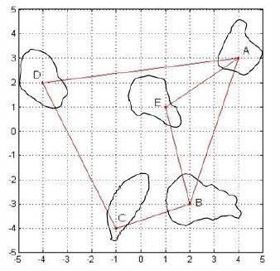
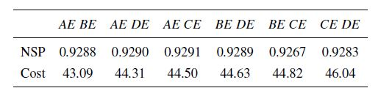
Stage 2: Connecting the internal nodes by straight lines
Connect each internal node to two nodes that are already connected
use two straight lines.
In each step, choose the internal node that incurs the minimal cost to connect it.
After all nodes are connected, compute the network survival probability
by simulations.
If the survivability constraint is not met, choose the next least cost option, and continue.
Given that the number of options is large, we limit the number of attempts to M in each step (M is based on the computing power).
Then we have a list of instances to connect all the nodes with or without meeting the survival probability constraint.
Table 1: six instances in Stage 2
Notes:
This figure shows the first instance where we connect AE and BE.
Here, none of the six meet the survival constraint.
So we go to Stage 3.

Slide 28
Stage 3: Improvement by multiple segments per link
For each Stage 2 instance, consider segmented links.
Use 2 city segments and 1 main segment to replace the straight-line links.
Consider different a_{in} and a_{out} for internal and external links.
Begin with the instance of low cost in the list.
Use a branch and bound approach.
Increase the parameters a_{in} and a_{out} for each instance until the survivability constraint is met, and calculate the cost.
Repeat the process for the next Stage 2 instance
until either the survivability constraint is met, or the cost exceeds the cost of other feasible instances.
Notes:
The purpose of Stage 3 is to find cases that meet the survivability constraint when the search limited to straight-line internal links in Stage 2 has found no feasible solution, or to improve on feasible solutions found in Stage 2.

Slide 29
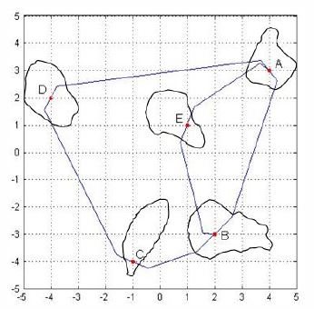
Stage 3: Improvement by multiple segments per link (Example)
The list of the instances from Stage 2.
The order: (AE,BE), (AE, CE), (AE, DE), (BE, CE), (BE, DE), (CE, DE)
The First instance in the list: (AE, BE):
Lay city segments on Node E perpendicular to the bisector of ∠AEB.
Lay two main segments parallel to AE and BE,
Lay city segments on Node A and B perpendicular to bisectors of ∠EAB and ∠EBA, respectively.
Stage 2
Stage 3

Slide 30
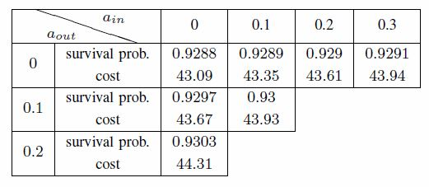
Stage 3: Improvement by multiple segments per link (Example)
Increase the value of a_{in} and a_{out}.
Find a solution (a_{in} = 0.1, a_{out}= 0.1).
Table 2: results for the first instance (AE, BE).
Table 1: six instances of Stage 2
The cost of this solution 43.93 is lower than the costs of the remaining five instances in list of Stage 2.
No need to consider these five instances further into Stage 3.
Notes:
We also observe that the cost of this case is lower than the costs of the remaining
five cases considered in Stage 2. Hence, we do not need to consider
these five cases in Stage 3 as they will only incur higher costs if the parameters a_in
and a_out increase to meet the network survival probability constraint.

Slide 31
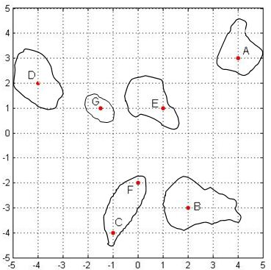
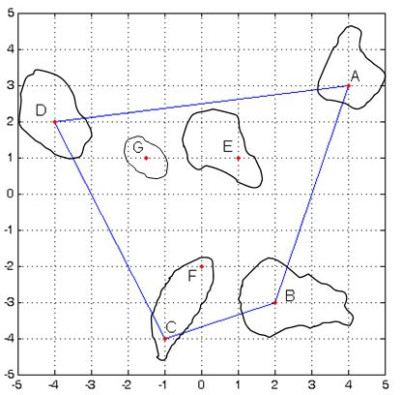
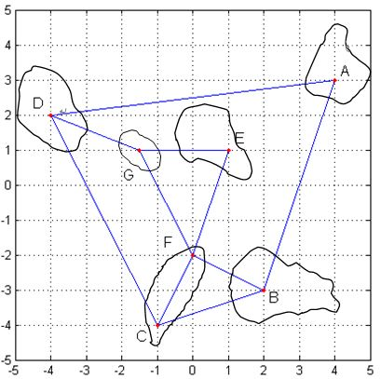
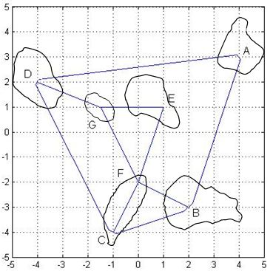
A 7-Node Example (4 external & 3 internal nodes)
A 7-Node Example
Stage 1
An instance in Stage 2
An instance in Stage 3

Slide 32
Conclusion
We have consider the problem of how to lay a singe cable between two nodes across an earthquake fault line.
Three Connected Segments (TCS).
Hook with Right Angles (HRA).
We have considered the problem of how to lay multiple cables (including the undersea and the inland parts) between two nodes, under a major disaster.
Rectangular Topology
Rhombus Topology
Rounded-corner Rectangular Topology
We have further extended the discussion to a network with multiple nodes.
An N-node Convex Polygon Topology
The Heuristic Algorithm for a general N-node case

Slide 33
Publication & Submission
C. Cao, M. Zukerman, W. Wu, J. Manton, and B. Moran, ''Survivable topology design of submarine networks,'' Journal of Lightwave Technology, vol. 31, no. 5, pp. 715-730, March 2013.
C. Cao, Z. Wang, M. Zukerman, J. Manton, A. Bensoussan, and Y. Wang, ''Optimal cable laying across an earthquake fault line considering elliptical failures,'' submitted for publication.

Slide 34
The End
Thank You

Slide 35
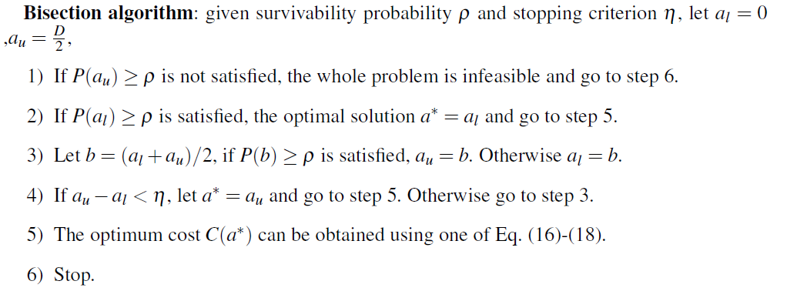
Appendix

